Slide 1
Think Globally, Act Locally: Reducing the Burden of Documentation in the EHR
NENIC Annual Symposium April 26, 2019
Patricia Sengstack DNP, RN-BC, FAAN
patricia.r.sengstack@Vanderbilt.edu

Slide 2
Objectives
Define the contributing factors to the burden of clinical documentation in the electronic health record
Discuss national efforts underway to address the burden of clinical documentation in the electronic health record.
Identify organizational strategies to help reduce documentation burden for nurses

Slide 3


Slide 4
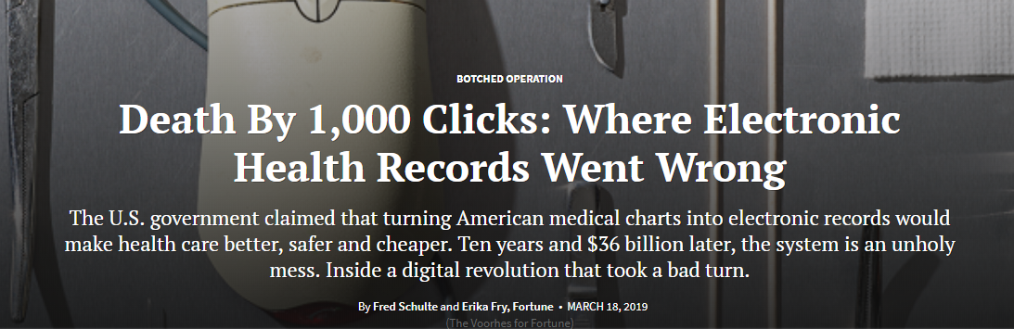
Source: https://khn.org/news/death-by-a-thousand-clicks/

Slide 5
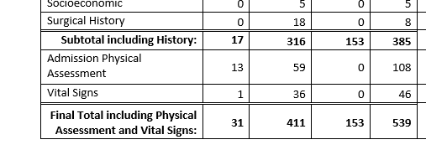
The story of hundreds of clicks
Nursing Admission Assessment Documentation
Bon Secours = 539
Virginia Mason = 459
Vanderbilt = 500+
Notes:
Nursing Admission Navigator has 28 activities such as: Vital signs, consents, medications, medical and surgical history, nutritional assessment
Each activity has 10 – 30 fields. Each field requires you to open the dialogue box , select from drop downs, add dates etc – so each field has 5 – 8 clicks.
Conservatiave 28 X 5 fields = 140 X3 = 420

Slide 6
Clinical Documentation
The medical record dates back to Hippocrates in the fifth century B.C.
He noted that the patient’s record should accurately reflect the course of the disease and indicate the probable cause of the disease
National Institutes of Health National Center for Research Resources (NIH NCRR). (2006). Electronic health records overview. McLean, VA: The MITRE
Corporation (contractor). Retrieved from
http://www.himss.org/files/HIMSSorg/content/files/Code%20180%20MITRE%20Key%20Components%20of%20an%20EHR.pdf

Slide 7
Information Nurses Document
Assessments
Clinical problems
Communications with other health care professionals regarding the patient
Communication with and education of the patient, family, and the patient’s designated support person and other third parties
Medication records (MAR)
Order acknowledgement, implementation, and management
Patient clinical parameters
Patient responses and outcomes, including changes in the patient’s status
Plans of care that reflect the social and cultural framework of the patient
Source: ANA’s Principles for Nursing Documentation Guidance for Registered Nurses (2010). http://www.nursingworld.org/MainMenuCategories/ThePracticeofProfessionalNursing/NursingStandards/ANAPrinciples/PrinciplesforDocumentation.pdf
Notes:
ANA – conceptual overview

Slide 8
Major Forces Driving Changes In Clinical Documentation
Computerization of the patient medical/health record
Documentation of services is a requirement for payment – coding and billing (new payment models)
  Medicare/Medicaid
  Private Payers
Regulation and legislation (Meaningful Use, eCQM)
Notes:
(Medicare and Medicaid), documentation of services became a requirement for payment, because federal payers needed to ensure that taxpayer funds were appropriately spent and beneficiaries received medically necessary services. Additionally, payers had to guard against fraud. However, payers are requiring increasingly detailed documentation to provide reimbursement. Similarly, private payers have increased administrative oversight in the form of administrative preapproval processes and very specific documentation criteria to reimburse for drugs and procedures
Early systems fulfilled the need to collect data from different sources (pharmacy, laboratory, transcription). These electronic health records (EHRs) were often used to support billing and collections, and not necessarily clinical needs and workflow.

Slide 9
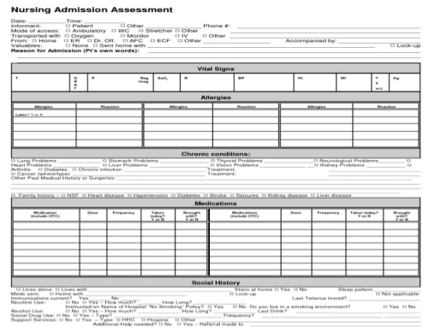
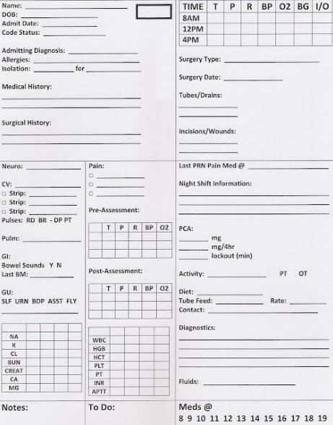
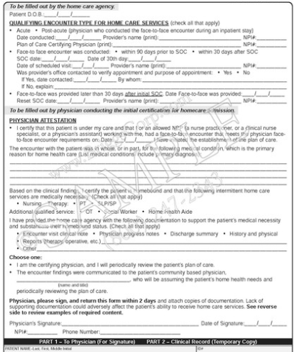

Slide 10
The Purpose of Documentation Today
Capture the clinical care provided to patients
Communication with other professionals
Reimbursement
Regulation and legislation
Quality processes and performance improvement
Accreditation
Legal purposes
Research

Slide 11
Impact of the Burden
Nurses and physicians spend as much as
30 – 50%
of their day performing documentation activities
Munyisia EN, et al. The impact of an electronic nursing documentation system on efficiency of documentation by caregivers in a residential aged care facility. J Clin Nurs. 2012.
Oxentenko AS, West CP, Popkave C, Weinberger SE, Kolars JC. Time spent on clinical documentation: a survey of internal medicine residents and program directors. Arch In Med. 2010;170:377–380.
Block L, Habicht R, Wu AW, et al. In the wake of the 2003 and 2011 duty hours regulations, how do internal medicine interns spend their time? J Gen Intern Med. 2013;28(8):1042–1047.
Kelley TF, Brandon DH, Docherty SL. Electronic nursing documentation as a strategy to improve quality of patient care. J Nurs Scholarsh. 2011; 43(2):154–162.

Slide 12

National Attention
21st Century Cures Act
  Centers for Medicare and Medicaid Services (CMS)
  Office of the National Coordinator for Health IT (ONC HIT)
National Academy of Medicine
University of Minnesota’s - Nursing Knowledge: Big Data Science Initiative

Slide 13
21st Century Cures Act
21st Century Cures Act (Dec 13, 2016)
SEC. 4001. (a) ASSISTING DOCTORS AND HOSPITALS IN IMPROVING QUALITY OF CARE FOR PATIENTS.
(1) (a) Reduction in Burdens Goal.--The Secretary of Health and Human Services (referred to in this section as the `Secretary'), in consultation with providers of health services, health care suppliers of services, health care payers, health professional societies, health information technology developers, health care quality organizations, health care accreditation organizations, public health entities, States, and other appropriate entities, shall:
1) establish a goal with respect to the reduction of regulatory or administrative burdens (such as documentation requirements) relating to the use of electronic health records;
2) develop a strategy for meeting the goal established; and
3) develop recommendations for meeting the goal established
1) establish a goal with respect to the reduction of regulatory or administrative burdens (such as documentation requirements) relating to the use of electronic health records;
Updates from CMS (2018): https://www.ehidc.org/sites/default/files/resources/files/Updates%20from%20CMS.pdf
Notes:
The 21st Century Cures Act (Cures Act), signed into law on December 13, 2016, is designed to help accelerate medical product development and bring new innovations and advances to patients who need them faster and more efficiently.
21st Century Cures Act
SEC. 4001. (a) ASSISTING DOCTORS AND HOSPITALS IN IMPROVING QUALITY OF CARE FOR PATIENTS.
(1)(b)(3) Recommendations.--The recommendations developed under paragraph shall address--
actions that improve the clinical documentation experience;
actions that improve patient care;
actions to be taken by the Secretary and by other entities; and
other areas, as the Secretary determines appropriate, to reduce the reporting burden required of health care providers

Slide 14

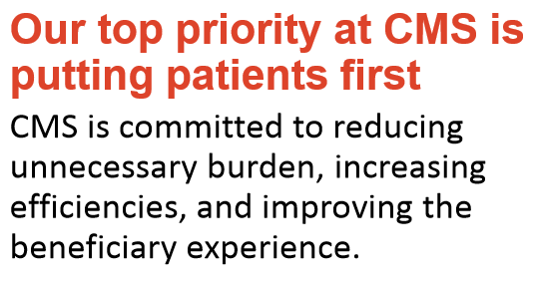
ONC/CMS Reducing Clinician Burden
Source: Handout from ONC/CMS Meeting on Clinician Burden, February 22, 2018, Hubert Humphrey Building Auditorium, Washington, DC 20201. http://365.himss.org/sites/himss365/files/365/handouts/550400239/handout-137.pdf

Slide 15
CMS Burden Reduction Initiatives Include:
E/M Med Student Documentation - Now allow teaching physicians to verify in the medical record student documentation of E/M services, rather than re-documenting the students notes
Signature Requirements - Claims won’t be denied if support staff forget to sign part of the record
Greatly reduced the number of EHR measures and thresholds required for Meaningful use and QPP
Therapeutic Shoe inserts - Now allow payment for inserts made with digital technology, without an actual impression of the foot
Source: Handout from ONC/CMS Meeting on Clinician Burden, February 22, 2018, Hubert Humphrey Building Auditorium, Washington, DC 20201. http://365.himss.org/sites/himss365/files/365/handouts/550400239/handout-137.pdf
Notes:
Center for Clinical Standards and Quality
qualified clinical data registry
application program interface
Evaluation and management
For Medicare Administrative Contractors (MACs):

Slide 16

“Patients Over Paperwork”
CMS Administrator Seema Verma’s Charge:
    Simplify our requirements
    Make them easier to understand
    Get rid of requirements we no longer need
    Seek input from stakeholders
    Challenge the way we have always done things
    We Need Your Input: You can email: ReducingProviderBurden@cms.hhs.gov
Source: ONC/CMS Reducing Clinician Burden Public Meeting 2/22, 2018
https://www.cms.gov/About-CMS/story-page/patients-over-paperwork.html

Slide 17


DRAFT – Open for Public Comment until Jan.28, 2019

Slide 18
Burden Reduction Goals
Reduce the effort and time required to record information in EHRs for health care providers during care delivery
Reduce the effort and time required to meet regulatory reporting requirements for clinicians, hospitals, and health care organizations
Improve the functionality and intuitiveness (ease of use) of EHRs
Source: https://www.healthit.gov/sites/default/files/page/2018-11/Draft%20Strategy%20on%20Reducing%20Regulatory%20and%20Administrative%20Burden%20Relating.pdf
Notes:
Issues and challenges
Clinical Documentation
Health IT Usability and the User Experience
EHR Reporting
Public Health Reporting

Slide 19
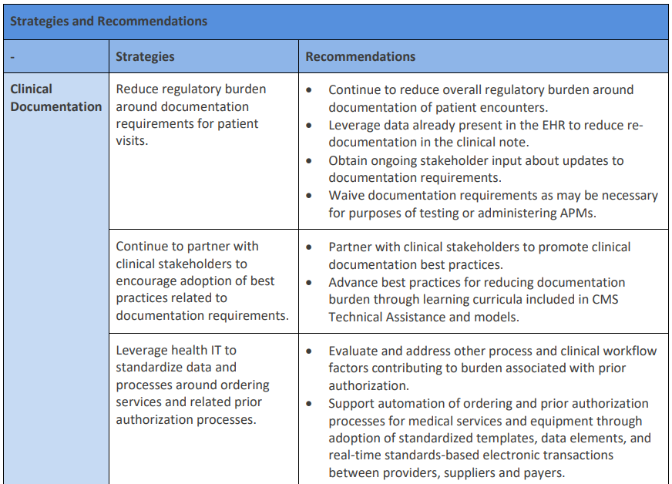

Slide 20
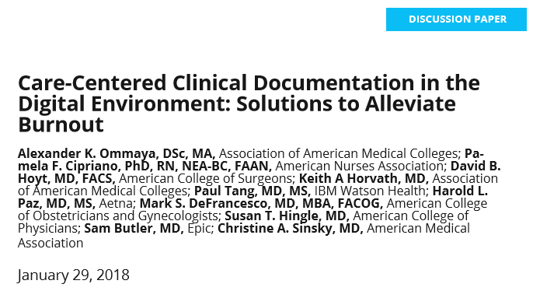
National Academy of Medicine
Source: https://nam.edu/wp-content/uploads/2018/01/Care-Centered-Clinical-Documentation.pdf

Slide 21
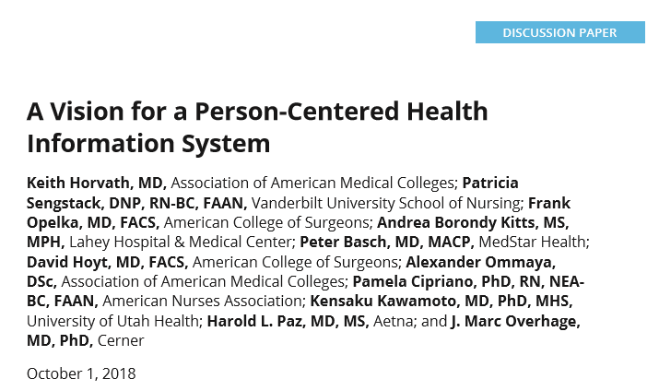
National Academy of Medicine
Source: https://nam.edu/a-vision-for-a-person-centered-health-information-system/

Slide 22
National Academy of Medicine
Clinicians should be responsible only for essential primary data entry that is required to support the care of a patient
EHR developers should increase the development of capabilities that allow clinicians to understand the previous medical, health, and social history of the patient (patient centered)
CMS should deemphasize documentation requirements as a condition of payment for healthcare services
An authoritative body should initiate a study focused on redesigning clinical documentation suited to the modern digital age, with a primacy focus on informing clinical management and improving patient outcomes and health
Source: https://nam.edu/wp-content/uploads/2018/01/Care-Centered-Clinical-Documentation.pdf
Notes:
We recognize that the primary drivers for current capabilities in EHRs include regulatory requirements, and documentation to support coding and billing.
Clinicians spend much of their time focused on documentation and related coding issues. This use of highly specialized clinical knowledge seems to be a misapplication of resources.
Meanwhile, the patients have been left in their exam rooms or hospital beds wondering if all the activity going on is helping to address their needs.

Slide 23

University of Minnesota’s - Nursing Knowledge: Big Data Science Initiative
10 Workgroups – one of which is Documentation Transformation
Developing a framework for a topical series of ‘Transformation in Action’ papers including best-practices, with a focus on effective usability
Subgroup – Nursing Admission Assessment – Patient History Section
Source: https://www.nursing.umn.edu/centers/center-nursing-informatics/news-events/2019-nursing-knowledge-big-data-science-conference/2018-workgroups

Slide 24
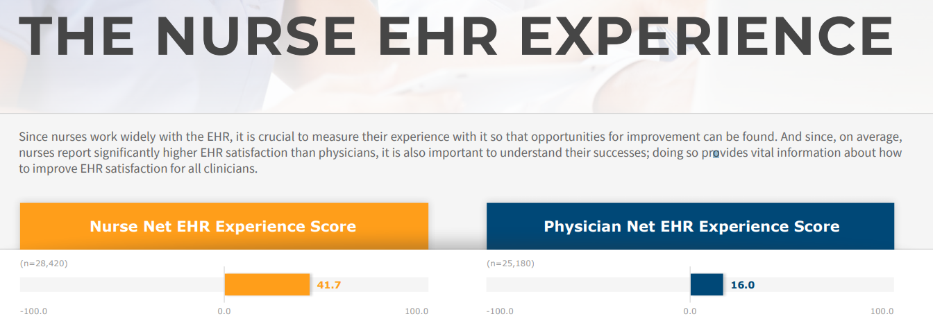
KLAS Report: The Nurse EHR Experience
Source: KLAS. (2019). THE NURSE EHR EXPERIENCE IMPACT REPORT file:///C:/Users/sengstpr/Downloads/KLAS-report-the-nurse-ehr-experience-brief%20(1).pdf

Slide 25
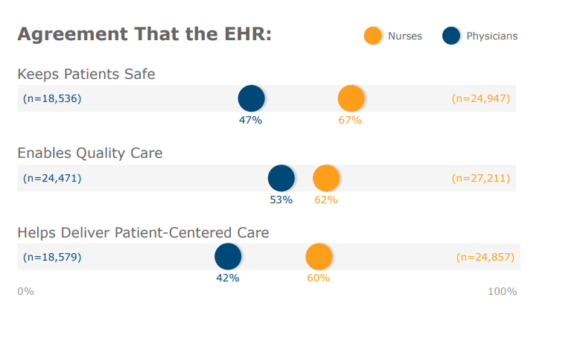
KLAS: The Nurse EHR Experience
Source: KLAS. (2019). THE NURSE EHR EXPERIENCE IMPACT REPORT file:///C:/Users/sengstpr/Downloads/KLAS-report-the-nurse-ehr-experience-brief%20(1).pdf

Slide 26

Think Globally
Act Locally

Slide 27
The Six Domains of Burden
  Reimbursement – Documentation, coding and other administrative data entry tasks required for payment
  Regulatory – Accreditation agency documentation requirements
  Quality – Documentation required to demonstrate that quality patient care has been provided. This includes documentation requirements by the healthcare organization itself, as well as by governmental and regulatory agencies
  Usability – Limited and insufficient use of human factors engineering and human-computer interface principles resulting in extra time spent entering data, scrolling, clicking and searching for pertinent information in the record
  Interoperability/Standards – Insufficient configuration standards resulting in duplication and re-entry of data even though it resides elsewhere, either internal to the organization or in an external system.
  Self-Imposed - (by the healthcare organization) aka - “We’ve Done it To Ourselves”

Slide 28
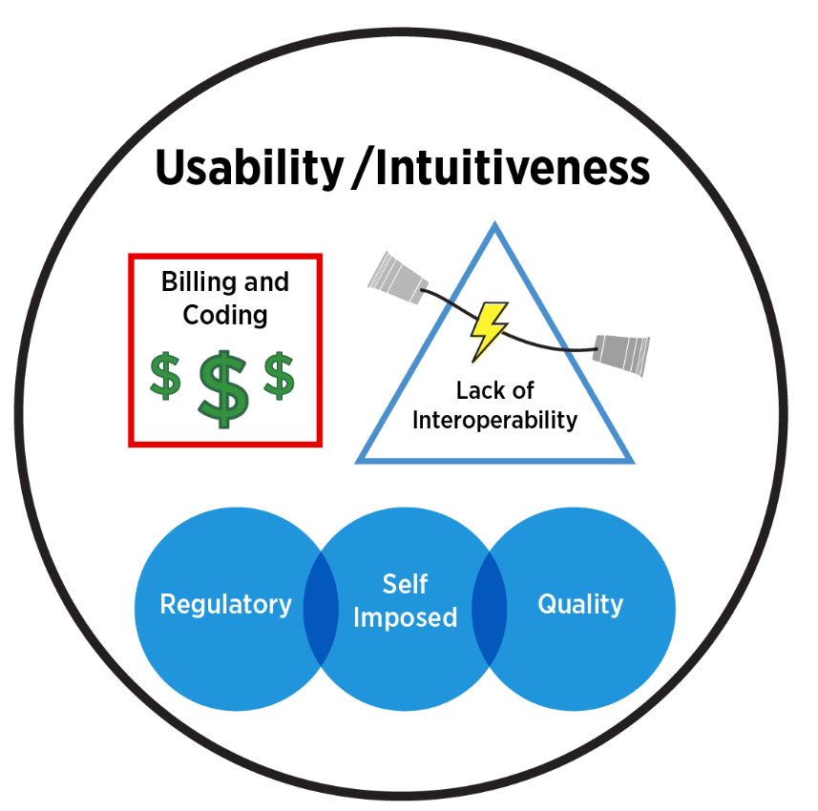
The Six Domains of Burden
Notes:
Organizational culture’s influence on what should be documented can exceed what is needed for patient care, including fear of litigation, “we’ve always done it this way”, and misinterpretation of regulatory standards. This domain also includes insufficient education on system use.
Examples of Documentation Burden
“Squeaky wheel” or
powerful special interest groups want added documentation by clinicians to meet their needs.
Excessive documentation on admission to the hospital or an initial visit to a clinic
End users oftentimes are not aware that the functionality to improve effectiveness is available. It was not taught during initial system use training.
Fear of litigation
Extra “CYA” charting in comment sections.
The nature of nursing and the desire to capture more than necessary to provide and communicate the essentials of care

Slide 29

Self Imposed - Defined
Organizational culture’s influence on what should be documented can exceed what is needed for patient care, including:
  Fear of litigation
  “We’ve always done it this way” mentality
  Misinterpretation of regulatory standards
  Powerful special interest groups
  Over zealous risk managers
  Insufficient education on system use
  Outdated organizational policies

Slide 30
Self Imposed - Examples
“Squeaky wheel” or powerful special interest groups want added documentation by clinicians to meet their needs.
Excessive documentation on admission to the hospital or an initial visit to a clinic
End users oftentimes are not aware that the functionality to improve effectiveness is available. It was not taught during initial system use training.
Extra “CYA” charting (fear of litigation)
The nature of nursing and the desire to capture more than necessary to provide and communicate the essentials of care

Slide 31

Nursing Culture
Do you document in the chart that you washed your hands when you entered and left the patients room?
“If it’s not documented, it’s not done”

Slide 32

Improve What We Can Control
Review patient care policies and procedures
  Search for the word “document” and determine value and continued need
Review documentation needed for accreditation agencies
  Does the standard say – must be documented?
  TJC’s Project REFRESH (2016 – today)
    Phases I and II resulted in the deletion of ~300 hospital elements of performance.
Notes:
Similar to, implicit in, or duplicative of other existing EPs.
Address issues that have been covered by standards for many years and are now a routine part of operations or clinical care processes, so they no longer need to be addressed in standards. Some no longer address contemporary quality and safety concerns, and how they are managed can be left to the discretion of the organization.
Elements of performance adequately addressed by law and regulation or other external requirements, so separate Joint Commission requirements are not needed.

Slide 33
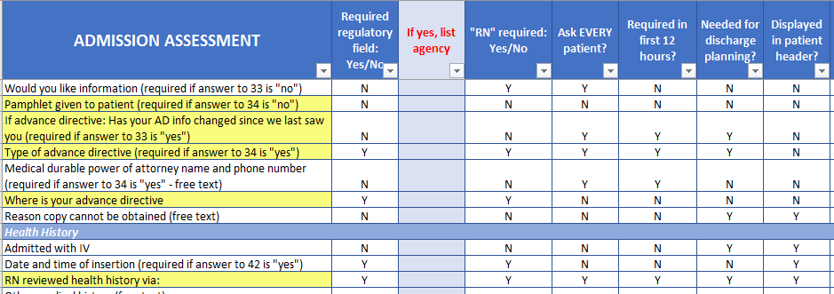
Evaluate What’s Currently in the System

Slide 34
Analyze the Nursing Admission Assessment Data Elements
Is it imperative or required to document the data element for:
Clinical care of the patient?
Communication of patient information to the care team?
A regulatory agency? (TJC, CMS, MU, Core Measure – that requires documentation)
Does it trigger an alert?
Notes:
150 data elements being reviewed

Slide 35
Analyze the Nursing Admission Assessment Data Elements
Is it documented elsewhere in the chart?
Is an RN required to document?
Is it required in the first 8 - 12 hours of admission?
Is it something that EVERY patient must be asked?
Is it pulled into the patient header?
Is it needed for a report?

Slide 36
Analyze the Nursing Admission Assessment Data Elements
Of the 127 admission assessment elements evaluated
  30 (24%) assessment elements were recommended for retaining
  40 (31%) assessment elements were recommended for removal
  57 (45%) assessment elements were recommended for further review
Of the forty elements recommended for removal:
  Their scores fell below a pre-determined threshold of 15
  Ten of the 40 had total scores of ZERO - and they are documented elsewhere in the EHR
  None of the 40 identified were required by a regulatory agency
  One is currently being used in some type of CDS within the electronic health record, and only one is used for discharge planning
  Removing all 40 items recommended for removal decreases the admission assessment by 31%.
Source: Swietlik, M. (2019). Vanderbilt University School of Nursing . DNP Scholarly Project. A Decision Support Tool to Evaluate Nursing Documentation for Burden Reduction Opportunities. Committee Chair: Sengstack, P.

Slide 37
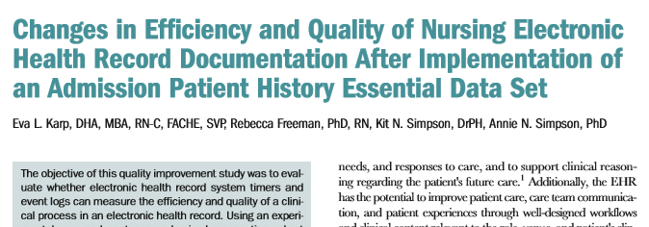
Use Data to Make Informed Decisions
This review resulted in the study site reducing its Admission Patient History (APH) from 215 data elements to 58 data elements, reflecting a 73% reduction in its APH Essential Clinical Dataset.
Source: Karp, E., Freeman, R., Simpson, K. & Simpson, A. (2019). Changes in Efficiency and Quality of Nursing Electronic Health Record Documentation After Implementation of an Admission Patient History Essential Data Set. Comput Inform Nurs 2019 Feb 21. doi: 10.1097/CIN.0000000000000516. [Epub ahead of print]

Slide 38
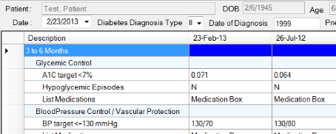
Use Data to Make Informed Decisions
Vendor provided data
  Provider Efficiency Profile (PEP)
  Nursing Efficiency Assessment Tool (NEAT)
  Flowsheet row data
    Are there any flowsheets we do not use?
    Are there any flowsheet row elements that have not been used?

Slide 39
Use Data to Make Informed Decisions
Flowsheet row data (Epic provided)
2/20/2018 – 3/20/2018
Unique flowsheet rows = 7,851
Total Documentations = 12,634,080
9 Excel worksheets

Slide 40

Use Data to Make Informed Decisions
Flowsheet Usage by Department
Flowsheet Usage by Template
Flowsheet Custom List Usage
Flowsheet Row Comments
  Example: Blood Pressure Comments
Notes:
260,000 total comments

Slide 41
Number of Comments Added to Documentation of Vital Signs 2/20/18 - 3/20/18
Notes:
Don’t know how many did not have comments out of the 5,00o+

Slide 42
Blood Pressure Comments
pt states he felt dizzy when he leaned back his head
MD paged
nurse notified
100ml bolus of ns given
Paged Phy. Gave pain med. Awaiting pharm. to send Catopril.
will re-check.
appears to be sleeping.
Pt screaming and crying about hedache. Will recheck
MD notified, no new orders received at this time.
NP notified; no HA, no worsening chest pressure c pepcid adm
I went in to assess the pt's BP and realized the BP cuff was on the pt's left arm which had a fistula. I placed the BP cuff on the pt's right arm and reassessed the BP.
pre-nitroglycerin paste administration
Cuff adjusted
right arm sitting
manual recheck after auto read 162/105, pt refusing BP med

Slide 43
In summary, what should we do?
Stay informed of changes by federal and regulatory agencies. If we don’t know - we can’t capitalize on their efforts to streamline and reduce the documentation burden
  TJC efforts – Project REFRESH
  CMS – Patients over Paperwork
  University of Minnesota’s - Nursing Knowledge: Big Data Science Initiative
Re-evaluate interpretation of regulations
Review and revise our own written policies and procedures as appropriate
Clean up the clutter (using data available)
Work with our vendor to improve usability and increase efficiencies
Continue to standardized where possible
Innovate – Mobile technologies, Voice recognition, Device integration
Publish!
Develop guiding principles for improving/enhancing clinical documentation. Such as…..
Notes:
Dr. Deborah Ariosto
Peter Shave
Kumah-Crystal, Yaa Aboagyewa

Slide 44
Ideas for Guiding Principles
No new documentation
Unless:
  Mandated
  Based on data/evidence
  Identified how the data entered into the new fields will be used and what actions will be taken (and by whom) based on what is entered
  The requesting or responsible party for the addition reports out on the outcomes achieved by adding the documentation - at specified time intervals (ie – 3 months, 6 months, 9 months, etc)
  The addition is vetted and approved via a governance process
  If adding something – need to remove something

Slide 45

patricia.r.sengstack@vanderbilt.edu

