Slide 1




Empowering Nurses NOW: AI Tools for Better Care and Outcomes
Patricia C. Dykes PhD, MA, RN, FAAN, FACMI
Brigham and Women’s Hospital
Harvard Medical School
Boston, MA
Notes:
Good afternoon. It is an honor to be here once again at NENIC, speaking to a group of professionals who form the very backbone of healthcare—nurses. Many of you are nurse informaticists and know very well that we stand at the crossroads of two powerful forces: artificial intelligence and healthcare informatics. These technologies are reshaping the landscape of patient care, streamlining workflows, enhancing decision-making, and even redefining the nurse-patient relationship. But at the heart of this transformation are the nurses.
AI is not here to replace you; rather, it is here to empower you. From predictive analytics that help identify at-risk patients to AI-powered documentation that reduces administrative burdens, these advancements are creating new opportunities for nurses to focus on what truly matters—compassionate, high-quality patient care.

Slide 2

Overview
Nursing and the Promise of AI
Nursing and Healthcare AI Case Examples
Discussion/Conclusions
AI and Healthcare Informatics
Notes:
So, in today’s lecture, we will explore:
✅ AI and healthcare informatics and how they are already being used in nursing and patient care ✅ The promise of AI and healthcare informatics in improving outcomes ✅ The ethical and practical considerations of AI in nursing ✅ How nurses are shaping the integration of AI into healthcare
The message that I hope to convey is that the future is not just being written in code—it’s being written by you, the clinicians, the caregivers, the advocates, and the change-makers of modern healthcare.

Slide 3

Introduction: What is Artificial Intelligence or “AI”
The science and engineering of making intelligent machines, especially intelligent computer programs’ (McCarthy, 1956).
McCarthy, John. "What is Artificial Intelligence?" ​ Computer Science Department, Stanford University, November 12, 2007. ​ Available at: http://www-formal.stanford.edu/jmc/
Notes:
Before we dive into how AI is transforming healthcare, let's first take a step back and define what we mean by artificial intelligence. AI is a term we hear everywhere, but what does it actually mean in a healthcare context?
At its core, artificial intelligence refers to computer systems that can perform tasks that typically require human intelligence—things like learning from data, recognizing patterns, making decisions, and even predicting outcomes.

Slide 4
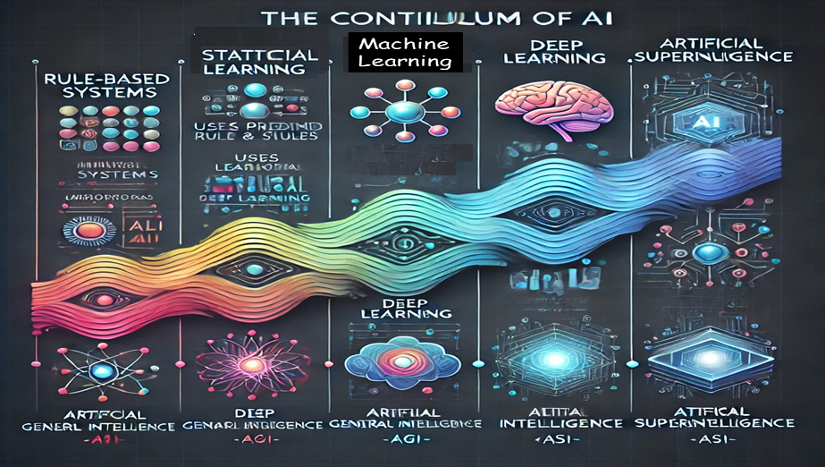
The Continuum of AI: From Rule-based Systems to Artificial Superintelligence
Notes:
When we talk about AI, it’s easy to think of it as a single entity—something futuristic, like what we see in sci-fi movies. But in reality, AI isn’t just one thing; it exists on a continuum—a progressive journey from simple rule-based systems to highly advanced intelligence.
At one end, we have basic AI that follows predefined rules—think of early expert systems that could only provide answers based on ‘if-then’ logic. As we move forward, AI becomes more sophisticated, learning from data, making predictions, and even mimicking aspects of human cognition. The ultimate goal? Artificial General Intelligence—AI that can think and reason like a human—and beyond that, the theoretical concept of Artificial Superintelligence, where machines surpass human capabilities entirely.
A diagram of artificial intelligence (AI) as a continuum typically illustrates the progressive stages of AI development, from simple rule-based systems to advanced general intelligence. Here’s how the continuum can be structured:
Rule-Based Systems (Symbolic AI) – AI that follows predefined rules and logic (e.g., expert systems).
Statistical Learning – AI that uses data-driven methods for pattern recognition (e.g., regression models).
Machine Learning (ML) – AI that improves performance over time using data (e.g., decision trees, SVMs).
Deep Learning (DL) – AI that mimics human brain neural networks for complex tasks (e.g., CNNs, RNNs).
Artificial General Intelligence (AGI) – AI that can perform any intellectual task a human can do.
Artificial Superintelligence (ASI) – Hypothetical AI surpassing human intelligence in all domains.

Slide 5
The Promise of AI and Informatics for Improving Patient Care
Reduced Administrative Burden
Enhanced Decision Making
Analyzing vast amounts of data in real time
Offering evidence-based recommendations
Improved Patient Outcomes
Automating repetitive tasks e.g., documentation and scheduling,
Allowing nurses to focus on patient care
Reminders and increased communication
Proactive, personalized care
Ongoing, real-time identification of safety issues
Predictive Analytics
Optimized Resource Allocation
Identify data trends and patterns
Early disease detection
Predict outcomes
Time savings from more efficient documentation can be reallocated to higher value clinical tasks
Notes:
As nurses, your focus has always been on providing compassionate, high-quality patient care. But let’s be honest—modern healthcare comes with challenges: heavy workloads, administrative burdens, staff shortages, and the constant demand to do more with less.
Now, imagine a world where technology works alongside you—helping to reduce documentation time, predict patient deterioration before it happens, personalize treatment plans, and even assist in clinical decision-making. This isn’t the future; it’s already happening. AI holds tremendous promise for nursing care, not by replacing nurses, but by amplifying their expertise, reducing burnout, and giving them more time for what matters most—the patient.

Slide 6
AI Challenges & Ethical Considerations
O'Connor, S., Yan, Y., Thilo, F.J., Felzmann, H., Dowding, D.W., & Lee, J.J. (2022). Artificial intelligence in nursing and midwifery: A systematic review. Journal of clinical nursing.
Notes:
AI in healthcare brings incredible opportunities—but with great power comes great responsibility. While AI can enhance decision-making, streamline workflows, and improve patient outcomes, it also raises important questions.
What happens if an AI system makes a mistake? Who is responsible? How do we ensure patient data remains private and secure? Can AI ever truly replace human judgment in critical care situations?
These are not just theoretical concerns—they are real challenges that nurses and other healthcare professionals, policymakers, and technology developers must navigate as AI continues to evolve.
So, before we embrace AI fully, we must also examine its limitations, biases, ethical considerations, and risks to ensure that its use in nursing and patient care remains safe, fair, and aligned with human values.

Slide 7

Role of Nurses in AI Integration
Nurses play a vital role in integrating AI into patient care.
Advocate for patient-centered AI solutions.
Collaborate in AI tool development and refinement.
Ensure ethical AI use and safeguard patient data.
How will you be part of this transformation?
Notes:
AI is transforming healthcare, but here’s something crucial to remember: technology alone doesn’t improve patient care—people do. And no one understands patient needs better than nurses.
As frontline caregivers, you are the bridge between technology and compassionate care. You see firsthand what works and what doesn’t in real-world clinical settings. That means you have a critical role in guiding how AI is integrated into nursing practice—for example, ensuring AI is enhancing, rather than hindering, patient care. Nurses must advocate for ethical AI use, and be involved in designing AI tools that truly meet the needs of both nurses and patients.
AI is not something happening to nursing; it’s something nursing can shape. The question is: How will you be part of this change?

Slide 8

Nursing and AI
Real world case examples
Early Recognition of Patient Deterioration
Pressure injury Prevention
Fall Injury Prevention
Timely Diagnosis of Venous Thromboembolism
Notes:
Over the next few minutes I am going to dive into some real case examples of AI that our team has developed, some of which are being used in clinical practice. The first 2 studies relate to AI models that are designed to improve patient outcomes in hospitals and the second 2, falls and VTE relate to improving safety for community dwelling older adults.

Slide 9






Communicating
Narrative
Concerns
Entered by
RNs
(CONCERN)
This project is supported by:
American Nurses Foundation (ANF): Reimagining Nursing Initiative
&
National Institute of Nursing Research (NINR): 1R01NR016941-01
*The content is solely the responsibility of the authors and does not necessarily represent the official views of the National Institutes of Health or ANF*
Notes:
The first project I will present is CONCERN. Concerns stands for … Concern is funded by NINR and it was developed at MGB and NYP. The Pis are Sarah rossetti from NYP, Kenrick Cato from Penn, I am the Site PI from MGB and Sandy Cho is the NWH site PI.

Slide 10
What is CONCERN?
CONCERN is an early warning system (EWS) for patient deterioration based on nursing documentation patterns or “signals”
CONCERN detects the nurses’ expert clinical judgment when it perceives changes in a patient’s clinical state
Alerts earlier than other EWSs that rely on physiological alterations in the patient
Leverages existing documentation
COmmunicating Narrative Concerns Entered by RNs

Slide 11
CONCERN Predictive Model
Vital Sign
Comment Frequency
(HR, BP, RR, SpO2, Temp.
comments)
MAR Frequency
(PRN medications given,
Medications withheld)
Vital Sign Entry Frequency
(HR, BP, RR, SpO2, Temp.)
CONCERN
Model
Nursing Note Frequency
Nursing Note Content
(“MD aware”,
“EKG obtained”)
Demographics
(Age, Gender,
Race, etc.)
CONCERN: Machine learning based ensemble models that capture patient-specific care processes.

Slide 12
CONCERN Study Data Set Used to Develop the EWS
 | MGB (Partners) | NYP
Unique Patients | 45,309 | 44,589
Encounter Cohort | 61,782 | 64,842
Flowsheet Data | 141,097,242 Rows | 76,785,642 rows (Vitals Template) 170,541,580 rows (Assess. Template)
Notes | 4,652,682 Rows | 4,181,900 rows
Orders | Medication: 9,052,279 Rows Procedures: 5,872,679 Rows | Medication: 3,607,277 Diagnostic: 7,294,739 Other: 4,045,800
MAR(Medication Administration Records) | 27,745,906 Rows | 16,027,243 Rows

Slide 13

The CONCERN Predictive Model
Validation
Multinomial Gradient Boosted Machine (GBM) model selected
Built on random 12-hour time slices to predict (over the next 24 hours) whether a patient is discharged, will still be in the hospital, or has a negative event
Trained on 70% of the dataset – 30% was used for 10-fold cross validation
Model Performance
Setting | Accuracy | Precision | Recall | Logloss | AUC
ICU | 0.970938 | 0.431373 | 0.594595 | 0.073695 | 0.934683
ACU | 0.973341 | 0.813559 | 0.643935 | 0.089369 | 0.955982
Better lead time than other early warning scores (EWS)
Rossetti SC, Knaplund C, Albers D, Tariq A, Tang K, Vawdrey D, Yip NH, Dykes PC, Klann JG, Kang MJ, Garcia J, Fu LH, Schnock K, Cato K. Leveraging Clinical Expertise as a Feature - not an Outcome - of Predictive Models: Evaluation of an Early Warning System Use Case. AMIA Annu Symp Proc. 2020 Mar 4;2019:323-332. PMID: 32308825; PMCID: PMC7153052.

Slide 14
How is CONCERN Different than Other Early Warning Systems (EWS)?
 | Patient Deterioration (Early Warning System) | 24 Hour Mortality | ICU Readmission | 30-Day Readmission
MEWS | x | x
CONCERN | x | x
Rothman Index |  | x | x | x
“Clinically, deteriorating patients in general wards either die or are transferred to ICU. This criterion resulted in exclusion of the Rothman Index, which predicts “death within 24 hours” but not ICU transfer.”
Linnen et. al. Statistical Modeling and Aggregate-Weighted Scoring Systems in Prediction of Mortality and ICU Transfer: A Systematic Review. J Hosp Med. 2019 Mar; 14(3): 161–169.
Notes:
Concern is different from other early warning systems b/c it uses documentation patterns and unstructured data which hold signals for patient deterioration and occur before changes in physiological data such as vital signs and other structured data. We conducted several sub-studies looking at the performance of concern in comparison to the MEWS and the NEWS and we found that the likelihood of an event occurring 48 hours after observing a CONCERN high risk score is comparable to the likelihood of an event occurring 6 hours after observing a high-risk MEWS or NEWS score – a difference of 42 hours.

Slide 15

Racial Bias: 3 Early Warning Systems
Notes:
In developing the CONCERN Early Warning System (EWS), we anticipated that patient demographics, especially race, could impact the accuracy of deterioration risk predictions. To address this, we integrated demographic data into the model-building and post-processing steps, ensuring that race did not unfairly influence the score. Our goal was to reduce racial bias and create a more equitable system.
When comparing CONCERN to established EWS tools like NEWS and MEWS, we found a critical difference. These EWS don’t account for racial bias, and research reveals that white or Caucasian patients often receive higher EWS scores, especially when it comes to ICU transfers, compared to Black or African American patients. This suggests that racial bias is embedded in the way these EWS function, potentially leading to unequal care.
By incorporating demographic data into CONCERN, we aimed to reduce this bias and ensure that every patient, regardless of race, receives timely and accurate care. This work not only improves patient outcomes but also sets a precedent for making healthcare technology more inclusive and equitable.
In healthcare, as in many fields, it’s important to routinely assess the systems we build for fairness. Our efforts with CONCERN highlight the significance of addressing bias to create tools that can truly serve all patients.

Slide 16

CONCERN Early Warning System: Participatory User- Centered Design
Notes:
When we set out to create the CONCERN EWS, we knew that it had to be more than just a tool CONCERN had to be a system that truly worked for the people using it: the nurses and physicians on the front lines. To ensure that, we embraced a user-centered participatory design approach. This meant engaging directly with healthcare professionals throughout the entire process, from initial design to final implementation.
We started by collaborating with nurses and physicians to understand how they interpret clinical documentation patterns. Their insights were invaluable in shaping the way the system identifies early warning signals. Together, we defined what constitutes high, medium, and low thresholds for CONCERN EWS scores. By involving them in these critical decisions, we created a system is aligned with real-world clinical practice.
But it didn’t stop there. We also focused on designing the CONCERN app to enhance communication and decision-making within care teams. We wanted to ensure that the app didn’t just provide data. It had to make it easier for teams to collaborate quickly and effectively. With features that allow nurses and physicians to easily track patient status, communicate alerts, and make decisions together. The app fosters a more coordinated and responsive approach to patient care.
In the end, the success of CONCERN hinges on the fact that it was built with the people who will use it. The input from nurses and physicians guided every step, ensuring that the tool wasn’t just technically advanced, but truly practical and supportive of team-based care.

Slide 17
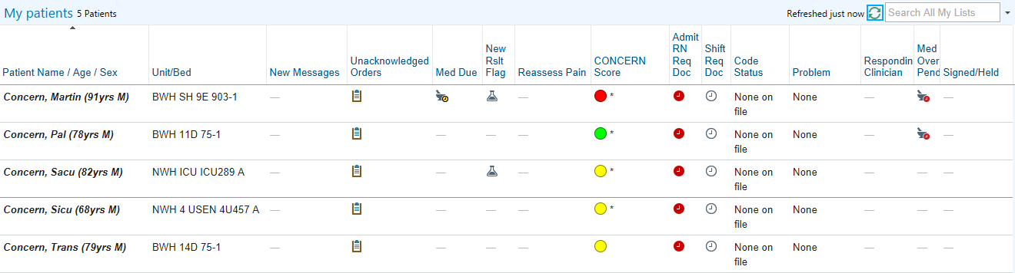
CONCERN Intervention: Configured in EHR Patient List

Slide 18
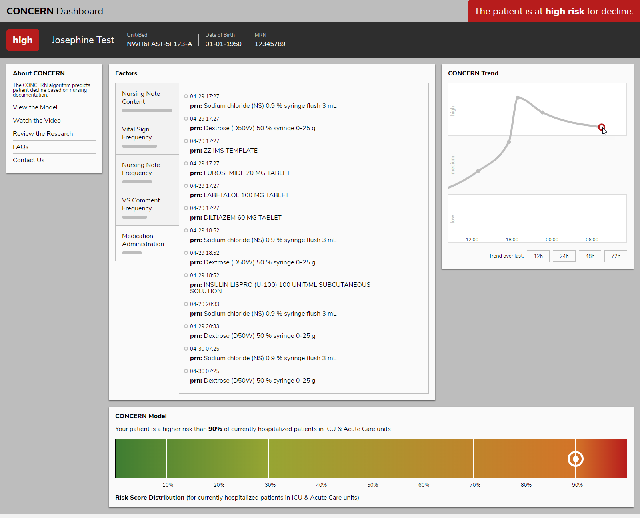
CONCERN “App” Intervention

Slide 19
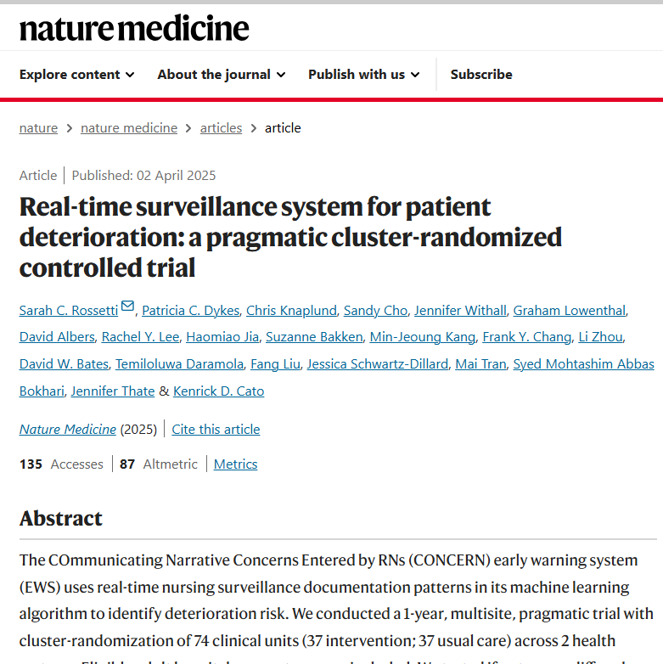
CONCERN Early Warning System: Pragmatic Clinical Trial
Decreased risk of Mortality
Decreased Length of Stay
Decreased risk of Sepsis
Increased unanticipated transfer to ICU
Notes:
After years of research and collaboration, we conducted a clinical trial in two health systems in the US, MassGeneral Brigham in Boston and New York Presbyterian in NYC to test the effectiveness of the CONCERN EWS. The results were both powerful and promising. On the CONCERN intervention units, we saw a significant reduction in inpatient deterioration events. The average length of stay dropped by 11.2%, from 7.2 days to 6.4 days. More importantly, we observed a 35.6% decrease in the likelihood of in-hospital mortality, meaning fewer patients were at risk of dying.
The risk of sepsis, a life-threatening condition characterized by infection and multiple organ failure, also decreased by 7.5%. In other words, patients on CONCERN units had a better chance of avoiding this dangerous condition. Overall, there was a 6.4% decrease in the likelihood of any major hospital adverse event, reducing complications across the board.
But perhaps most encouraging were the outcomes that truly reflect better care. While we saw a 24.9% increase in unanticipated ICU transfers, this is not a negative outcome—it means that CONCERN was able to identify patients at risk early, ensuring they got the intensive care they needed before it was too late.
And here's the best part: there was a 10.7% higher probability of patients being discharged alive, which means that the CONCERN EWS didn’t just help reduce deterioration, it saved lives.
These results demonstrate the tangible impact of integrating AI into healthcare to predict and prevent deterioration. The CONCERN EWS didn’t just improve patient outcomes. It redefined what’s possible in EWSs.

Slide 20
Discussion/Conclusions
CONCERN is an EWS that leverages existing EHR data to identify as risk patients.
Uses metadata patterns that reflect nurse expert decision making
Clinically significant improved lead time for patient deterioration
Was developed with user-centered design to optimize workflow integration
CONCERN enables early identification of at-risk patients
Detects clinical deterioration early-- prompting early actions and resulting in better patient outcomes
CONCERN has been rigorously tested and has demonstrated significant impact on patient outcomes and length of stay.

Slide 21

Innovations in Pressure Injury Electronic Health Record (EHR)-Based Phenotyping Pipelines
Multi-state Pressure Injury Modeling
Notes:
This next project relates to using machine learning to improve primary and secondary pressure injury prevention that was funded by crico, the RMF of the HMS hospitals.

Slide 22
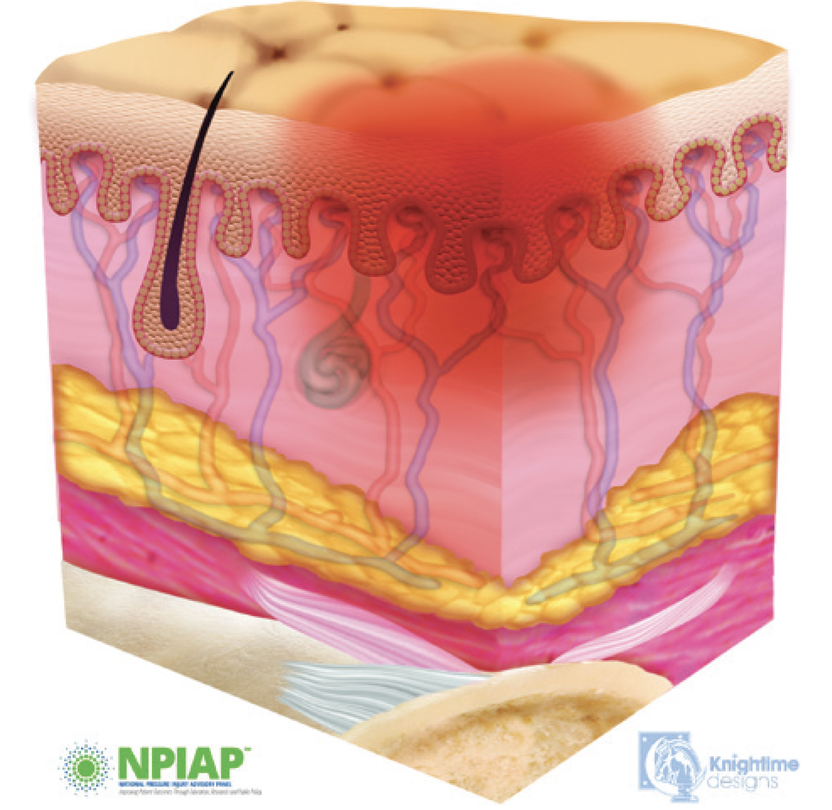
Background: Pressure Injuries and Staging
National Pressure Injury Advisory Panel Definition: ‘Localized damage to the skin and/or underlying tissue due to pressure or pressure in combination with shear’*
Painful, expensive, and frequently occurring health problems
Associated with increased morbidity and mortality
Nurses play a critical role in pressure injury care
The National Pressure Injury Advisory Panel pressure injury (PrI) categorization:
Stage I, II, III, IV, unstageable, suspected deep tissue injury , and mucosal*
Determining accurate PrI staging information from EHR is a crucial step in developing personalized and generalizable PrI risk assessment tools
Accurate PrI staging is a nursing challenge
*Kottner J, et al. Journal of tissue viability. 2019;28(2):51-8.
Notes:
I don’t believe this audience needs much background about PrIs and staging but I include this slide to summarize the evidence that informs our work. The NPAIAP PrI staging categories include stages 1-4 corresponding with the severity and depth of the PrI and unstageable refer to PrIs that are covered and therefore unable to be staged. Deep tissue PrI affect the soft tissue under the skin. Mucosal PrI are localized damage to the mucous membranes, typically occurring where a medical device has been placed.
Determining accurate PrI staging information from EHR is a crucial step in developing personalized and generalizable PrI risk assessment tools, but accurate PrI staging is a challenge

Slide 23
Background: Limitations of Existing Machine Learning Methods for Processing Pressure Injury Data
Rarely include dynamic changes in daily nursing assessments
Missing time-sensitive patterns to improve risk prediction.
When nursing assessments are included, the data from a single time point missing temporal patterns
Single value documented prior to occurrence of PrI in cases and the single value documented prior to discharge in controls.
Results in loss and bias in patient status information, especially temporal changes
Notes:
Our team focuses largely on how we can use nursing data to develop EHR based PrI phenotypes. Widespread EHR adoption since MU has resulted in a significant amount of data and, there are many opportunities and challenges assoc wth EHR-based PrI phenotyping. EHR data can be used to develop more personalized PrI RA tools. However, EHR data mining and phenotype development can be complicated due to the complexity of data sources, data quality, and variation in nurse proficiency with PrI staging.
First by way of background there are a number of machine learning models for PI risk prediction in the literature but they have limitations…

Slide 24
Background: EHR-based Pressure Injury Phenotyping Challenges
EHR data challenges
Accuracy
Completeness
Complexity
Bias
Health care process models
Represents how processes occur and how data are recorded
Inform phenotyping
Help to identify issues with the recording process that impact data accuracy
Hripcsak & Albers. Next-generation phenotyping of electronic health records. J Am Med Inform Assoc 2013;20:117–121.
Notes:
The limitations of existing PrI risk perdition models are not surprising b/c there are a multitude of challenges associated with PrI EHR data including large variation in accuracy and completeness, these data are complex and associated with bias. About a decade ago, George Hripcsak and Dave Albers published a perspective piece in JAMIA where they make the point the EHR is not a direct reflection of the patient and their physiology, but rather a reflection of the recording process inherent in healthcare that includes lots of noise and feedback loops.
The figure on the right is from their paper -- they make the point that we spend a lot of time talking about the data and developing phenotypes. However, if we are ever to automate phenotyping, we also need to get a handle on the health care process models that help us better understand the patient care and health care processes that are reflected in clinical documentation. In this project, we collaborated with wound care experts and clinical nurses to flesh out PrI clinical workflow and associated documentation and to define associated healthcare process models. Over the next few minutes I will be talking about a few studies we did to try to build a pipeline to support use of EHR data to improve PrI prevention.

Slide 25
Project Goal
Project Goal: To develop a comprehensive set of EHR data-based severe pressure injury risk factors and compare its prediction accuracy to the Braden Scale.
To describe differences in pressure injury detection by age and race
To explore the potential value of the Braden Scale and its subcomponents in predicting dynamic pressure injury stage transition patterns.

Slide 26
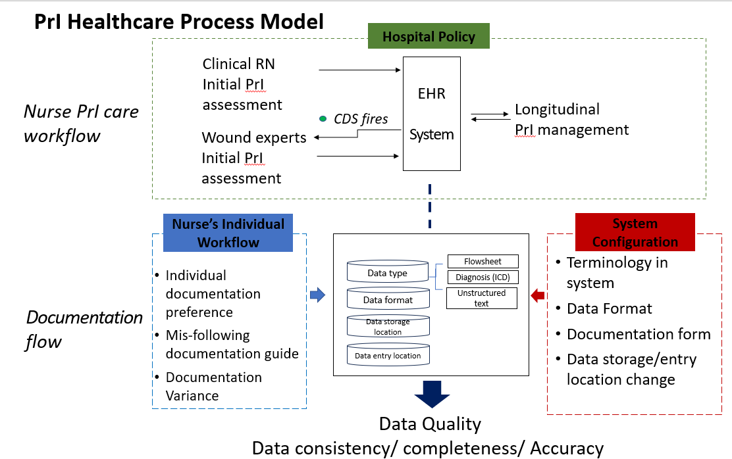
Pressure Injury Health Care Process Model
Notes:
We first developed a PrI healthcare process model displayed here that includes the Nursing PrI assessment, prevention, and documentation workflows including clinical nurses conducting PrI risk assessment and documenting their assessment in the EHR. For patients at high risk, CDS fires and a wound care consult is ordered. The skin and wound expert then evaluates the patient, completes the PrI staging and make recommendations for longitudinal PrI mgt.
We identified several issues that can impact the data quality. For example, the large variation noted in PrI data due to differences in how nurses documentation PrI and EHR system configuration issues. You may have heard before that there are many ways to document PrI in the EHR system. There are MGB enterprise documentation guidelines, but they are not always followed. With regard to system config, the terminology used w/in the EHR system has changed overtime based on NPIAP guidelines as well as the data format, the forms used for PrI documentation and where PrI data are entered and stored.

Slide 27
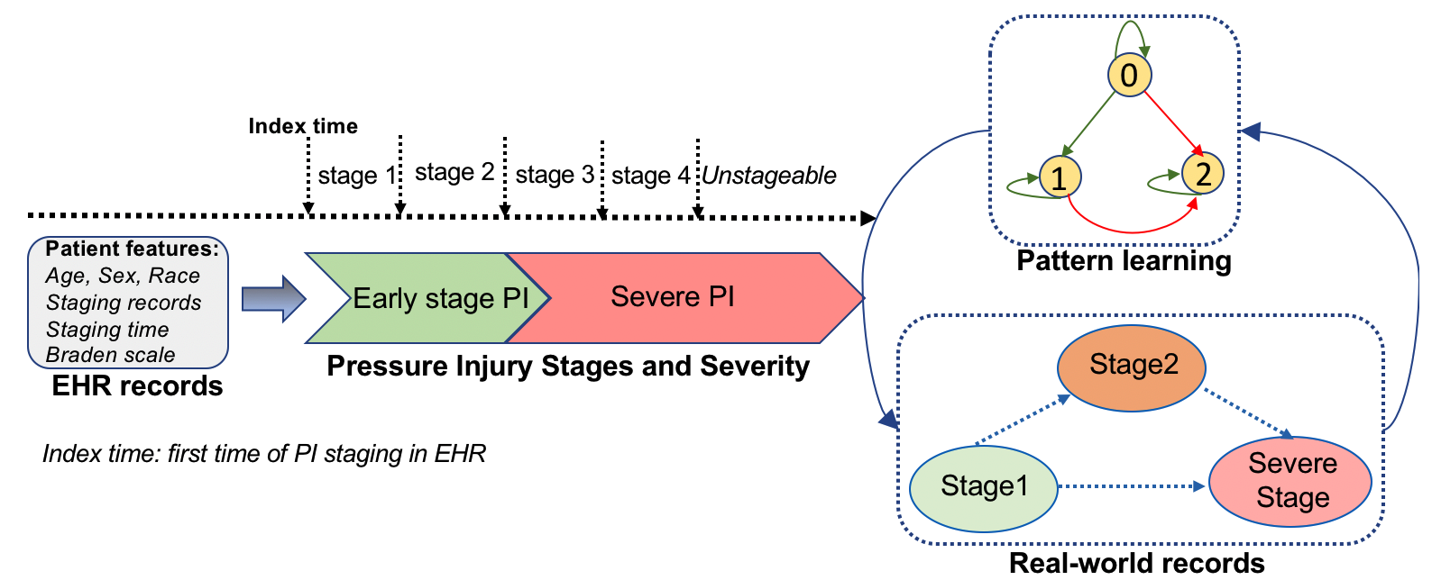
We used Markov Multi-state Modeling to evaluate time-sensitive PrI Staging Transition Trajectories.
Based on expert opinion, stage 1 and stage 2 were defined as early-stage pressure injury and other stages were defined as severe pressure injury.
Notes:
Using the lessons learned from building the PrI healthcare process model, we were able to clean the data and build our cohort
We used Markov Multi-state Modeling to evaluate time-sensitive PrI Staging Transition Trajectories to inform primary and secondary PrI prevention models.
Based on expert opinion, we defined stage 1 and stage 2 as early-stage pressure injury and other stages were defined as severe pressure injury.

Slide 28
Study Cohort
Developed a cohort of 29,475 patients with at least one record of pressure injury documented during 2015 to 2023 from five MGB hospitals.
Patients were divided into four groups according to pressure injury anatomical locations, including coccyx, buttocks, sacrum and heel.
Within each pressure injury location group, we further divided patients into 3 staging groups, including stage 1, 2 and severe stage (including stage 3, 4 or unstageable)
Notes:
As mentioned our study cohort came from 5 MGB hospitals from 2015-2023…

Slide 29
Research Questions
What is the distribution of PrIs by location?
Are there differences in age at the time of PrI diagnosis based on patient demographics.
What are the transition paths and intensities between PrI states using pressure injury stages derived from rules based on domain knowledge (provided by clinical experts) and NPIAP PrI clinical practice guidelines?
What is the impact of the Braden Scale and its 6 sub-components as time-varying covariates to all transitions between pressure injury stages?

Slide 30
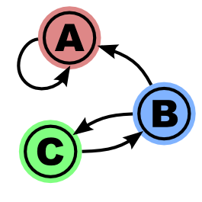
Methods
Comparative analysis among 4 common PrI locations by age, race, and sex.
Markov multi-state modeling to evaluate time-sensitive progression trajectory of pressure injury stages
Covariate analysis: estimated impact of Braden Scale and its 6 sub-components as time-varying covariates to all transitions between pressure injury stages.
Notes:
Our methods included first…
We used Markov Multi-state Modeling to evaluate time-sensitive PrI Staging Transition Trajectories.
Markov models are frequently used to model the probabilities of various states and the rates of transitions among them. The method is generally used to model systems. Markov models can also be used to identify patterns, make predictions, and learn the statistics of sequential data.
As mentioned earlier we did our data science work in collaboration with a team of clinical wound and nursing care experts to help us clean the data but also to define our rules. For this project, Based on the opinion of these expert, we defined stages 1 and 2 as early-stage PrIs and other stages (including stages 3, 4 or unstageable) were defined as severe pressure injury.

Slide 31
Methods used to minimize challenges
1. Identify cohort
EHR data
Identify features
3. Train models
Unsupervised machine learning
5. Incorporate Expert Clinical Knowledge
Validating clusters
Refining clusters
Identify DTI phenotype clusters
6. Evaluate Model Accuracy
Trajectory Analysis
Braden Scale
Trajectory Analysis Models
Combination
Future Goal
4. Incorporate Expert Clinical Knowledge
EPIC CDS
2. Incorporate Expert Clinical Knowledge
Clinical nurse and wound care expertise essential across all phases of model development
Notes:
This slide illustrates that PrI modeling is an iterative, multi phase process. Clinical nurses and wound care experts were involved in all phases of model development. Our ultimate goal is to integrate our models into the EHR as CDS.

Slide 32
Results: Baseline Characteristics
Number of patients in the dataset (2015-2023): 29,475
Mean age: 70.7; White 79.5%, Black 9%; Female 43.6%
Total number of pressure injuries after data cleaning/exclusions applied: 3474
Number of pressure injuries per location:
Coccyx
1342 (38.6%)
Buttocks
1085 (31.2%)
Sacrum
612 (17.6%)
Heel
435 (12.5%)

Slide 33
Results: Distribution of Pressure Injury Anatomical Locations and Stages
Heel pressure injuries had lowest prevalence but highest % of severe pressure injuries (30.5%), as compared with other locations (18.1- to 22.5%)
Significant difference in median age pressure injury first documented among different injury location groups (p<0.001)
Median age of Black or African American patients significantly lower than both White and Asian (p <0.001)

Slide 34
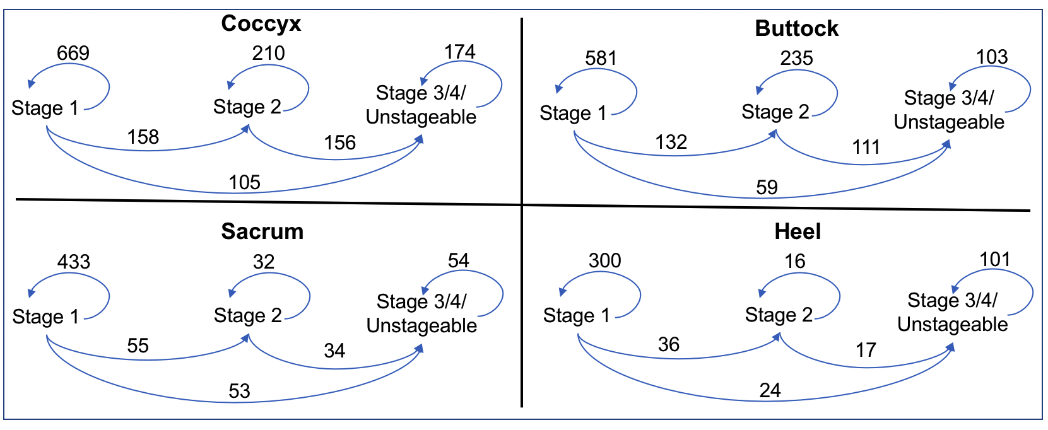
Observed Transition Frequencies Between Stages
Transition = A change from one stage to the distinct following stage.
In all locations, patients in stage 2 were more likely to transition to severe stages.
Notes:
We also calculated the transition frequencies b/t stages
The transition between stages 1 and 2 were the most frequent in all groups. We further estimated transition intensities between stages as shown here. We observed several patterns including:
In all four locations, patients in stage 1 were more likely to transition to stage 2 than to transition to the severe stages;
In all four locations, patients in stage 2 were more likely to transition to severe stages. The likelihood of this transition was higher than patients transitioning from stage 1 to stage 2;
There were location-dependent variations for transition patterns.

Slide 35
Results: Impact of Braden Scale and Sub-components as Time-varying Covariates
Low-risk Braden Scale score significantly associated with < likelihood of transitions from stage 2 to severe stages on Buttocks and from stage 1 to severe stages on Sacrum.
Significant associations identified in Braden sub-components for transition from low to severe stages only.
No significant associations found for nutrition, friction and shear in any transitions
No significant associations for transitions between stages 1 to 2.
No significant associations between age or sex with stage transitions
Nonwhite patients more likely to transition from stage 1 to 3 in coccyx and sacrum groups
Notes:
In terms of the impact of the BS and subscales as time varying components we found that…
The fact that we found no significant associations for the transition between stages 1 to stage 2, demonstrating its lack of effectiveness for early stage prevention and the need for data driven time varying approaches.

Slide 36
Discussion/Implications
We developed a novel multi-state pressure injury trajectory model using real-world clinical data.
Stage 2 serves as a "gateway state" during the development trajectory to a severe stage pressure injury.
Once a patient progresses to stage 2, the likelihood of transiting to severe stages is much greater.
Observed location-dependent variations, suggesting location-specific interventions and treatments can be important for pressure injury management.
Notes:
So to summarize

Slide 37
Discussion/Implications
The Braden Scale and its sub-scales are suboptimal for predicting early stage PrI transitions and may limit its value for supporting early PrI prevention.
Highlights the lack of important time-sensitive information in current pressure injury risk assessment tools.
The trajectory model showed the advantages of capturing time-dependent information among stage transitions and the need for data-driven CDS.
Dynamic pressure injury risk screening CDS is needed to facilitate personalized and timely prevention.

Slide 38
Future Implications of Next Generation CDS Using Multi-state Modeling
Pressure Injury Dynamic Progression And Data-driven Risk Assessment CDS
Early and Targeted Intervention
Real-time tracking of patient progression, enabling timely interventions at critical transition points (e.g., prevention of stage 1 and 2).
Identify higher risk patients earlier and trigger alerts for preventive care.
Improving Prediction Beyond Traditional Methods
Data-driven, time-dependent risk assessments, improving predictive power beyond traditional cross-sectional tools.
Identify patients at risk before they reach the “gateway” Stage 2; preventing severe PrIs more effectively.

Slide 39
Future Implications of Next Generation CDS Using Multi-state Modeling (Continued)
Dynamic Risk Assessment and Real-Time Monitoring
Enables continuous, dynamic assessment of patient condition, allowing CDS to adapt recommendations as risk factors change.
Personalized Risk Stratification
Incorporate demographic, anatomical, and comorbidity data to tailor risk predictions for individual patients or subgroups.
Address race-dependent and location-specific variations in PrI progression.
Customized prevention strategies based on patient-specific trajectories.

Slide 40
Future Implications of Next Generation CDS Using Multi-state Modeling (Continued)
Enhanced Clinical Decision-Making
Provide real-time alerts and predictive analytics.
Recommend preventative actions before PrIs progress to severe stages, improving adherence to evidence-based care.
Bridging Gaps in Clinical Practice
Rigorous and objective foundation for risk assessment, potentially replacing or enhancing existing tools.
Supports proactive rather than reactive prevention efforts.

Slide 41
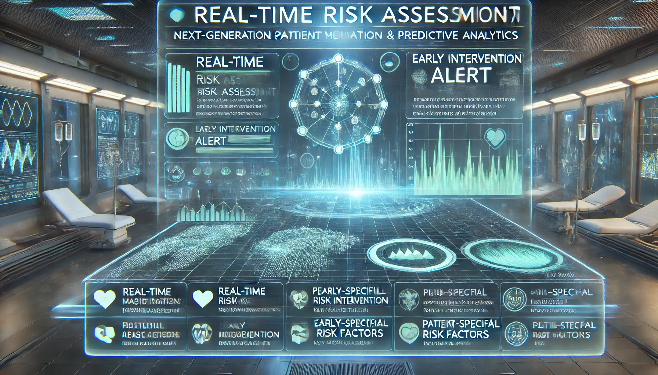
Future Vision: Integration of Multi-state Modeling for PrI Tracking Into Hospital EHR Systems
Notes:
So in summary, The integration of multi-state modeling for PrI tracking into AI-enhanced EHR systems represents a game-changing shift toward proactive prevention, real-time decision-making, and data-driven patient care. Through collaboration among clinicians, researchers, and product vendors, we can accelerate innovation, scale AI-driven solutions, and redefine pressure injury prevention across care settings.

Slide 42

Improving outcomes for community dwelling older adults
Patient Safety Research (Primary Care)
eSTEPS
DOVE
Notes:
This next set of studies relate to improving care for community dwelling older adults.

Slide 43



eSTEPS
Participation in fall-prevention exercise program for an older adult reduces fall risk by 23%
Guidelines recommend fall-prevention exercise programs for older adults at risk of falls
Fall prevention is inadequately addressed in primary care and disparities exist.
Providers uncomfortable recommending exercise for unsteady patients
Providers and patient believe that walking is an acceptable fall prevention exercise
Older people in rural areas more likely to fall and experience fall-related injuries and less likely to participate in fall prevention programs
* electronic Strategies for Tailored Exercise to Prevent fallS

Slide 44
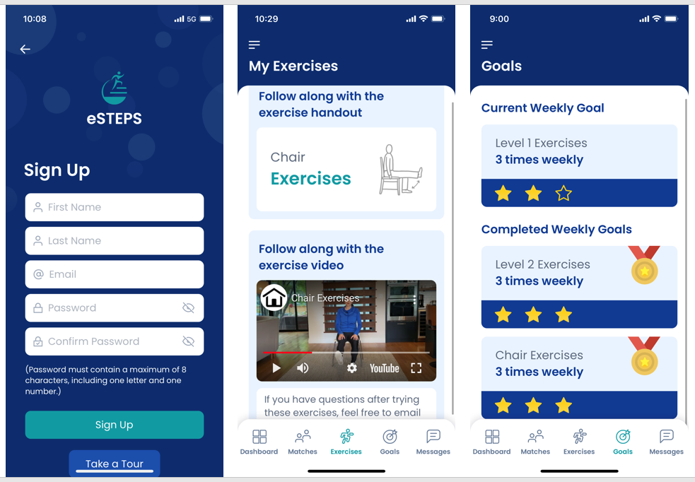
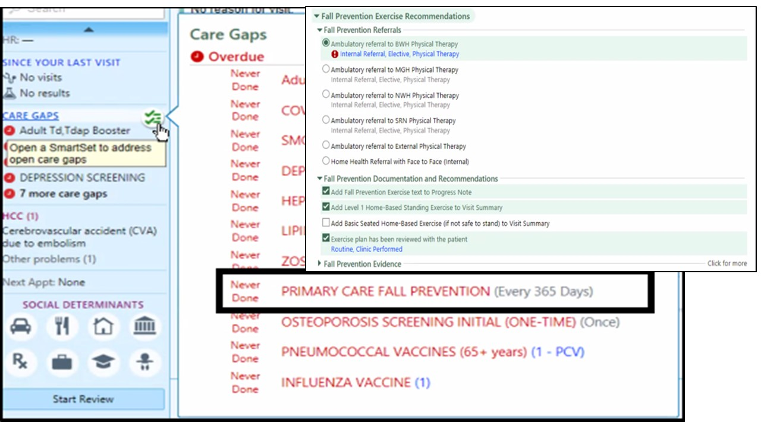
eSTEPS
Traditional Fall Injury Risk Screening (eCare)
AUC .59
EHR-based Fall Injury Risk Screening
AUC .76
Goals:
To improve traditional fall risk screening by using machine learning approaches to accurately identify older adults at risk for falls.
To provide clinical decision support that helps primary care providers and staff develop a tailored fall prevention exercise plan for high-risk patients.
To provide patients with low-tech to high tech resources to help them to carry out their personalized exercise plan.
Manual Fall Risk Screening is Suboptimal
A machine learning tool using EHR data showed superior sensitivity and accuracy in detecting patients at risk of future fall injuries compared to standard models.
Clinical decision support can link patient-specific risk factors to evidence-based prevention interventions for real-world use.
Notes:
Goals of the eSTEPS project are:
To improve traditional fall risk screening by using machine learning approaches to accurately identify older adults at risk for falls.
To provide clinical decision support that helps primary care providers and staff develop a tailored fall prevention exercise plan for high-risk patients.
To provide patients with low tech to high tech resources to help them to carry out their personalized exercise plan.
We used EHR data and machine learning methods to develop a predictive model for fall injuries which is much more accurate than the existing screening tool.
Based on interviews with primary care providers, nurses, staff and patients, we developed CDS in epic to help the primary care team provide personalized exercise prescriptions to improve strength gait and balance and to prevent falls. The decision support includes a care gap and smart set for providers and a BPA/smart set for other team members that is triggered for older patients who fail their fall screener.
We also developed a range of low-tech to high tech resources for patients including an eSTEPS app and so providers can send patients an exercise prescription and other resources directly to the patient app for use after the visit.

Slide 45

eSTEPS Clinical Trial
Cluster randomized control trial Mass General Brigham (22 practices/>8000 patients)
Replication trial University of Texas Medical Branch (12 practices/>4000 patients)
Recruitment 9 months/follow-up 12-21 months
Outcome measures:
Patient falls/injuries
Fear of falling/Exercise self-efficacy
Clinical trial ends May 2025– stay tuned!

Slide 46

Diagnostic delay Of VTE* (DOVE)
*Venous Thromboembolism
Notes:
The final study that we are doing targeting primary care patients is DOVE. Dove stands for Diagnostic delay Of VTE or Venous Thromboembolism. Through this project we are developing an eCQM and CDS to address this problem.

Slide 47
Background: Venous Thromboembolism (VTE)
Venous thromboembolic disease (VTED) = Deep Vein Thrombosis (DVT)-- Pulmonary Embolism (PE)
Dangerous, preventable public health problem
Affects 300,000-600,000 individuals in the U.S. annually
Requires timely and adequate treatment
VTE signs and symptoms are non-specific making timely recognition a challenge
Delayed VTE diagnosis in primary care settings is common: ≈ 4 days between symptom onset and diagnosis
Previous studies used retrospective record reviews and small sample sizes to estimate time from symptoms presented in primary care to diagnosis
Notes:
We focus on delayed diag of VTE b/c VTE, which include PE and DVT, is a dangerous health problem that requires timely and adequate treatment. However, diagnosis is often missed or delayed bc VTE symptoms are similar to those associated with many chronic illnesses treated in primary care. Diagnostic delay of VTE in primary care has been estimated at 4 days, but previous studies used retrospective record review and small sample sizes to estimate time from symptoms presented in primary care to diagnosis. There has not been a systematic way to measure diag delay of VTE or DOVE.

Slide 48
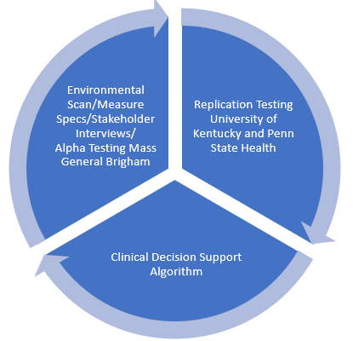
DOVE Project Goals and Data Sources
1. Develop DOVE electronic clinical quality measure (eCQM) to Quantify VTE diagnostic delay of adults in primary care at the provider group level.
VTE phenotype using commonly captured EHR data.
Natural Language Processing (NLP) approach to identify VTE symptoms in unstructured clinical notes.
2. Develop clinical decision support (CDS) using EHR data and machine learning methods Goal: Alert providers of patients at high risk for VTE diagnosis.
Data sources:
EHRs: Site 1 Mass General Brigham, Site 2 University of Kentucky, Site 3 Penn State Health
Notes:
The goal of this project was to Develop an eCQM to Quantify VTE diagnostic delay of adults in primary care at the provider group level. This involved developing a VTE phenotype using commonly captured EHR data and developing a rule-based NLP symptom extractor to identify VTE symptoms in primary care clinical notes Our data sources were EHR systems across three large healthcare systems; one urban integrated delivery system in Boston, an urban/metro and rural system in Kentucky, and an Urban/metro/rural system across PA.

Slide 49
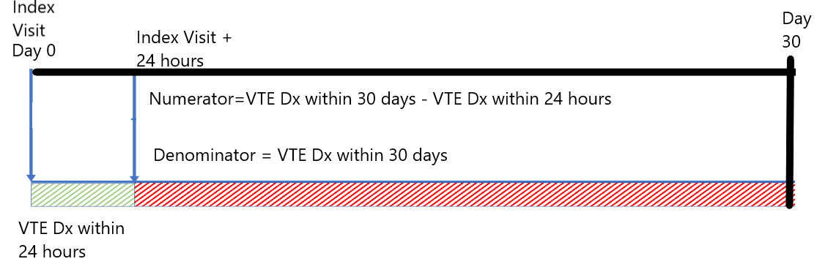
DOVE eCQM Measure Specifications
Denominator: All adult patients (18+) presenting in primary care with VTE-related symptoms (identified by the NLP algorithm) who are subsequently diagnosed with VTE (≤ 30 days of primary care visit).
Numerator: Subset of denominator where VTE diagnosis occurs greater than 24 hours following the index primary care visit.
Notes:
This slide summarizes our measure specifications The demon is…All adult patients presenting in primary care with VTE-related symptoms who are subsequently diagnosed with VTE within 30 days of a primary care visit.
Numerator: Subset of denominator where VTE diagnosis occurs greater than 24 hours following the index primary care visit.
Note that the presence of symptoms documented during the primary care visit and captured by the NLP algorithm starts the clock for measuring diagnostic delay.

Slide 50
DOVE VTE Phenotyping Algorithm Accuracy
Traditional method
ICD
PPV* = 64%
Recent studies
ICD
Imaging
PPV = 75%
+
BWH method
ICD
+
Imaging
+
RxNorm
PPV = ?
PPV = 95.8%
Billing
Identification
Treatment
*PPV=Positive Predictive Value
50
Notes:
EHR phenotyping algorithm uses data from patient records to identify patterns of data that signify health conditions. Phenotypes allow us to identify a condition without chart review. When measuring its accuracy, we use manual record review as the gold standard. This shows our VTE phenotyping method compared to other published methods. For example identifying VTE using using just ICD codes has a PPV of 64%, adding imaging codes increases PPV to 75%. In our study we also included RX Norm treatment codes and found a PPV close to 96%.

Slide 51
Natural Language Processing (NLP) in eCQMs
Developed rule-based symptom extractor algorithm to identify classic VTE symptoms in the EHR clinical notes using notes from the MGB system, literature reviews, and expert consensus:
NLP addresses the gap in capturing unstructured data in quality measures
Cough
Hypotension
Lightheadedness
Shortness of breath
Syncope
Tachycardia
Chest pain
Hemoptysis
Calf pain
Leg pain
Foot pain
Calf numbness
Leg numbness
Foot numbness
Calf tingling
Leg tingling
Foot tingling
Calf redness
Leg redness
Foot redness
Calf swelling
Leg swelling
Foot swelling
Calf tenderness
Leg tenderness
Foot tenderness
Calf warmth
Leg warmth
Foot warmth
Notes:
We developed a rule-based NLP symptom extractor to identify VTE symptoms in primary care patient clinical notes as an integral component of the eCQM. This slide shows the VTE symptoms that are typically documented in clinical notes.

Slide 52
Delayed VTE Diagnosis eCQM Rates:
MGB 2016-2021 Overall (5,514 encounters): 72.6%
Sub-analysis of 50 Largest MGB Practices
Number Delayed VTE Diagnosis Events 2016-2021: 425
UK 2016-2020 Overall (632 encounters; Organizational level only): 77.14%
Penn State Health 2019-2022 Overall (545 encounters): 81.85%
Range 50-100% (SD 15.36)
Range: 0-100% (SD 21.52)
214 Practice Locations
Interquartile range 27.03%
Interquartile range 40%
19 Practice Locations
Unadjusted rate: 66.3% (range 0-100%, SD 32.4)
Notes:
This slides shows the rates of delayed VTE diagnosis across MGB and UK, practices. Rates ranged from 72.6 at MGB to 77.14 at UK. We also looked at the reliability of the measure across different size practices at MGB and found that that there is some variability but consistently high DOVE rates across the different size practices, indicating a lot of room for improvement.

Slide 53
Delayed VTE Diagnosis eCQM Alpha and Beta Testing
Frequency of data elements:
MGB 1.53% missing (ethnicity)
UK: 1.02% missing (ethnicity)
PSH: 0% missing
NLP algorithm easily implemented at organizations with different EHR systems.
Face validity: 100% agreement among technical expert panel members DOVE eCQM, as specified, can be used to distinguish good from poor quality related to patient safety at the clinician group-level.
DOVE Benchmark. Based on the ABC method which establishes benchmark performance as the level consistently attained by the top performers accounting for at least 10% of the overall population, the overall benchmark rate for the DOVE eCQM is 49.63%.
*Kiefe CI, Weissman NW, Allison JJ, Farmer R, Weaver M, Williams OD. Identifying achievable benchmarks of care: concepts and methodology. Int J Qual Health Care. 1998;10(5):443-7.
Notes:
We found that the eCQM was feasible across all 3 systems with a very low % of missing data elements. The NLP platform was easily implemented at both sites. We established face validity through our Technical expert panel that agreed that DOVE eCQM, as specified can be used to distinguish good from poor clinician group-level quality related to patient safety. WE also used the ABC method to establish DOVE benchmark performance as the level consistently attained by the top performers accounting for at least 10% of the overall population. The overall benchmark rate for the DOVE eCQM is 49.63%.

Slide 54
Evidence for Improving Time to Diagnosis to Reduce Morbidity And Mortality
The relative risk of 30-day mortality following a VTE diagnosis was assessed for patients in Mass General Brigham cohort (2018-2022) with and without a delayed diagnosis (n=3591).
30-day mortality from date of diagnosis by VTE diagnosis type (delayed, not delayed)
* | Death Within 30 Days | No Death Within 30 Days | Total
Delayed Diagnosis | 217 (8.3%) | 2390 (91.7%) | 2607
No Delayed Diagnosis | 31 (3.2%) | 953 (96.8%) | 984
Total | 248 | 3343 | *
Notes:
Delayed diagnosis of VTE represents serious consequences for patients– I think we know that instinctively. However, in our current CMS MUC list submission we demonstrate the empiric validity of the DOVE eCQM by calculating the linkage between delayed diagnosis and mortality in patients in the Mass General Brigham cohort and found that patients with a delayed VTE diagnosis were more likely to die compared to individuals whose VTE diagnosis was not delayed. Specifically in the MGB cohort we found that patients with a delayed VTE diagnosis had 2.64 times the risk of death within 30 days compared to individuals whose VTE diagnosis was not delayed. We also conducted this testing in the PA health system and saw similar trends. This work is currently under peer review.

Slide 55
Summary of Evidence-base for Improving Time to Diagnosis to Reduce Morbidity And Mortality (continued)
A total of 8.3% of patients with a delayed VTE diagnosis died within 30 days of their primary care provider (PCP) visit where VTE symptoms were reported, compared to 3.2% of patients who died whose VTE diagnosis was not delayed.
Individuals with a delayed VTE diagnosis had 2.64 times the risk of death within 30 days (relative risk) compared to individuals whose VTE diagnosis was not delayed.
Patient characteristics (demographics, Charlson comorbidity score) in patients with and without delayed diagnosis, were similar, meaning the differences in the death within 30-day of diagnosis between groups was not due to confounding (of observed characteristics).
These results suggest a link between delayed diagnosis and subsequent risk of 30-day death
Notes:
Specifically in the MGB cohort we found that patients with a delayed VTE diagnosis had 2.64 times the risk of death within 30 days compared to individuals whose VTE diagnosis was not delayed. We also conducted this testing in the PA health system and saw similar trends. This work is currently under peer review.

Slide 56
DOVE eCQM Implementation
Partnership for Quality Measurement (PQM, formally NQF) 2023: Passed
CMS Measures Under Consideration List 2023: Rejected with following suggestions:
“Refine the 24-hour timeframe to account for weekends/holidays and the testing that would be required to diagnose a VTE”.
“Narrow list of symptoms to be more specific to lower limb venous thromboembolism (VTE) or possibly in combination with one of the more broad cardiopulmonary symptoms (syncope, tachycardia, shortness of breath, hemoptysis)”.
Notes:
For the past couple of years our team has been working hard to implement the DOVE eCQM in the NPP. We submitted to the..

Slide 57
DOVE eCQM Implementation
CMS Measures Under Consideration List Response
Calculated DOVE rates using >72-hour time frame
Rationale for not narrowing list of symptoms
Would lower the ability of the eCQM to detect cases of delayed/missed VTE diagnoses, and artificially lower the rates of delay reported.
Consequences of lowered sensitivity:
Persistence of the problem of delayed diagnosis.
Missed opportunities for education of physicians who may not include VTE in their differential diagnosis.
Lowers the index of suspicion for VTE.
CMS Measures Under Consideration List 2024: Passed
DOVE Rates Using >72 Hours Definition
MGB: 68%
Penn State Health: 69.9%

Slide 58
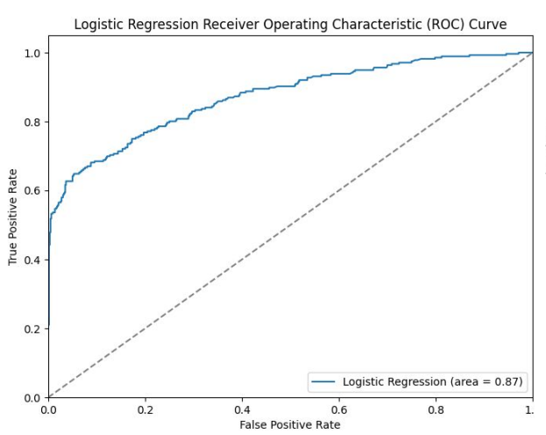
Clinical Decision Support (CDS) Preliminary Development and Model Performance
VTE CDS Final Study Cohort:
Feature selection: Symptoms + Diagnoses (structured)
Cases: 1,936 patients confirmed with VTE
Controls: 5,050 patients without VTE
Data duration: 01/01/2016-12/31/2019
Models: Logistic regression, Random Forest, Decision Tree, Gradient Boosting, XGBoost, SVM, Naïve Bayes
AUC Range: .76 (Decision tree) - .87 (Logistic regression)
Top 10 Predictors based on Logistic Regression
Smoking | Calf tenderness
Active cancer | Calf redness
Spinal cord injury | Pacemaker
Race | Prothrombin gene mutation
Leg tingling | Leg tenderness
Notes:
Our team believes that measurement is a good first start but insufficient, primary care providers also need CDS to identify patients at risk for VTE in outpatient settings. Currently we are working on a CDS system to help identify patients at risk for VTE in the context on a primary care visit to further support VTE diagnostic accuracy and provision of guideline-based care.

Slide 59
DOVE Discussion/Conclusions
The DOVE eCQM is a tool for primary care provider groups to quantify the rate of avoidable delayed diagnosis events
Includes only patients VTE symptoms in the primary care setting
Is automated and uses routinely collected EHR data
Multiple testing sites; geographically distant and different EHR systems
Delayed VTE rates similar (>70%) across all three systems.
Clinical decision support is needed to help identify patients at risk for VTE in the context on a primary care visit to further support VTE diagnostic accuracy and provision of guideline-based care.

Slide 60

Discussion/Conclusions
AI is here and holds potential to transform healthcare.
As frontline caregivers, nurses are crucial in leveraging AI for a more efficient and equitable healthcare system.
Nurses need training to apply AI effectively and ethically in patient care.
Healthcare informatics and AI projects are challenging but there are many strategies that can be used to overcome challenges:
Iterative approaches: Apply lessons learned
Engaging stakeholders: Clinicians, patients and family
Optimizing workflows
Leveraging both high and low-tech interventions
Educating and engaging nurses in building AI innovations is essential for overcoming challenges
Processing & analyzing clinical data
Translating predictive models for CDS design
CDS implementation
Ethical and patient-centered approaches
AI will not replace nurses, BUT nurses who use AI will provide better care than nurses who do not use AI!

Slide 61

Project Teams
Pressure Injury Prevention
Research Team
Patricia C Dykes PhD, MA, RN
Wenyu Song PhD
Min-Jeoung Kang PhD
David W Bates MD, MSc
Veysel Baris PhD
Luwei Liu MS
Graham Lowenthal BA
Stuart Lipsitz ScD
MGB Site Pis/Informaticists
Paula Wolski MSN, RN
Sandy Cho MPH, RN
Debra Furlong RN
Lisa Herlihy RN
Diane Carroll PhD, RN
Skin and Wound Experts
Tanya Martel DNP, RN
Wadia Gilles-Fowler RN
Jacqueline Massaro MSN, RN
Beth Melanson RN
Lori Morrow RN
eSTEPS
MassGeneral Brigham:
Patricia C. Dykes, PhD, RN
Nancy Latham, PhD, PT
Pam Garabedian
Stuart Lipsitz
Hannah Rice
Michael Sainlaire
David Bates
Tien Thai
Lipika Samal
Wenyu Song
Min Kang
University of Texas MB
Erin Hommel
Biai Digbeu
DOVE
BWH
Patricia C. Dykes, PhD, RN
Lipika Samal MD, MPH
David Bates MD, MSc
Wenyu Song PhD
Avery Pullman
Li Zhou MD, PhD
John Laurentiev
Frank Chang
Michael Sainlaire MS
Ann Hurley
Alexandra Frost
University of Kentucky:
Jin Chen PhD ,
Krissy Gray,
Purushottam Panta,
Penn State Health:
Shadi Hijjawi MD,
Khalid Nawab MD, Christopher Heron MD,
Tim Nye,
Richard Schreiber MD,
CONCERN
Columbia University:
Sarah Rossetti, PhD, RN
Kenrick Cato, PhD, RN
Haomiao Jia, PhD
Mohtashim Bokhari, PhD, Jennifer Withall, PhD, RN
Mollie Hobensack, BSN, RN
Temmi Daramola
MassGeneral Brigham:
Patricia Dykes PhD, MA, RN
Sandy Cho MPH, RN
Graham Lowenthal BA
Jeff Klann PhD
Li Zhou MD PhD
Min Jeoung Kang, RN, PhD
Frank Chang, MSE
Notes:
As I mentioned, all of these projects are not possible without multidisciplinary teams. I would like to acknowledge and thank my colleagues and teams that make these outcomes research projects possible.

Slide 62

Thank You!
pdykes@bwh.Harvard.edu

