Slide 1

Implementing a Virtual Care Model Program
NENIC Trends Conference
May 30th, 2025
Leslie Hutchins MBA, BSN, RN, NI-BC, NE-BC
Chief Nursing Information Officer at Yale New Haven Health
Email: Leslie.Hutchins@ynhh.org

Slide 2
Disclosures
The following speaker has no relevant financial relationships to disclose:
Leslie Hutchins

Slide 3
Learning Objectives
Identify 1 strategic design feature of a Virtual Care Model program to address healthcare challenges:
    Nursing retention
    Nursing satisfaction
    Premium labor costs
    ​
Describe 1-2 impacts of Virtual Care Model on patient care
    Patient satisfaction
    Quality measures
    Patient throughput​
    ​
Identify 1-2 value drivers and business justification for expanding Virtual Care Model programs
    Improved clinical outcomes
    Return on investment

Slide 4
Agenda
1. Getting Started:
Technology
Virtual Nurse
Setting the Foundation
2. Virtual Care Infrastructure:
Strategy & Vision
Business Plan and Value Drivers
Committee Structure/Governance
3. Workflow Operations:
Day in the Life with the Virtual Care Model
Staffing & Communication
Implementation Playbook
4. Metrics & Next Steps:
Outcomes
Future Vision
Lessons Learned
5. Questions/Discussion

Slide 5
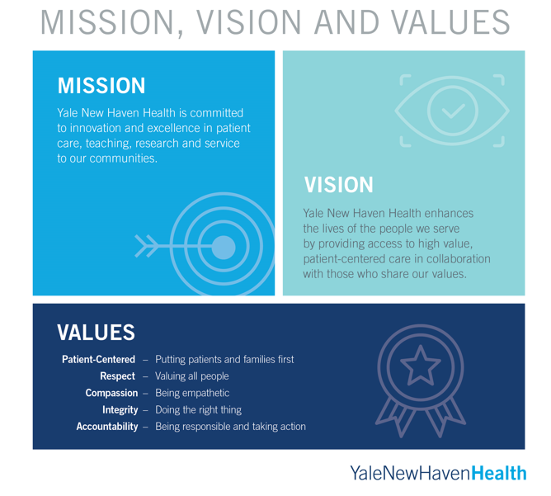

Slide 6


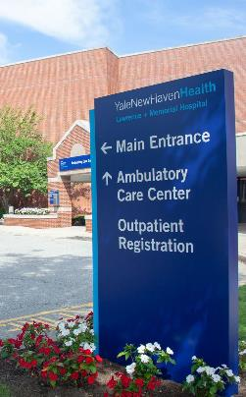
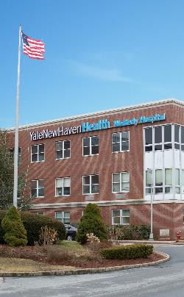


Yale New Haven Health
Our Healthcare System & Vision for Future
Bridgeport Hospital
Greenwich Hospital
Lawrence + Memorial Hospital
Westerly Hospital
Yale New Haven Hospital
Northeast Medical Group

Slide 7












Yale New Haven Health / Snapshot (FY 2024)
Five Hospitals
Yale New Haven Hospital, Bridgeport Hospital, Greenwich Hospital, Lawrence + Memorial Hospital, Westerly Hospital
31,115 Employees
$7.1 Billion in
Operating Revenue
248 Sites
23 Urgent Care Locations
3.5 Million Outpatient Encounters
2,681 Licensed Beds
8,034 Medical Staff
Includes 1,520 Residents and Fellows
126,968 Inpatient Cases
Academic Affiliation
System Physician Foundation
Yale School of Medicine
Northeast Medical Group, with over 1,500 providers
7

Slide 8
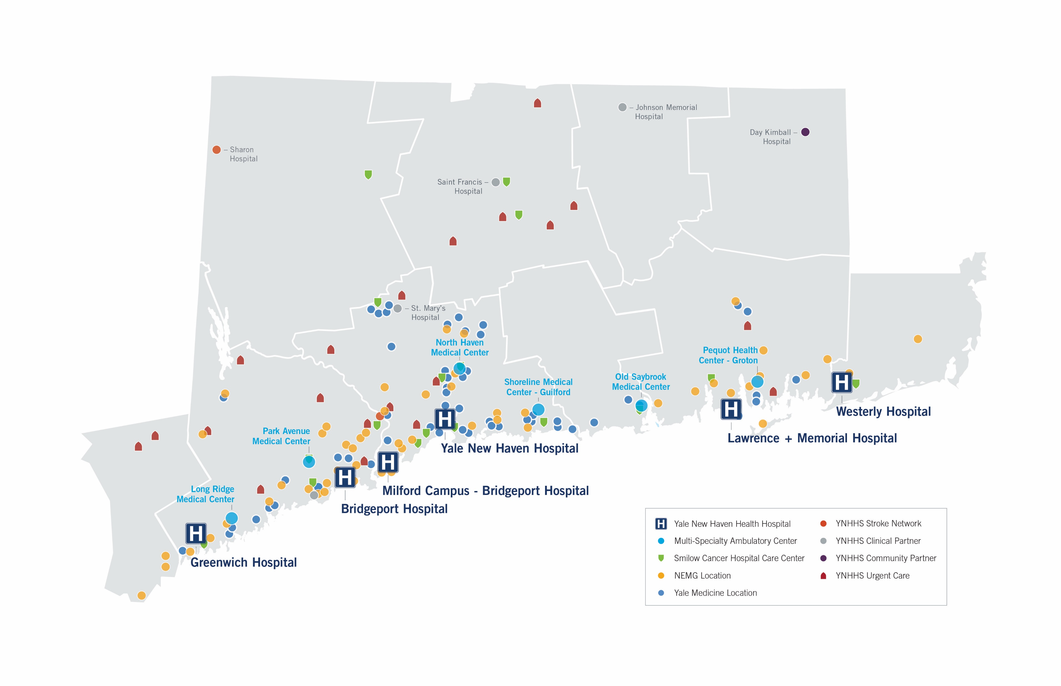
YNHHS / Throughout Our Communities

Slide 9










Employer of Choice & Provider of Choice

Slide 10
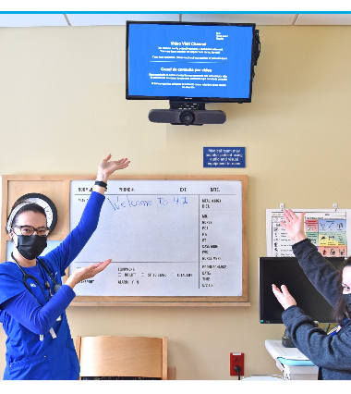
Getting Started (Proof of Concept)
  Decision made to take advantage of technology and workflows utilized during the pandemic.
  At 3 of our 5 campuses, an audio-visual solution was deployed during the pandemic that allowed for the clinical team and family to interact with the patient via the patient's tv.
  Virtual Care team partnered with Hospital Nurse Leaders
  Spoke with and assessed other health systems who already initiated a virtual care model
  Took a thoughtful approach when determining the first Virtual Nurse Candidate(s): knowledge/experience, interaction with patients, staff, and technology

Slide 11

Getting Started (Proof of Concept)
  Determine the Initial Scope
  Partner with Nurse Leaders and Staff
  1 RN for 2 Med/Surg Units (1:50 ratio)
  Support Admission and Discharges
  Determine Virtual Nurse support schedule
  7am-7pm
  Ideally 7 days a week but started with 1 RN Monday—Friday
  Communication of the Virtual Nurse’s schedule and Unit Partnership is Critical

Slide 12
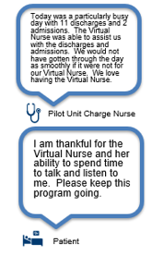
Getting Started – Initial Lessons
  Ensuring bedside teams have confidence in the workflows, that the Virtual Nurse is part of the care team and is used effectively:
  Virtual Nurse outreach
  Requires oversight of nurse manager in first few weeks
  Establish communication process
  Initial Outcomes on the units with a Virtual Nurse:
  Patient Satisfaction increased
  Nursing team satisfaction
  Technology limitations recognized: Need Omnichannel Solution for multiple workflows and use cases

Slide 13
Getting Started – Initial Lessons
Staffing
Quickly realized that virtual nursing coverage needs to be comprehensive
Metrics
Established key targets for metrics to evaluate the success of the Virtual Nurse Implementation
Governance
Need a pathway for scaling technical and operational requirements
Expanded coverage of 1 virtual nurse/4 days per week to the current model (7days/week, 7am—7pm)
Determine the stakeholders for the metric accountability

Slide 14

Setting the Foundation
  Health System Standardization
    Policies
    Procedures
    Equipment & Supplies
  All campuses utilize the same instance of Epic
  Centralize the location for the Virtual Care Team

Slide 15











Clinical Care Redesign: Virtual Nursing
Care Teams
Virtual Nurse
Benefits
Metrics
KEY TAKEAWAY:
The patient remains at the center of all care
Patient
& Family
Leveraging audio and visual technology across multiple disciplines
Virtual Nurse
Potential scope of work and applications
Family
Hourly Rounding
Audits
Coaching
Education
Critical Results
Admission & Discharge
Benefits the patient, staff & families in many ways
Experienced RN Retention
Broader Recruitment
Better Outcomes
Reduce Burnout
Applicable to future teams
Improved performance and outcomes
Patient Satisfaction
Employee Satisfaction
Employee Turnover
Nursing Sensitive Outcomes
Key Quality Metrics

Slide 16



Our Top Goals
Support Timely admissions and discharges
Decrease the time from discharge order to discharge time
Improve 11am discharges
Percentage of admissions discharges supported by the Virtual Nurse
Improve Staff Retention
Reduce administrative tasks for the Bedside RN
Alternative staffing & scheduling option (Hybrid RN Role): 2 shifts as the Virtual Nurse and 1 shift at the Bedside
Patient Satisfaction
Support an optimum patient experience
Improve patient outcomes

Slide 17
Virtual Care Infrastructure:
Strategy & Vision
Business Plan and Value Drivers
Virtual Care Model Timeline
Committee Structure/Governance

Slide 18




Virtual Care Platform: Strategy and Objectives
Care Model Innovation: Harnessing Digital Health Applications to improve access, patient experience and care network allowing for differentiation in our clinical offerings
Modern Digital Health Hub: Omnichannel technology solution integrated with Epic to support all Digital Health Programs to foster innovation and collaboration within one platform
Joy in Practice: Promote greater collaboration and learning across platforms to promote continuous learning and innovation including a focus on our cutting-edge clinical research
Patient Experience: Improve patient experience scores and provide timely care to deliver exceptional quality and value

Slide 19
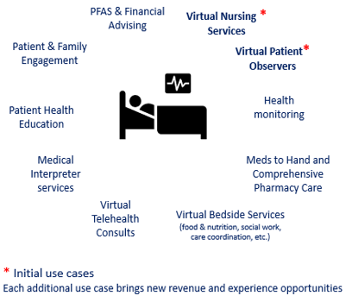
Vision for Inpatient Virtual Care Model
Vision Statement
Digitally Enabled Clinical Program Portfolio
Develop a unified technology platform for clinical programs
Incorporate an AI-enabled workflows to enhance patient care
Streamline operations and provide advanced analytics.
Ensure centralized governance and standard metrics.
Focus on patient and family engagement in care.
AI-enabled workflows

Slide 20
Virtual Care Model Journey Timeline
September 2022
Virtual Observation in place at YNHH Pediatric Emergency Department
(25 devices)
December 2023
Initiated Virtual Care Model at Lawrence Memorial Hospital
Started with 2 units covered by 1 Virtual Nurse
July 2024
Live on 6 units at Lawrence Memorial Hospital
2025
Approved for 400 Med-Surg beds at Yale New Haven Hospital
April 2023
Initiated Virtual Care Model at Bridgeport Hospital
Started with 2 units covered by 1 Virtual Nurse
June 2024
Live on 9 units at Bridgeport Hospital
August 2024
Yale New Haven Hospital - Live on 2 units utilizing an omnichannel solution for Virtual Nursing and Virtual Observation
Utilizing an in-room
Audio-Video visit technology solution

Slide 21



Setting up for success – Virtual Nursing
Virtual nurses
At least two years of Med-Surg experience, preceptor and charge capable.
Current staff of the units going virtual.
Staffing MODEL
Hybrid positions consisting of two virtual shifts and one on-unit shift per week.
Coverage from 7am – 7pm, 7-days a week, including weekends and holidays.
Unit coverage
One Virtual Nurse covers two units, with the ability to cross-cover other Virtual Nurses as needed.
Consistent Virtual Nurses covering the same units.
Communication
Clear and easy communication pathways between the Virtual Nurse and bedside teams.
Metrics
Created a structure that includes Nursing Leadership, and Informatics with the purpose of establishing clear, definable and achievable metrics.
Optimizations
Build tools within the electronic medical record to keep the Virtual Nursing workflow as similar to a bedside nurse as possible.

Slide 22
Technology Decision Points
Internal Request for Proposals (RFP)
Vetted Vendors with the focus on Omnichannel Solution for multiple use cases using an internal rubric
    Virtual Nursing, Virtual Observation, Tele-Consults
    AI Embedded in platform and AI use cases (i.e. Fall Risk)
    Ability to incorporate Interpreter Services
    Hardware and Software
    Technology Support Models
    Dashboard and Metrics
Clinical Comparison of technology occurred during pilot phases

Slide 23
Inpatient Virtual Care business planning and development
SMART AIM
Primary Key Drivers
Interventions
Implement a comprehensive inpatient virtual care solution for YNHHS utilizing an omni-channel technology solution
Initial workflows to include Virtual Observation (1:12 ratio) and Virtual Nursing (1:50 ratio) to support admissions, patient education, hourly rounding and discharge
60-day user acceptance before full roll-out
Staff Outcomes and Satisfaction
Virtual Nurse for Admission and Discharge Documentation
Staff Retention/Recruitment
Order Technology
Install Technology
Patient Outcomes and Satisfaction ​
11am Discharges,
Press Ganey
HCAHPS
Develop operational workflows
Train staff on technology
Scripting for education
ROI
Decrease Sitter Spend
Decrease Travelers
Decrease Incremental OT
Implement change management process
Identify and track metrics ​
Quality & Safety
Decrease Fall Risk

Slide 24
Roles and Responsibilities
Role | Responsibility
CNOs | Leadership oversight for Virtual Nursing within their hospital
Accountable Leads | Executive Directors within nursing to provide leadership and direction for nursing workflows; Working in collaboration with IT Virtual Care team
Virtual Care Team Support Leads | Workflow experts Workflow development, training development Virtual Nursing staffing oversight in collaboration with nursing managers Metric Dashboard development Co-lead Business Planning and Development with stakeholders
Project Managers | Clinical Workflow experts Collaborate on Workflow development Collaborate on job description, training materials, standard operating procedures, playbooks and other materials On-site with Bedside teams at go live
Clinical Leads – Nursing | Ensure effective use of Virtual Nurse by bedside teams Lead manager between beside/virtual teams Ensures metrics adherence
Technical Support | Implementation of technical devices and ongoing technical support
Reporting/Data Analytics | Create metrics and reporting; Works closely with virtual care team to develop and then vetted thru the committee structure

Slide 25
Governance Structure for Virtual Nursing Initiative
Nursing Driven
Virtual Nursing Executive Steering Committee
Re-Imagining Nursing Care Model Redesign Pillar Team
Project scope, goals & objectives
Budget, expenses, resources & productivity
Establish outcome measures/KPIs
Policies
Virtual Nursing Strategy Working Group
Integrate technology into nursing practice
Evaluate opportunities to expand activities of virtual nursing roles
Ensure alignment across system & with interprofessional team
Clinical Operations Group
Oversee project execution
Integrate processes into daily operations
Ensure engagement of clinical nurses (Nursing Professional Governance)
Role descriptions, hiring criteria, Competency Based Orientation (CBO)
Role responsibilities
Protocols & procedures
Unit specific processes

Slide 26
Workflow Operations:
Day in the Life with the Virtual Care Model
Staffing Models
Implementation Playbook

Slide 27
Admissions & Discharge focus
Virtual Nurse
Admissions
Discharge planning
Discharge education
Chart audits
Nurse mentoring
Patient acuity support
Patient rounding
Patient education
Care plan updates
Pain reassessment
Interdisciplinary rounds
Bedside Nurse
Physical assessment
Medication administration
Hands-on care
Procedural care
Admission & Discharge focus
Anticipates admissions from the ED
Perform the admission documentation (could be in the ED or inpatient room)
Patient orientation to the room
Handoff to floor nurse
Anticipates discharges from chart review, charge nurse, and huddles
Chart review to ensure no discharge delays
Patient discharge instructions

Slide 28
Day in the Life - Virtual Nurse
7-7:30AM
Sign into Virtual Nursing role
Check in with Charge Nurse
Review established early discharges
8-11AM
Actively prioritize and complete discharges
Continue to monitor unit ADT events for new discharge orders
12:45-1:30PM
Connect with the Charge Nurse for both units to identify next day discharges
Make note of next day discharges for tomorrows Virtual Nurse
Additional tasks
Patient Rounding
Procedure Checklist
MRI Questionnaire
Interpreter Services
Pain Re-Assessment
7:30-8AM
Review Patient Lists for the units being covered
Review Unit Manager for recent admissions or transfers
11-12PM
Check in with the Charge Nurse for each unit
2-7PM
Assist with admissions, transfers, and discharges on the units
Assist with additional tasks as applicable

Slide 29
Virtual Nursing Staffing Models – Current State
Hospital 1
Report up through Director of Nursing
Dotted line report to Nurse Manager
Hybrid Virtual Nurses
1 Virtual Nurse/2 Units
9 Units
Local cost center
Hospital 2
Report up through Float Pool Nurse Manager
Approval obtained from the union
Hybrid Virtual Nurses
1 Virtual Nurse/2 Units
6 Units
Local Float Pool cost center
Hospital 3
Nurses supplied from the units
Backfill via request
Report through Nurse Manager of home unit
Hybrid Virtual Nurses
1Virtual Nurse/2 Units
2 Units
(Expanding to 400 beds)
Local Unit cost center

Slide 30
Virtual Care Playbook
Planning Week 1
Planning Week 2-3
Operations
Meet with Hospital Nursing Leadership
Identify Units
Establish Accountability Leader
Clinical Operations
Virtual Nurse job description
Identify Unit Key Stakeholders
Operations
Meet with Hospital Nursing Leadership
Meet 1:1 with Unit Managers
Identify space for the Hub
Technical
Quality of check In-Room hardware
Clinical Operations
Identify any specialty training (ex: neuro)
Identify Staff
Go- Live
Post-Implementation Week 2-3
Operations
Daily Check-In Team Huddle (15 minutes)
Technical
On-going maintenance and monitoring
Metrics
Track and measure metrics
Operations
Daily Check-In Team Huddle (15 minutes)
Technical
On-going maintenance and monitoring
Metrics
Track and measure metrics
We have developed a template for implementation of Inpatient Virtual Care programs to ensure timely completion of tasks, standardized programs, and coordination among the teams

Slide 31
Metrics & Next Steps
Outcomes
Future Vision
Lessons Learned

Slide 32













Measuring Success | Setting the Stage for Virtual Care
Key Performance metrics
Decrease time from discharge order to discharge time
Integrate Virtual Nurse into admission workflow
90-day Target: 15 min reduction
90-day Target: ≥ 90% admissions by VN
Increase pre-11am discharges
Integrate Virtual Nurse into discharge workflow
90-day Target: +3%
90-day Target: ≥ 90% discharges by VN
Virtual Observation utilization
Ratio: 1 Observer to 12 Patients
Decrease patient falls and falls with injury
Target: 10% reduction
Decrease incidental overtime
Target: 5% reduction
Investigational metrics
Improve completion compliance of “Required Admission” documentation
Improved patient and family satisfaction
Great catches
Increased nurse satisfaction
Staff Survey
Increased percentages of individualized care plans and care plan completion rate
Camera time / hours supporting the bedside

Slide 33
Results (Fiscal Year to Date)
Decreasing time from order to discharge
Increasing the percentage of 11am discharge
Decreasing incidental overtime
Decreased by over $1800
Decreased by 26 minutes
Improved by 3.5%

Slide 34
Utilization:
Percentage of Admissions completed by a Virtual Nurse = 50%
Percentage of Discharges completed by a Virtual Nurse=90%

Slide 35
Patient Story + Feedback
A Virtual Nurse was reassessing a patient’s pain level over video after they had recently received medication to manage their discomfort. On the reassessment, the patient reported, and the Virtual Nurse observed, that the patient was still in significant pain.
The Virtual Nurse reached out to the covering physician to report these findings and a one-time order for Tylenol was placed. The Virtual Nurse connected to the patient over video again with an update that the medication was ordered. The patient informed the Virtual Nurse that they have difficulty swallowing Tylenol pills and would prefer the medication be prepared as a liquid. The Virtual Nurse was able to contact the team again and have it changed to liquid before it was dispensed.
During this time, the bedside nurse assigned to this specific patient was handling a busy assignment and was extremely appreciative of the Virtual Nurses assistance.

Slide 36




Future State – Care Transformation Model
Improve Virtual Nursing Workflow
Optimize established workflows to increase productivity and efficiency
Electronic Medical Record enhancements
Communication pathways
Data collection
Enhanced Workflows
Create more complex workflows as the available technology improves
Dual-Nurse sign-off for high-risk medications
Dual-Nurse skin check
Patient rounding (routine, and at-risk populations)
Incorporate AI resources into the Virtual Nursing
Take advantage of the evolving use of AI in the inpatient nursing settings
Fall risk detection
Pressure injury prevention
Aggression/violent behavior detection
Expand Programs
With lessons learned from Virtual Nursing, expand current virtual care programs
Care Management/Social Work
Pharmacy
Physician consults

Slide 37
Virtual Care Value Drivers
Decreased Inpatient Observer Costs: Improved patient care opportunity and cost savings from utilizing technology to move from a 1:1 observer requirement to 1:12
Incidental Overtime Reduction: Lower documentation burden for bedside nursing reduces the need to stay past end of shift to catch up on pending documentation tasks causing incidental overtime
Vendor Consolidation: Move from single use case technology to omnichannel platform which allows for multiple virtual care workflows
Fall Risk Savings: Increased observation of patients at high risk of falling in the hospital leads to a decrease in falls over time
RN Turnover Reduction/Improved Retention: Increased retention and reduced turnover decreases need for other staffing resources by increasing bedside and virtual nurse satisfaction and flexibility.
Reduction in RN Traveler Expenses: Improved nurse satisfaction and retention will increase the proportion of employed nurses, and increased flexibility of nursing roles can reduce reliance on temporary premium labor. More consistent employed staffing will also reduce variations in care

Slide 38

Virtual Care Hub
Development of a Virtual Team unit that houses all virtual care programs in a system-wide collaborative space
Allows for clinical cross-coverage, and virtual care program standardization
Virtual Nursing
Virtual Observation
Tele-ICU
Future
Central Monitoring Unit
Remote Patient Monitoring
Video-Enabled Rapid Response
Notes:
Centralized to improve standardization
Consistent leadership structure to represent presence at all hospital sites
Combination of resources for optimal efficiency
Common location for collaboration and innovation

Slide 39
Lessons Learned
Take advantage of technology and workflows utilized during the pandemic.
Partner with Nurse Leaders and Staff
Determine metric for success
Don't reinvent the wheel, learn from others experience
Take a thoughtful approach when determining the Virtual Nurse Candidate(s): knowledge/experience, interaction with patients, staff, and technology
Set up regular check-in meetings especially during the go-live weeks with the bedside and virtual team

Slide 40


Quote from HIMSS
“You can’t take the care out of Healthcare. But you can rewire the way it’s delivered --- with intelligence, empathy, and action at every step.”

Slide 41

Discussion

