Slide 1
Using AI to assist in the creation and documentation of nursing care plans in EHR
TAMARA G.R. MACIEIRA, PHD, RN

Slide 2
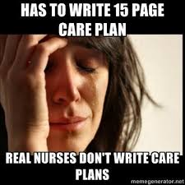
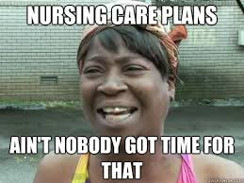
I love care plans!
Notes:
I want to start with a disclaimer… tell my story of why I love care plans
But you probably feel more like this…
And these are all real memes from social media, posted on nursing-related pages

Slide 3
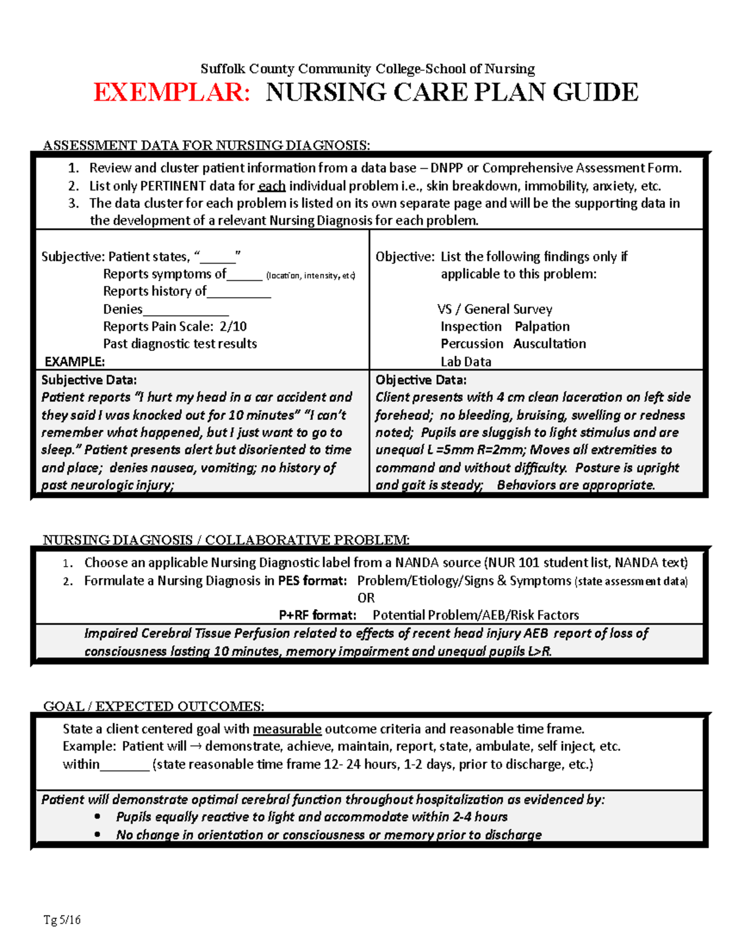
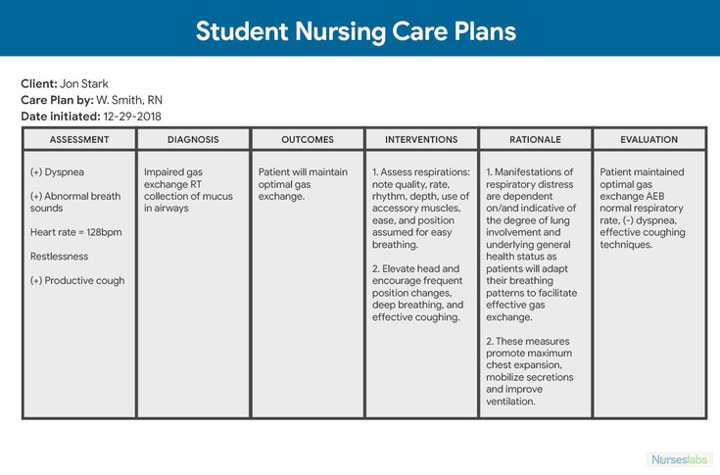
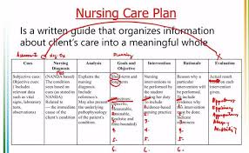
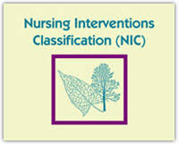
Care plans in nursing school
Notes:
In nursing school, we learn to create these detailed care plans, we learn how they can impact patients, that they are truly made to support and guide nursing practice.
We also learn about nursing terminologies…

Slide 4
WHAT HAPPENS BETWEEN NURSING SCHOOL AND PRACTICE?
Notes:
So what happens between nursing school and practice and we don’t really see the value of care plans anymore?
Maybe give a pause here for the audience to answer

Slide 5
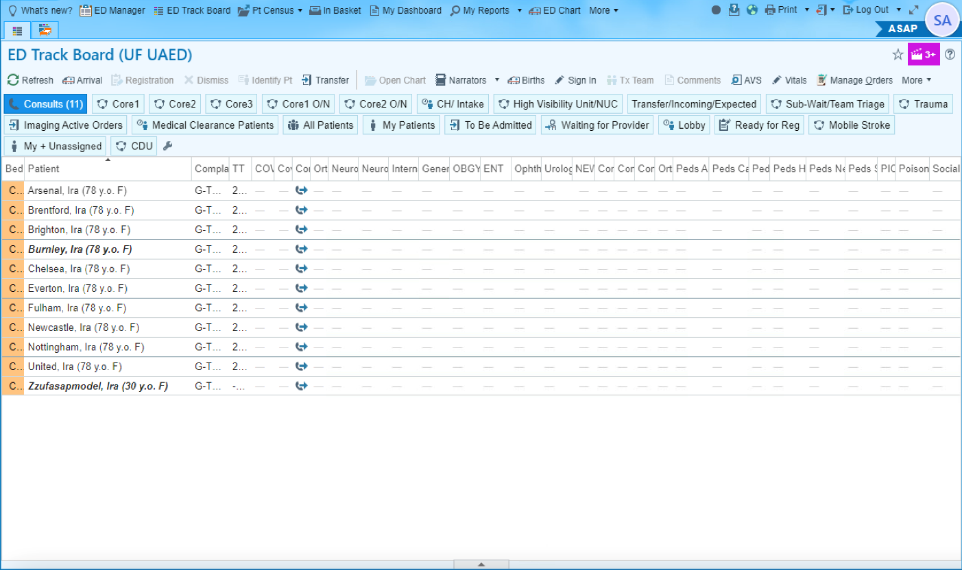
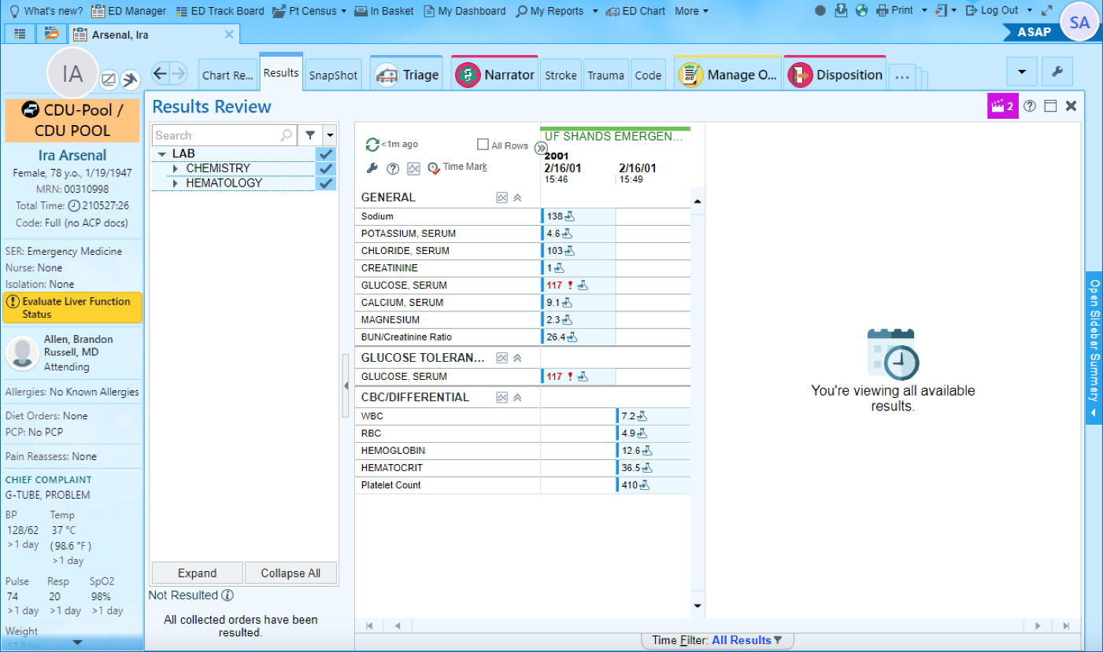
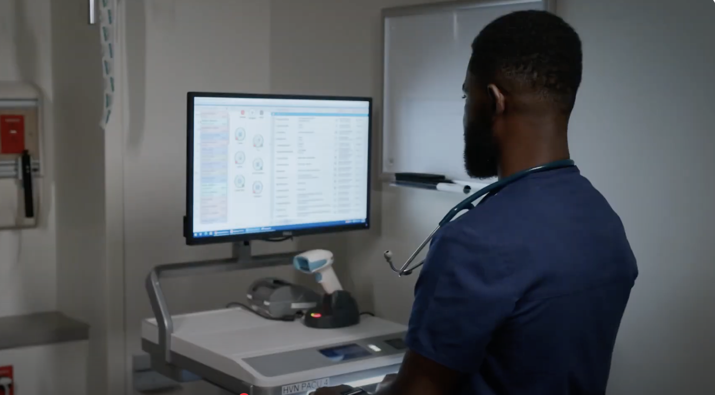
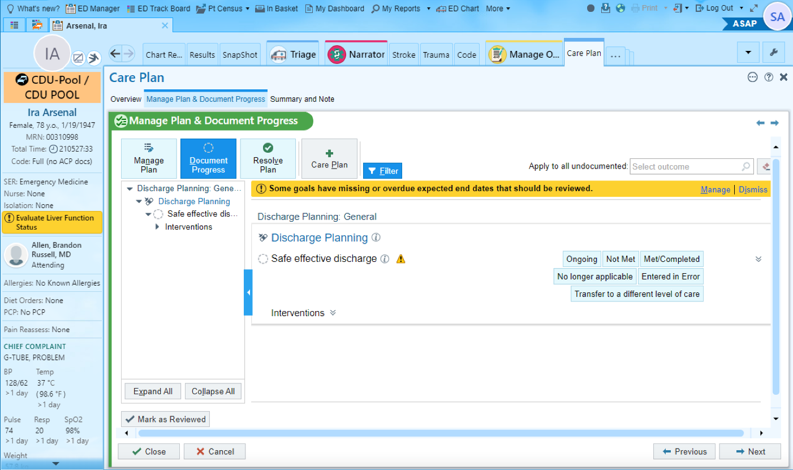
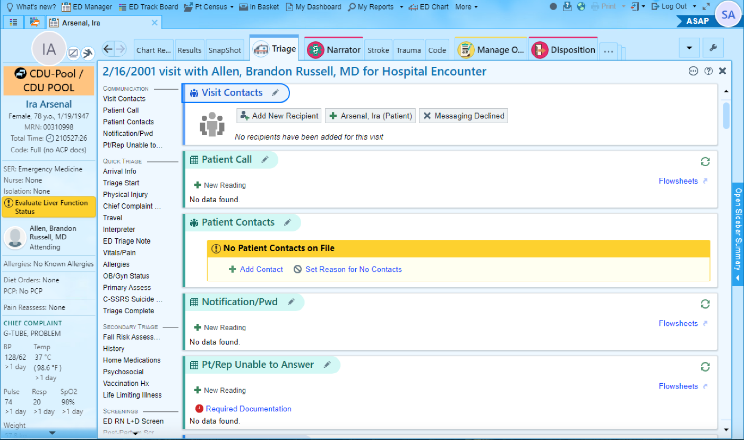
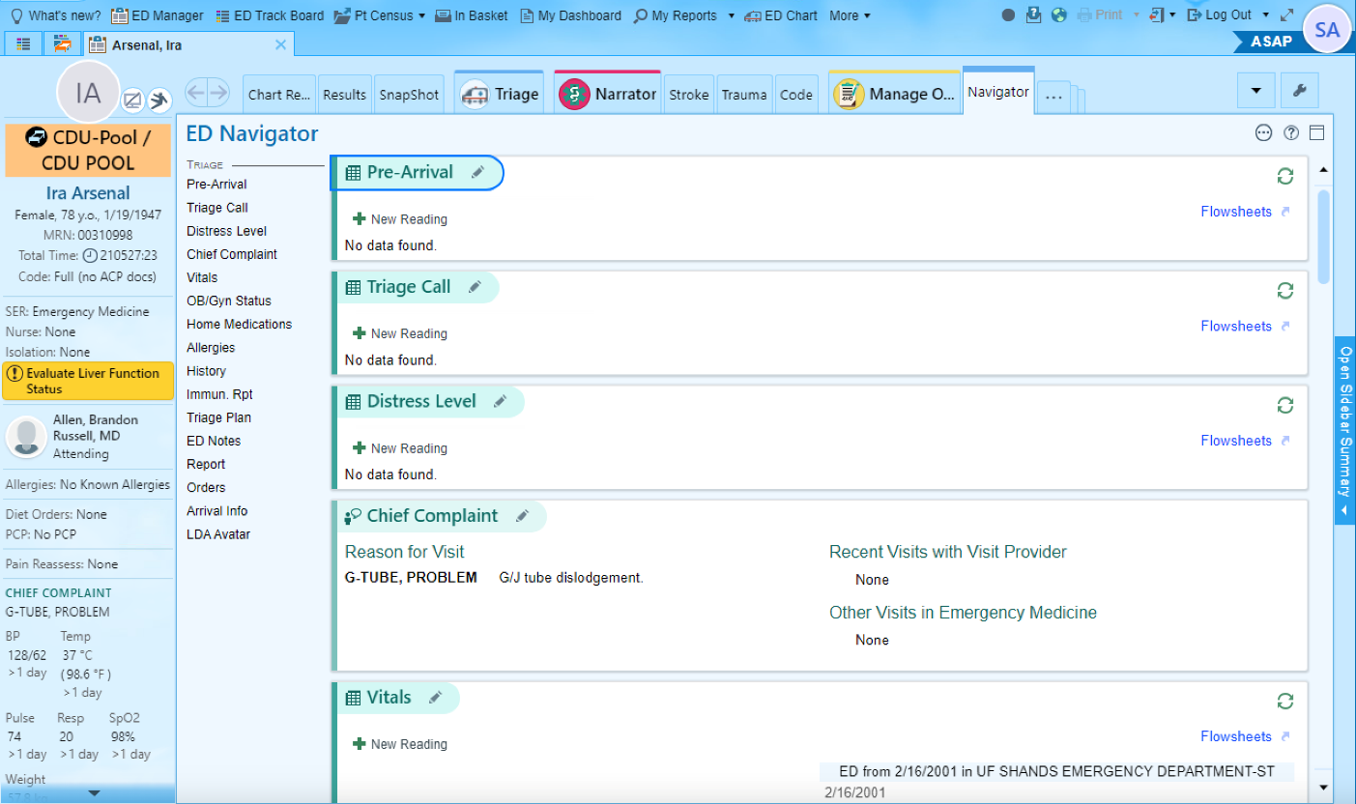
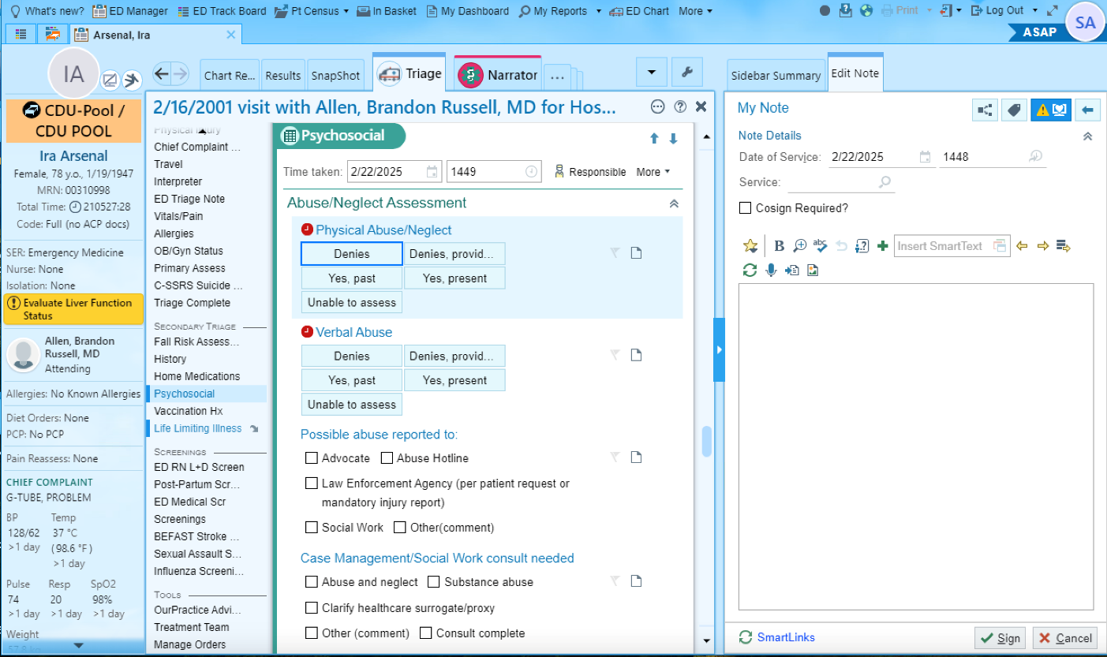
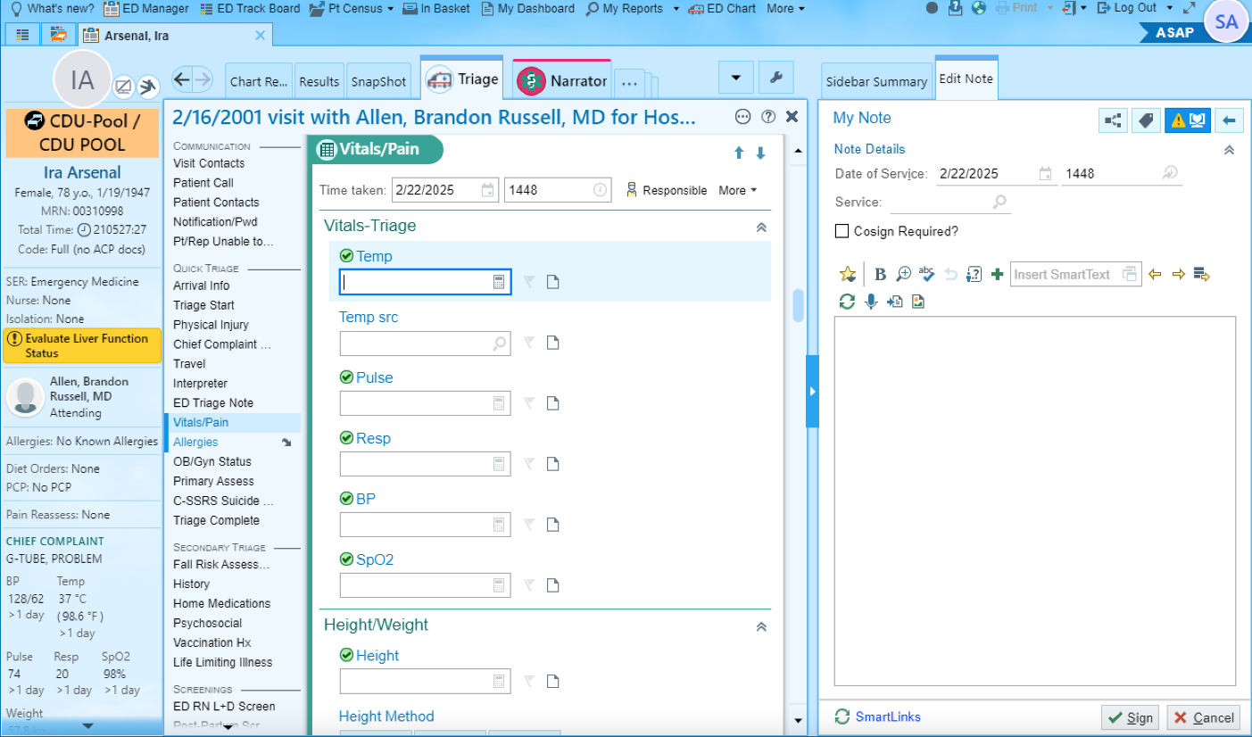
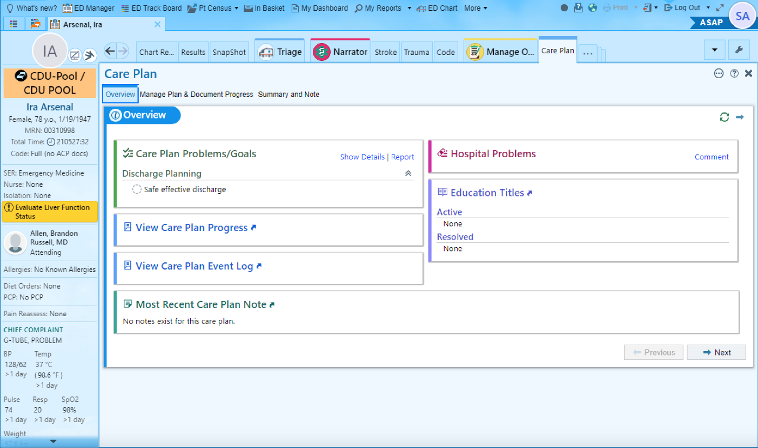
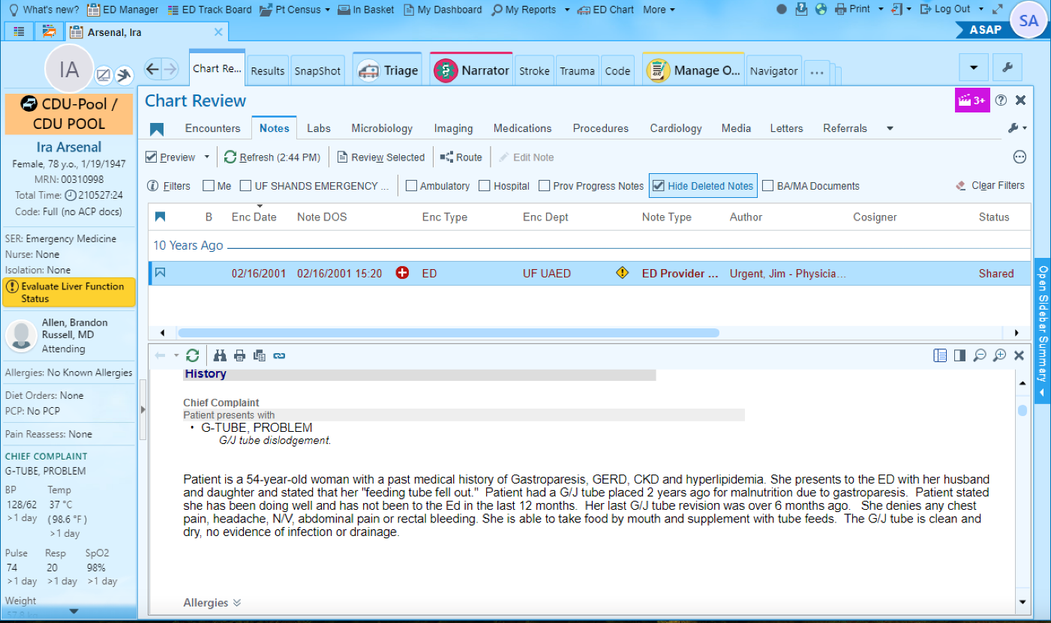
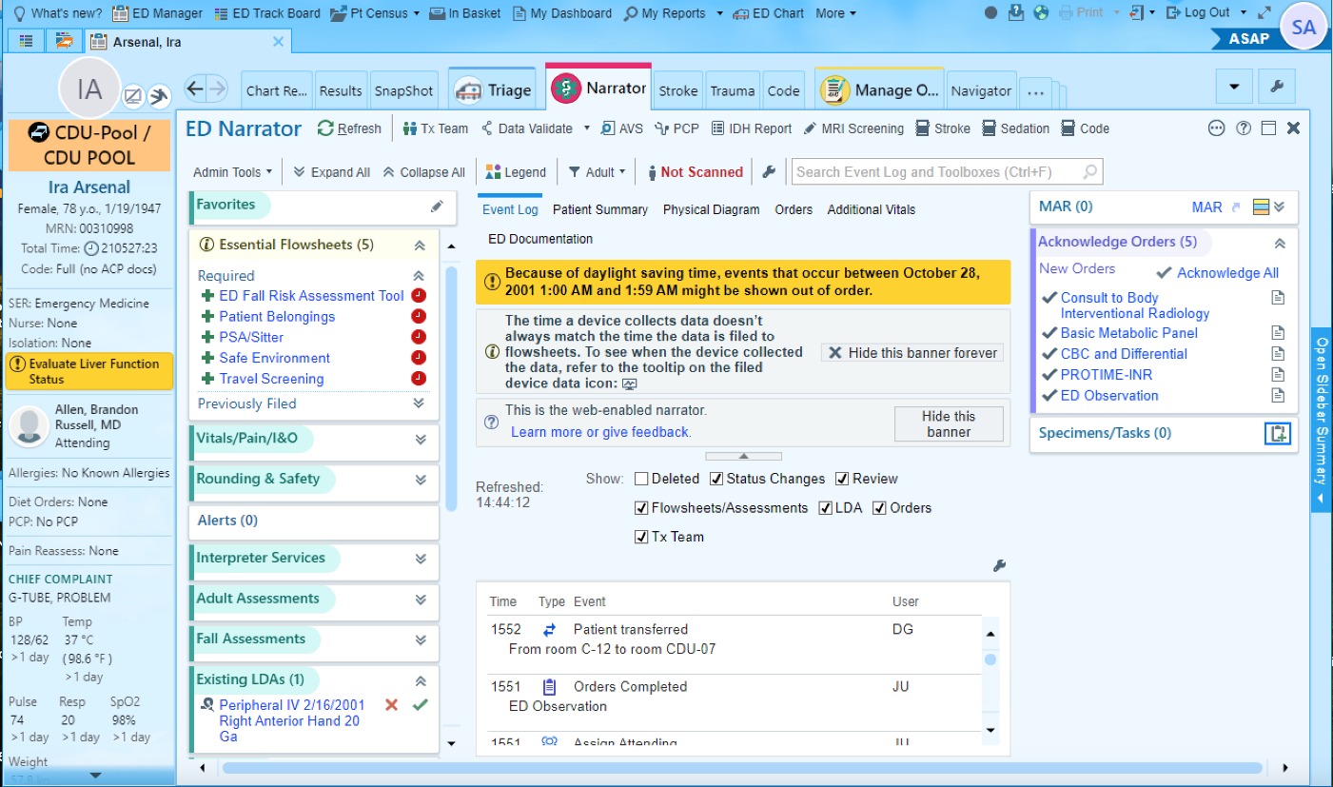
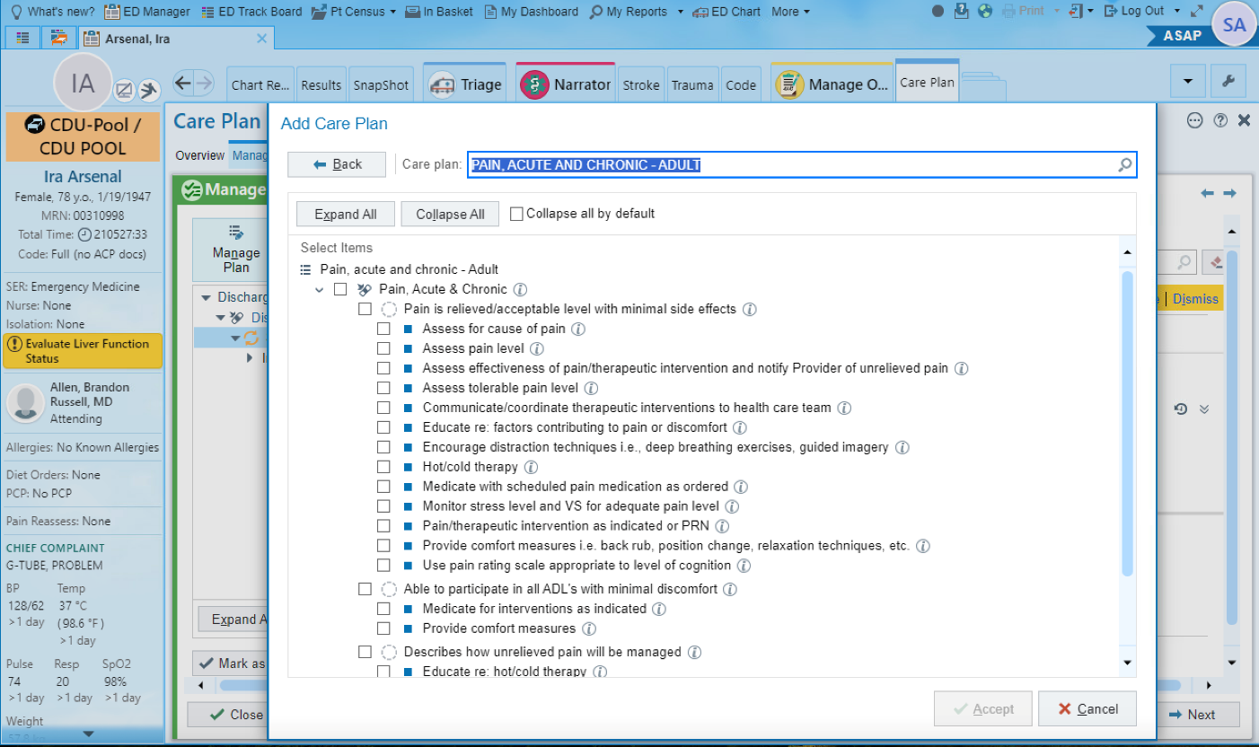
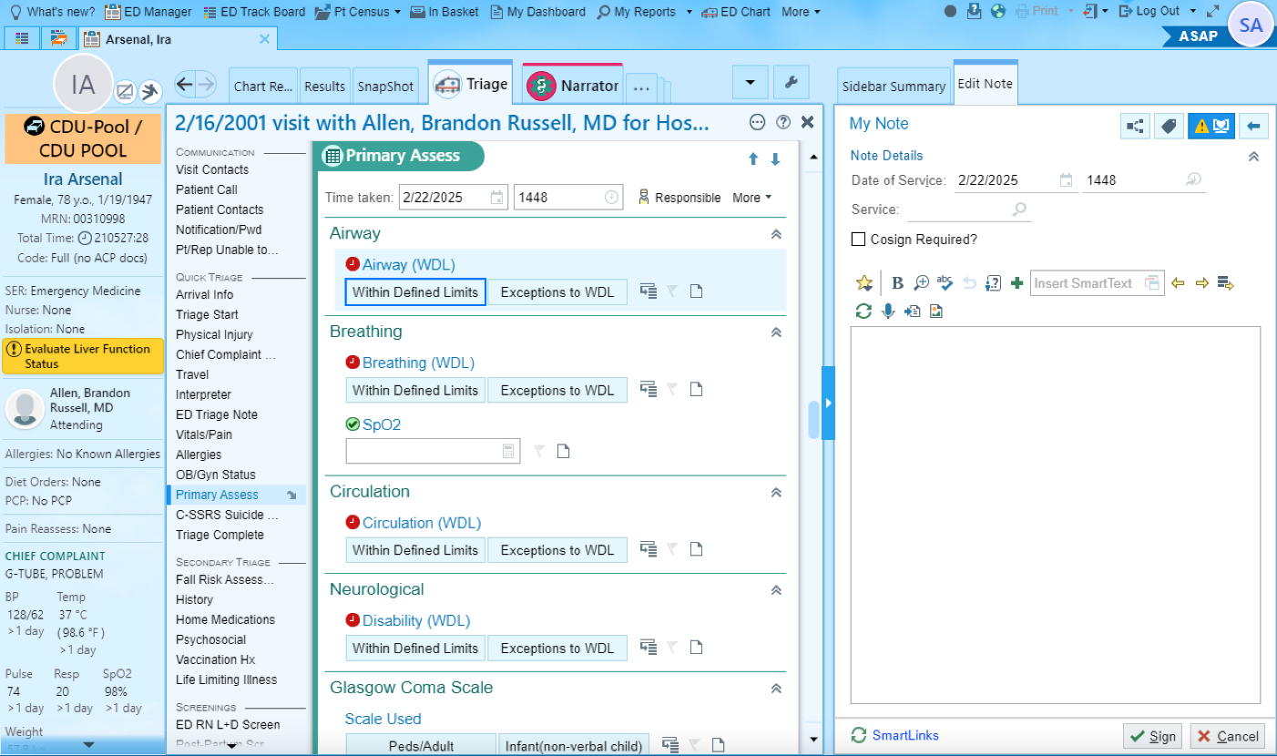
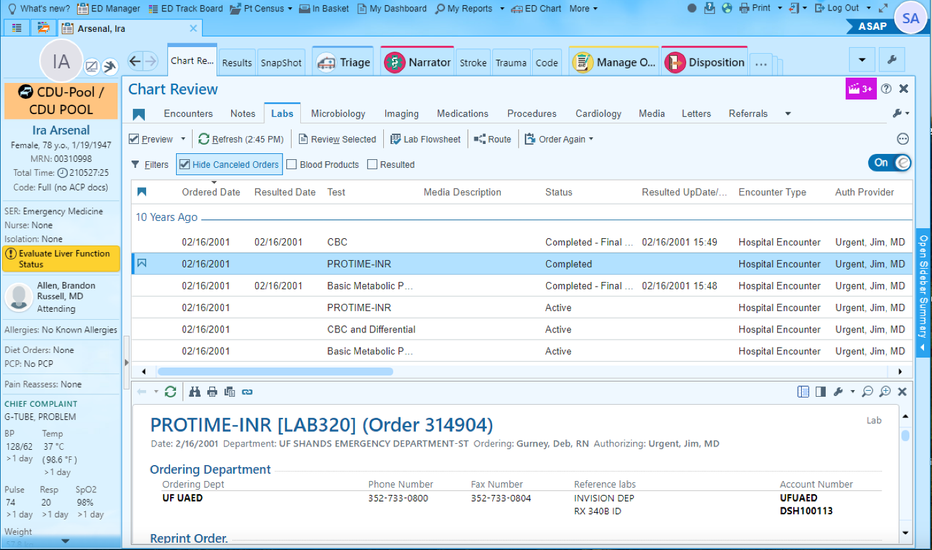
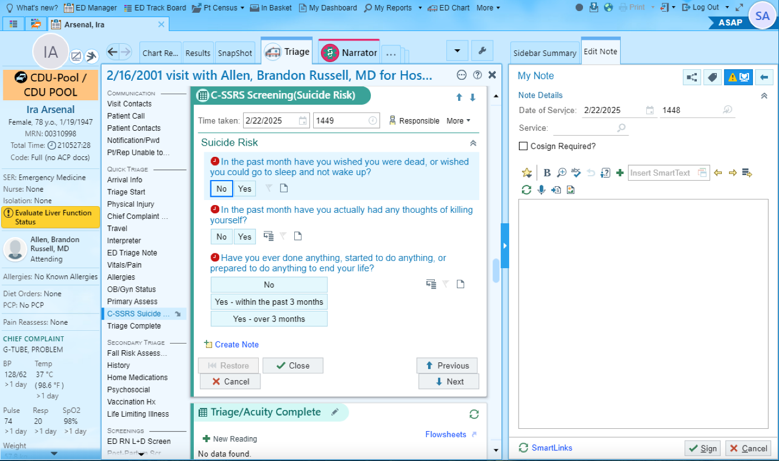
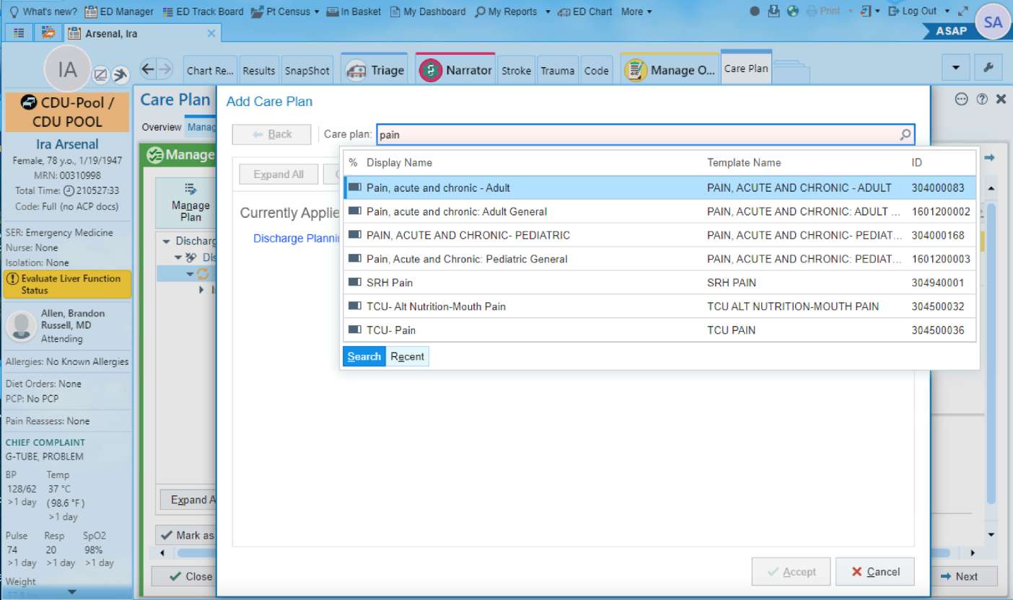
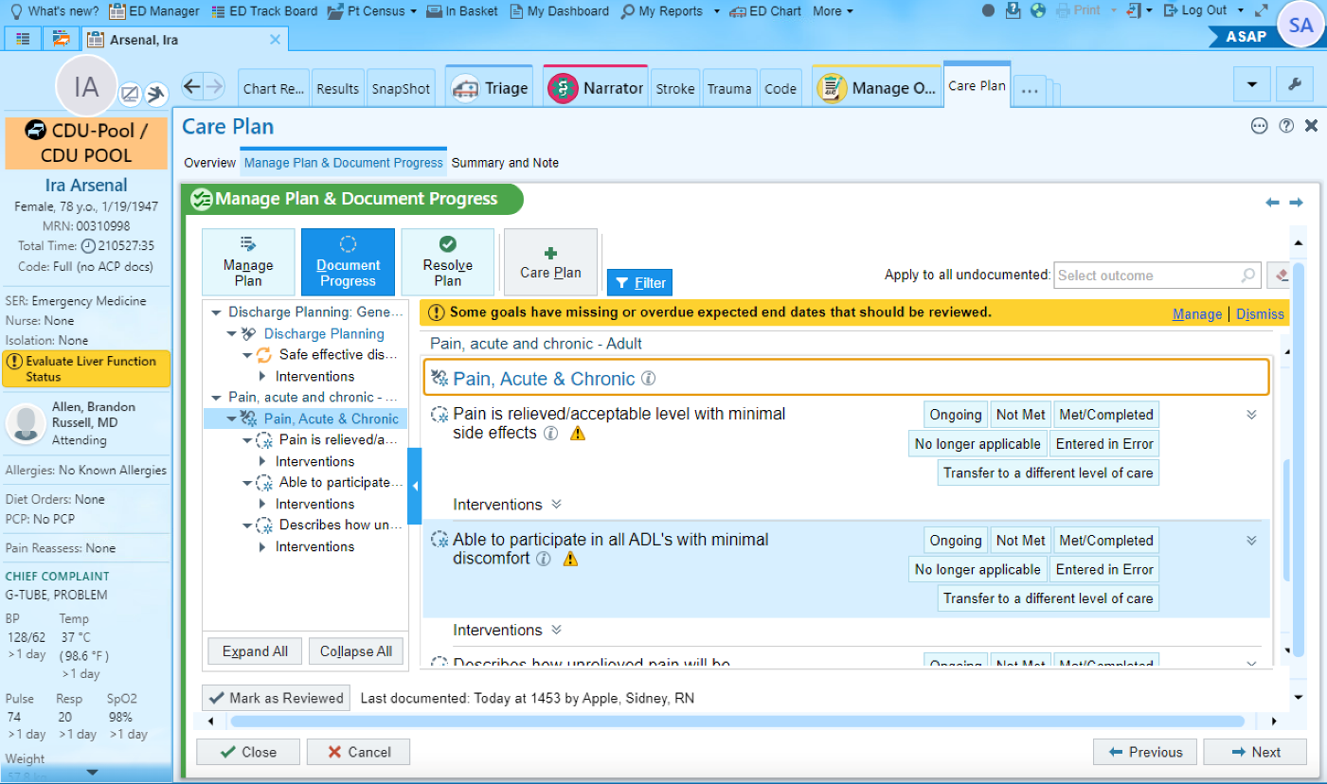
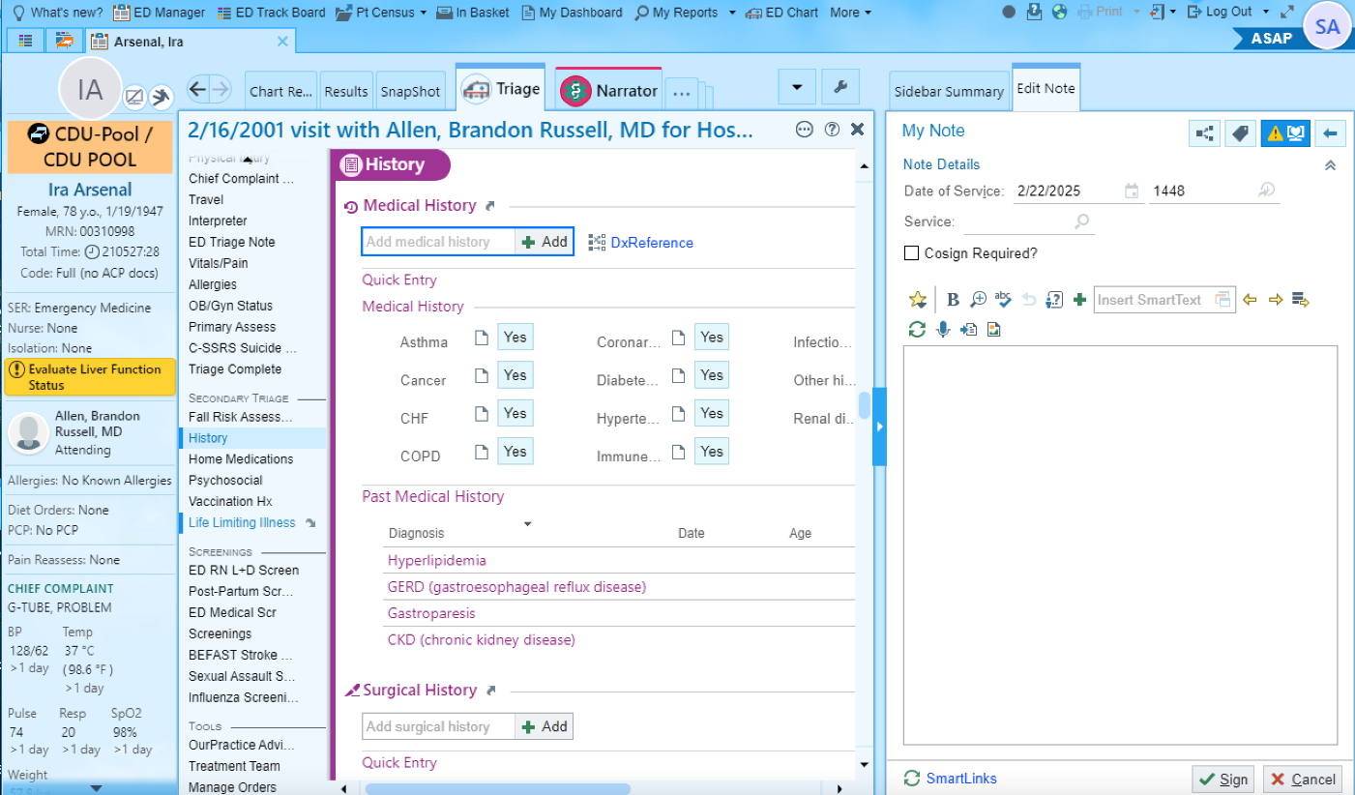
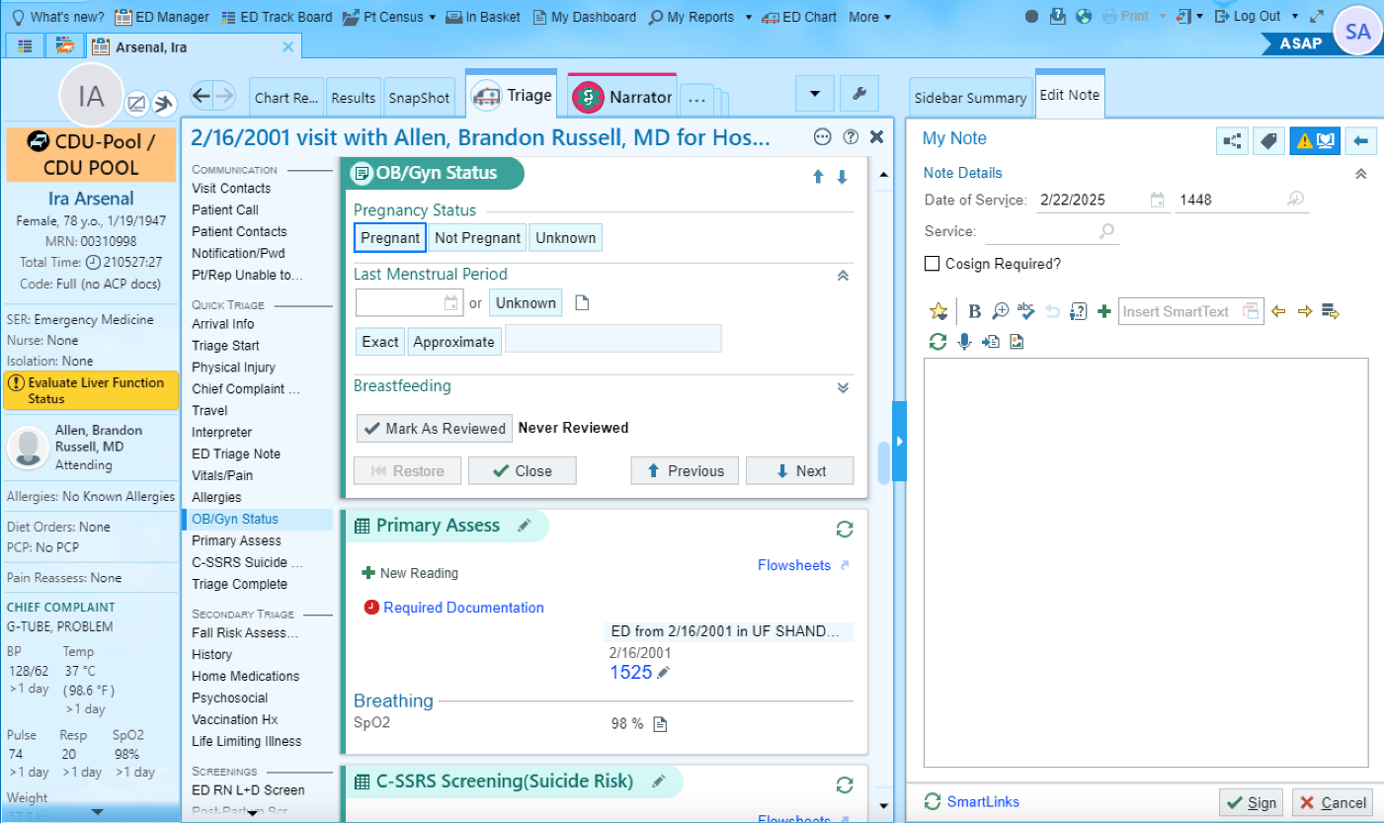
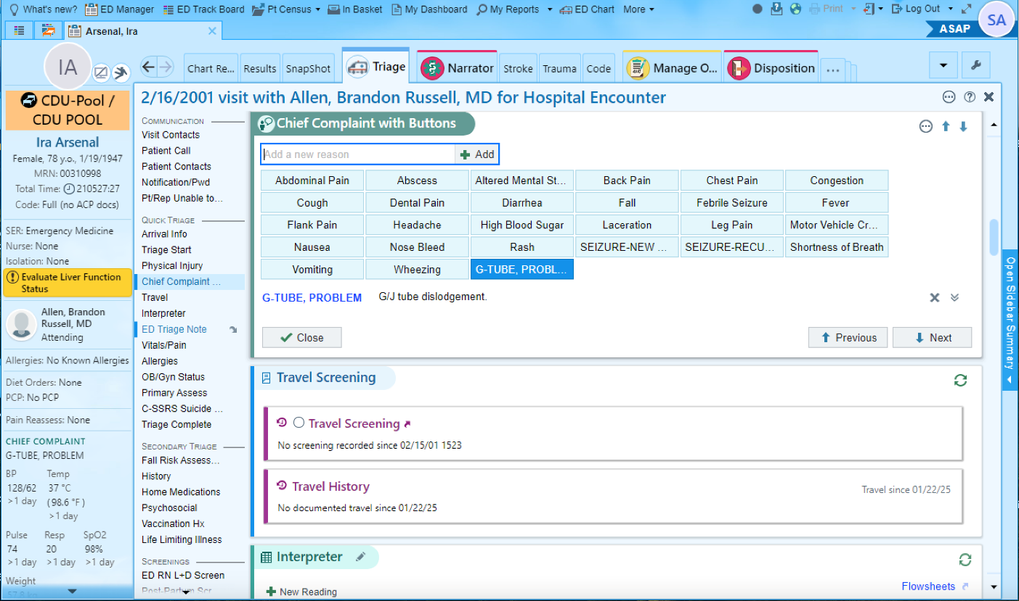
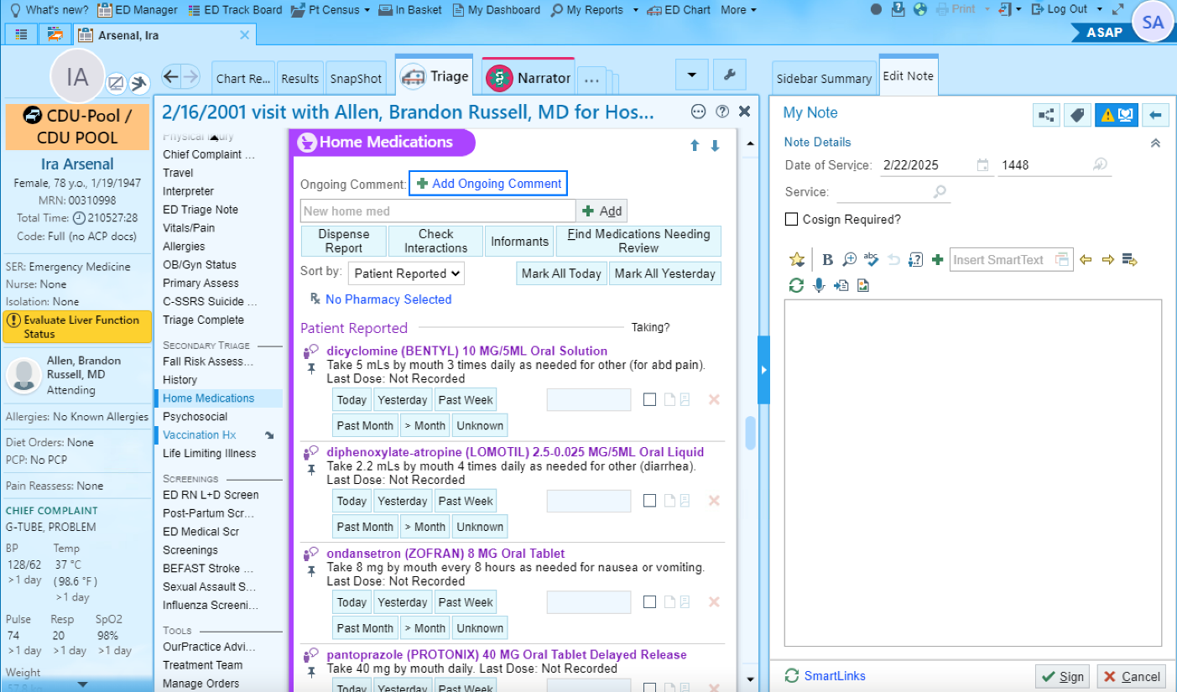
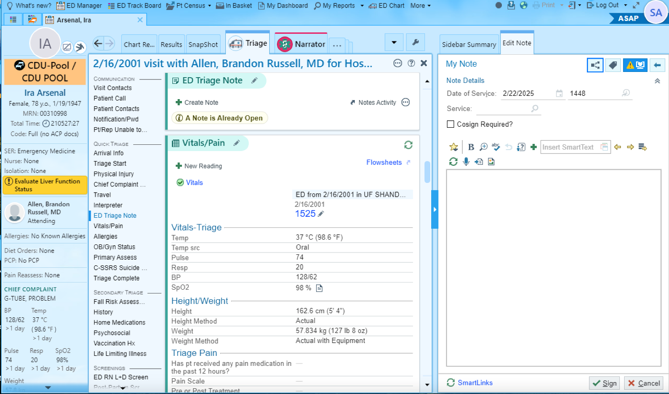
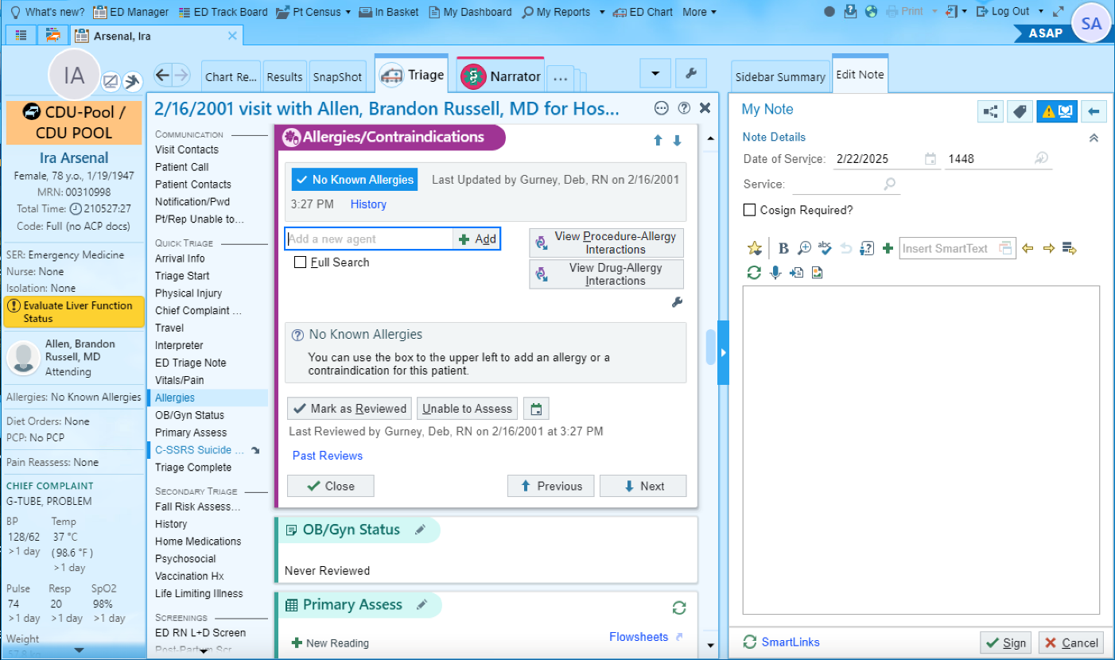
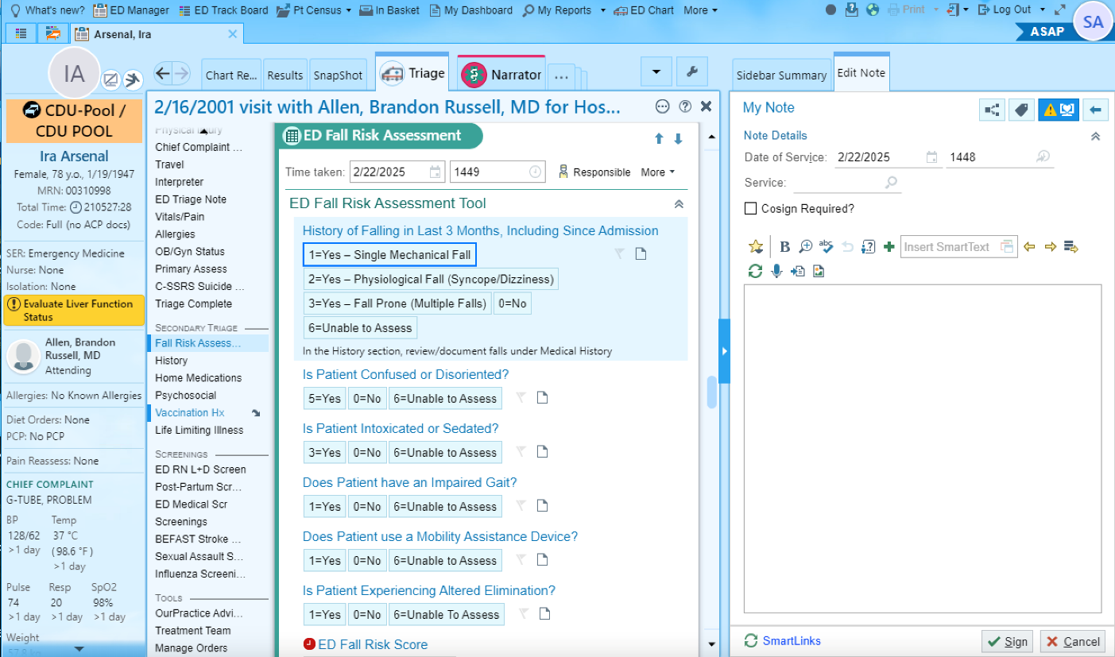
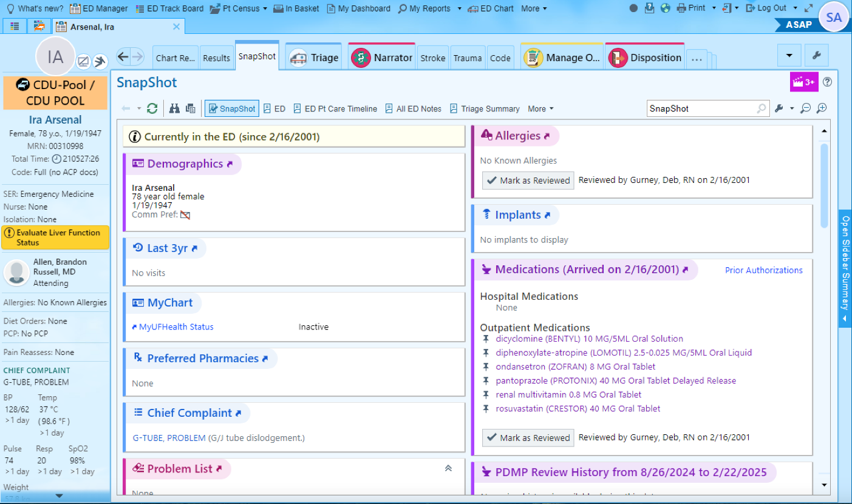
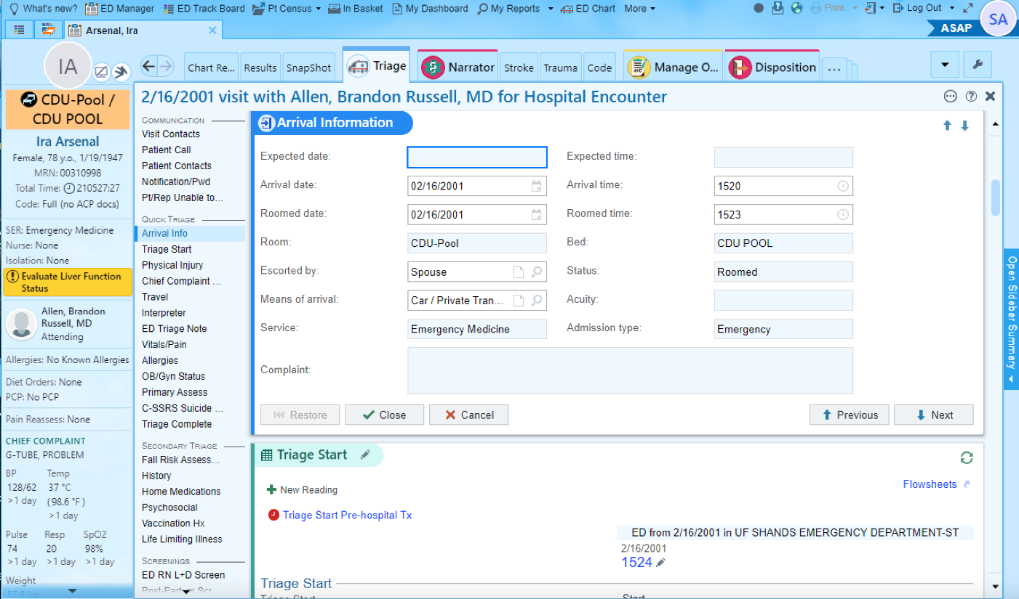
click, click, click…
Notes:
Go quickly to screen 3 to run through the clicks
I am tired just by looking at it? Aren’t you? Can you imagine you as the nurse, taking care of 8 patients, trying to provide all the care they need, and then each time you need to use the electronic health record, you are faced with this…

Slide 6
Nurses are spending 3-4 hrs of their shift in front of computers
Notes:
Could it be that nurses are so focused on computers and have so many things to do that care plan documentation are just not a reality anymore

Slide 7
My EHR does not support “good” nursing documentation!

Slide 8
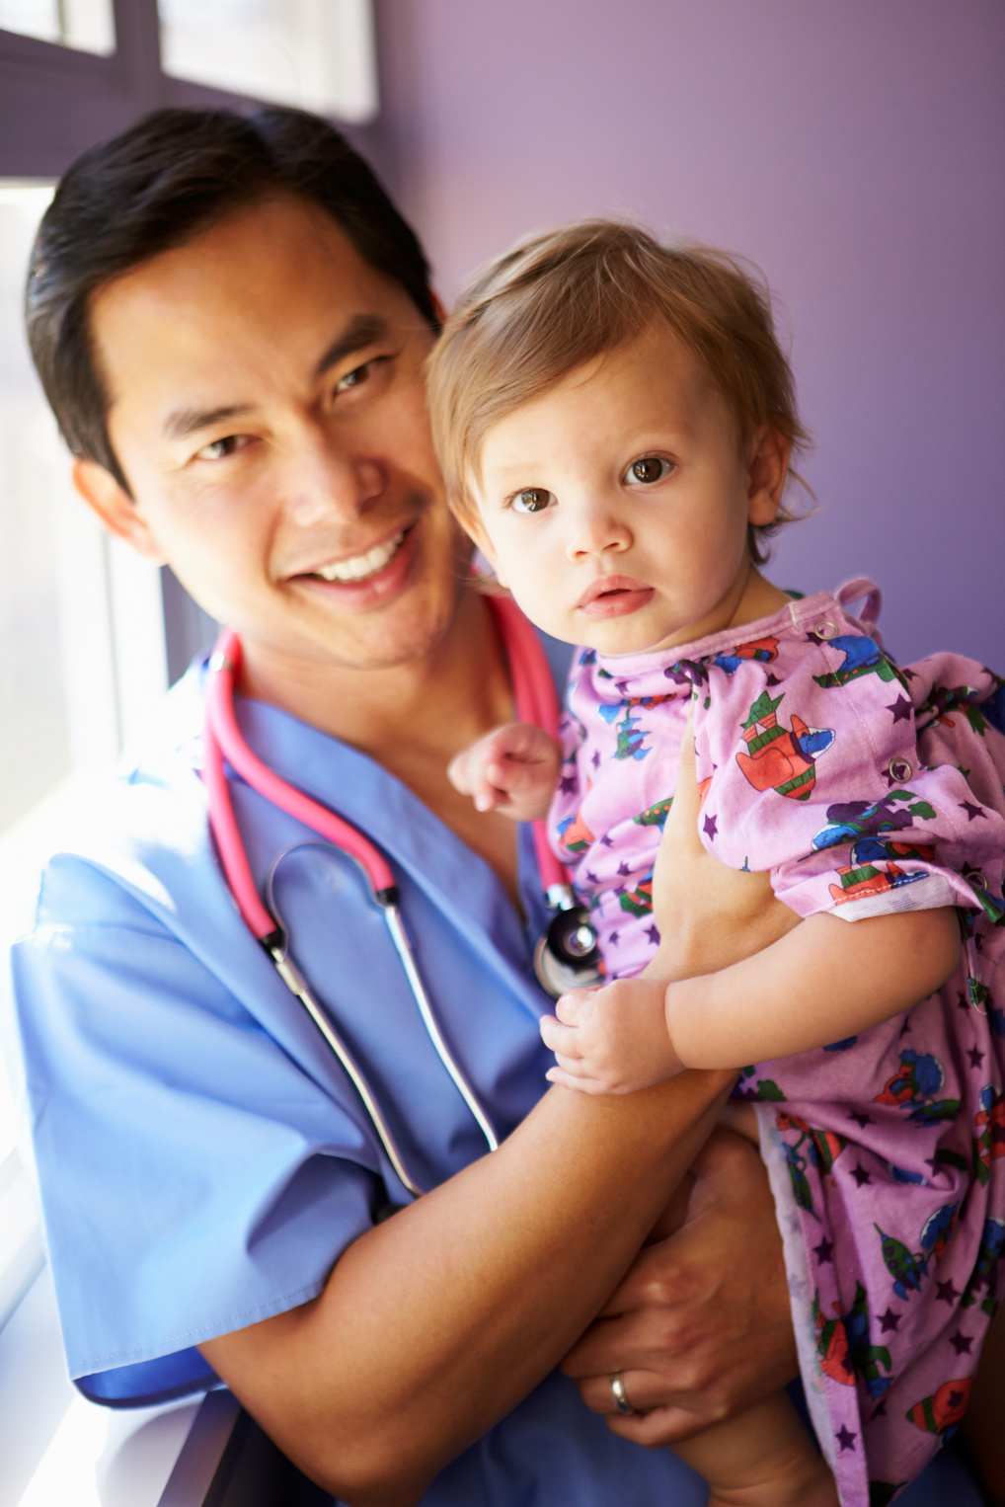
We all create mental care plans!
Notes:
But the thing is… whether you document care plans or not in the EHR, you already do that in your head. You go into a patient’s room with plan. You make your patient assessment and you identify what the patients’ problems are, you know what are the goals you need to achieve, and you know which interventions you should do…
But all that critical thinking does not go to the EHR…

Slide 9
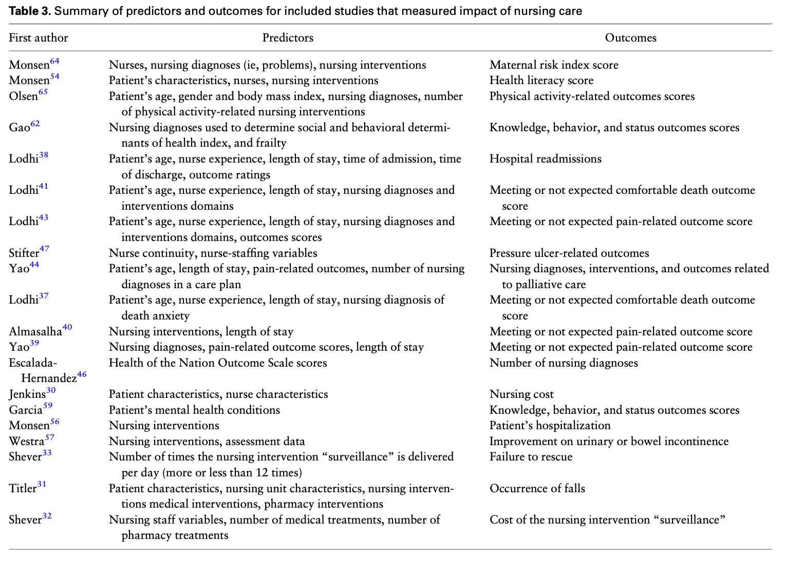
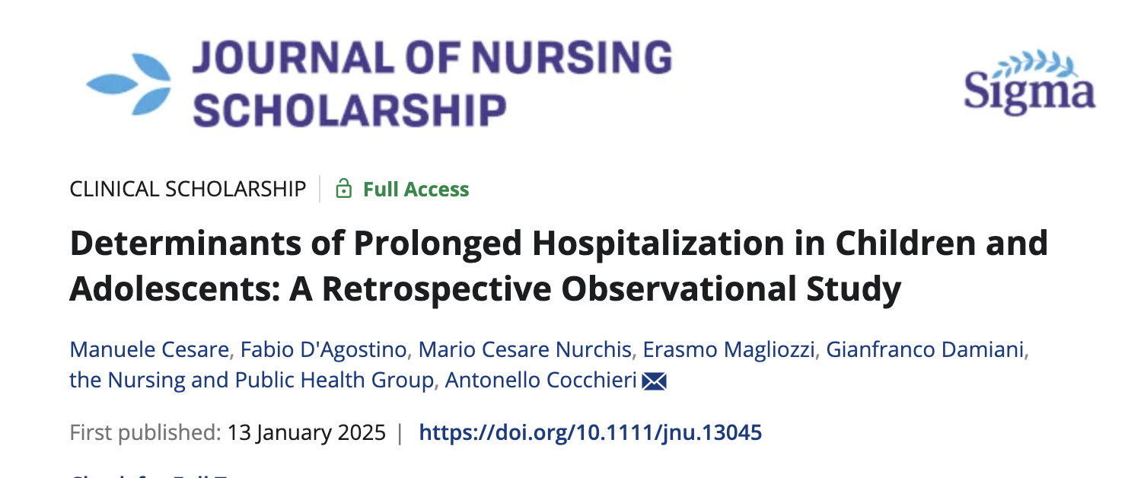
Care plans have value
Macieira TGR, Chianca TCM, Smith MB, et al. Secondary use of standardized nursing care data for advancing nursing science and practice: a systematic review. J Am Med Inform Assoc. 2019;26(11):1401-1411. doi:10.1093/jamia/ocz086

Slide 10
How do we change this scenario?

Slide 11
Can AI help us?

Slide 12
LLMs are advanced types of artificial intelligence (AI) designed to understand, generate, and manipulate human language.
LLMs are trained on vast amounts of text data and can perform a wide range of natural language processing tasks, such as translation, summarization, answering questions, and generating human-like text.
What are large language models (LLMs)?

Slide 13
Types of LLMs
Generative Pretrained Transformer (GPT)
They generate text based on a given prompt
GPT models are autoregressive, which means they predict the next word in a sequence based on the previous words
They are used in applications like chatbots, content generation, summarization, and creative writing
These models can generate highly coherent and contextually appropriate text, making them suitable for diverse healthcare applications, like generating patient summaries or aiding in clinical decision-making

Slide 14
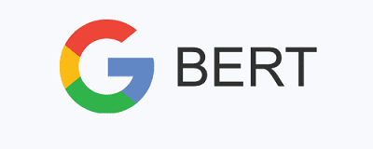
Types of LLMs
BERT (Bidirectional Encoder Representations from Transformers)
Bidirectional model, which means it understands the context of a word based on the words before and after it in a sentence
BERT excels in tasks like answering questions, sentiment analysis, and understanding complex queries, which makes it valuable for retrieving clinical knowledge and understanding nuanced medical texts
It’s often used in applications like clinical text mining, document classification, and information retrieval in healthcare settings

Slide 15
Why LLMs matter in healthcare today

Slide 16
Clinical Documentation Enhancement:
Auto-summarizing nursing notes and patient histories
Streamlining nursing workflows with smart documentation tools
Clinical Decision Support:
LLMs in assisting with clinical guidelines and recommendations
Patient Education and Communication:
Generating patient-friendly educational material
Enhancing nurse-patient communication through AI-driven interactions
Research and Data Analysis:
Supporting literature reviews and evidence synthesis
Patient engagement tools
Assisting with qualitative data analysis in nursing research

Slide 17
Data privacy and security concerns
Bias and fairness in LLMs
Nurses’ role in oversight and ethical use
Challenges and ethical considerations
Nurses need to be more involved in AI development
Notes:
Challenges and Ethical Considerations (5 min)
Data Privacy and Security Concerns
Risks with patient data and AI algorithms.
Mitigating risks of LLM use in healthcare settings.
Bias and Fairness in LLMs
Addressing potential biases in AI tools.
Ensuring equitable care across diverse populations.
Nurses' Role in Oversight and Ethical Use
Importance of nurses in guiding responsible AI adoption.
Ensuring that AI tools align with nursing values and patient advocacy.

Slide 18
Exemplars of LLM use in creation and documentation of care plans

Slide 19
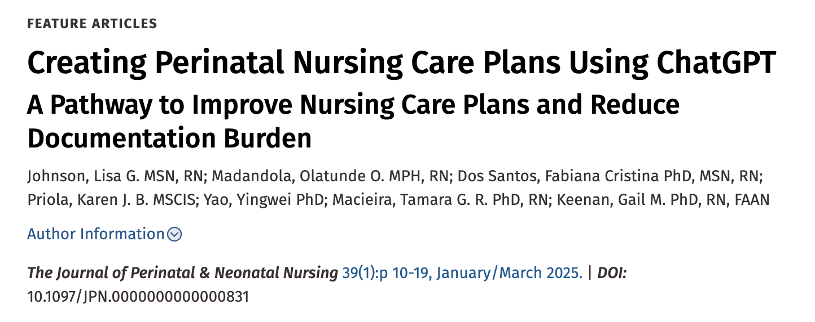
LLMs for
care plans
Notes:
These are our efforts in 1st exploring interacting with LLMs through the chat interface

Slide 20
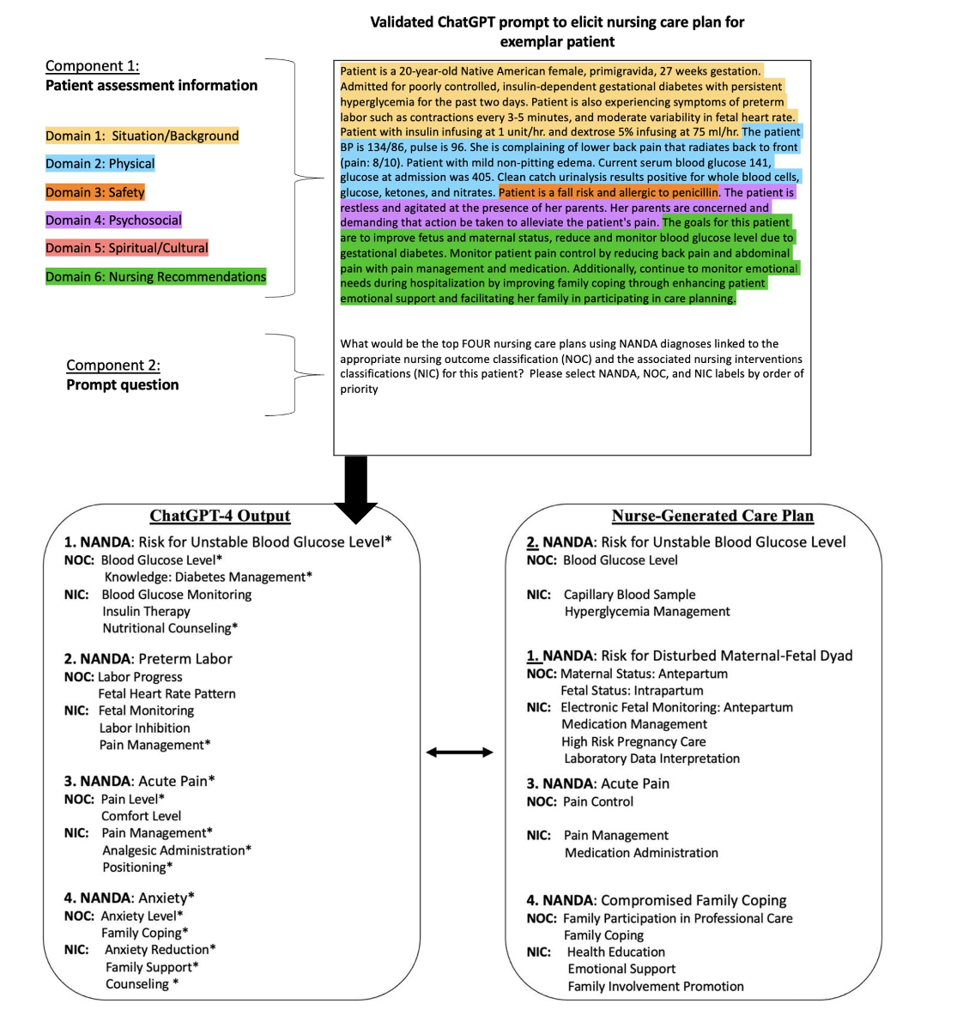
LLMs for care plans
Dos Santos FC, Johnson LG, Madandola OO, et al. An example of leveraging AI for documentation: ChatGPT-generated nursing care plan for an older adult with lung cancer. J Am Med Inform Assoc. 2024;31(9):2089-2096. doi:10.1093/jamia/ocae116
Johnson LG, Madandola OO, Dos Santos FC, et al. Creating Perinatal Nursing Care Plans Using ChatGPT: A Pathway to Improve Nursing Care Plans and Reduce Documentation Burden. J Perinat Neonatal Nurs. 2025;39(1):10-19. doi:10.1097/JPN.0000000000000831
Notes:
These are our efforts in 1st exploring interacting with LLMs through the chat interface

Slide 21
Our findings:
There is potential of using AI-based systems such as ChatGPT to generate nursing care plan documentation
While the generated care plans show promise, nurses need to evaluate these plans critically in the context of the patient's unique needs
LLM accessed through a chat interface does not generate standardized care plans – we have hallucinations
This is an issue for data interoperability, data exchange, and continuity of care

Slide 22
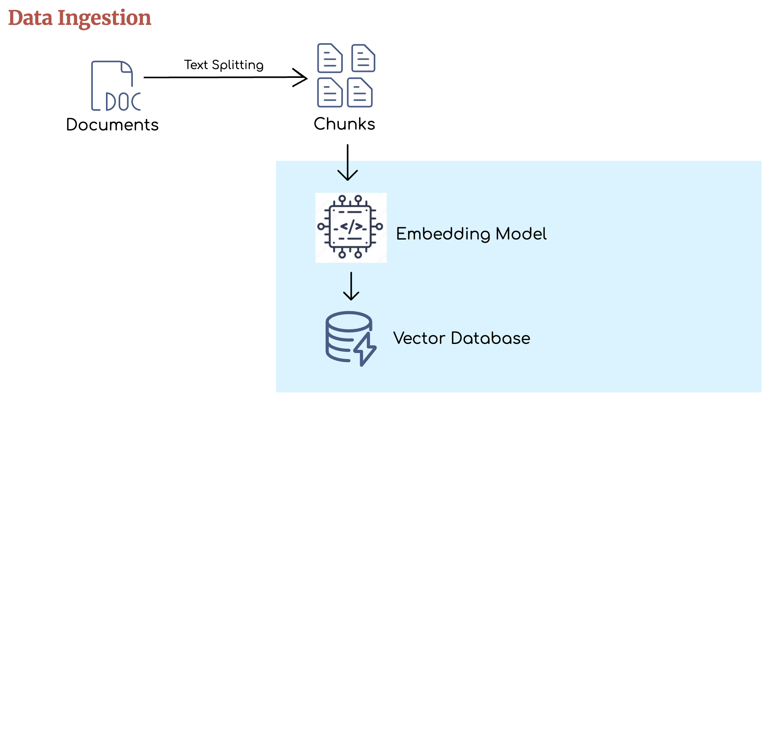
Our current approach: Implementing a retrieval augmented generation (RAG) pipeline

Slide 23
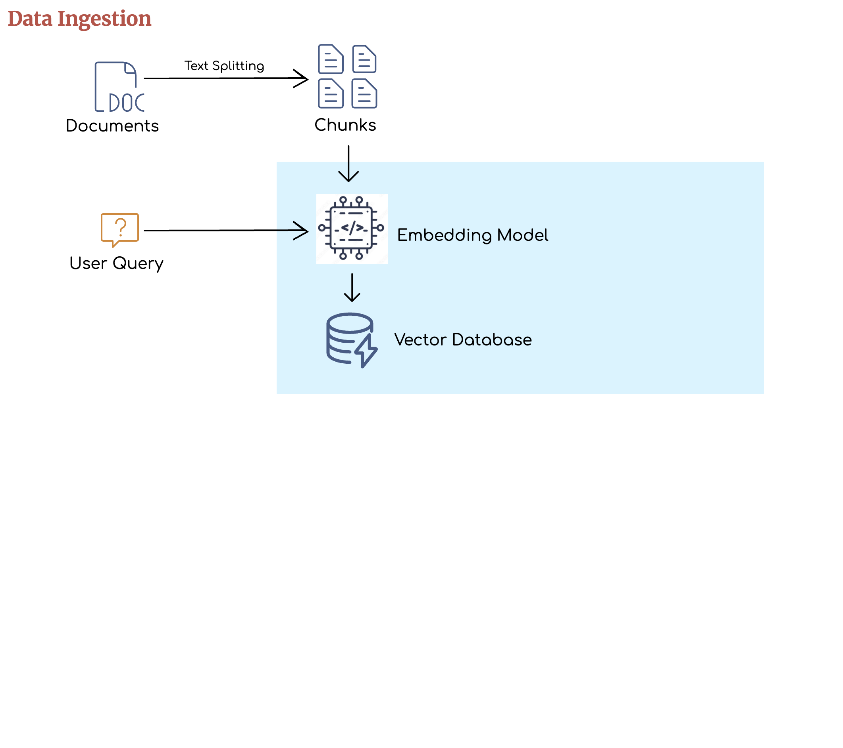
Our current approach: Implementing a retrieval augmented generation (RAG) pipeline

Slide 24
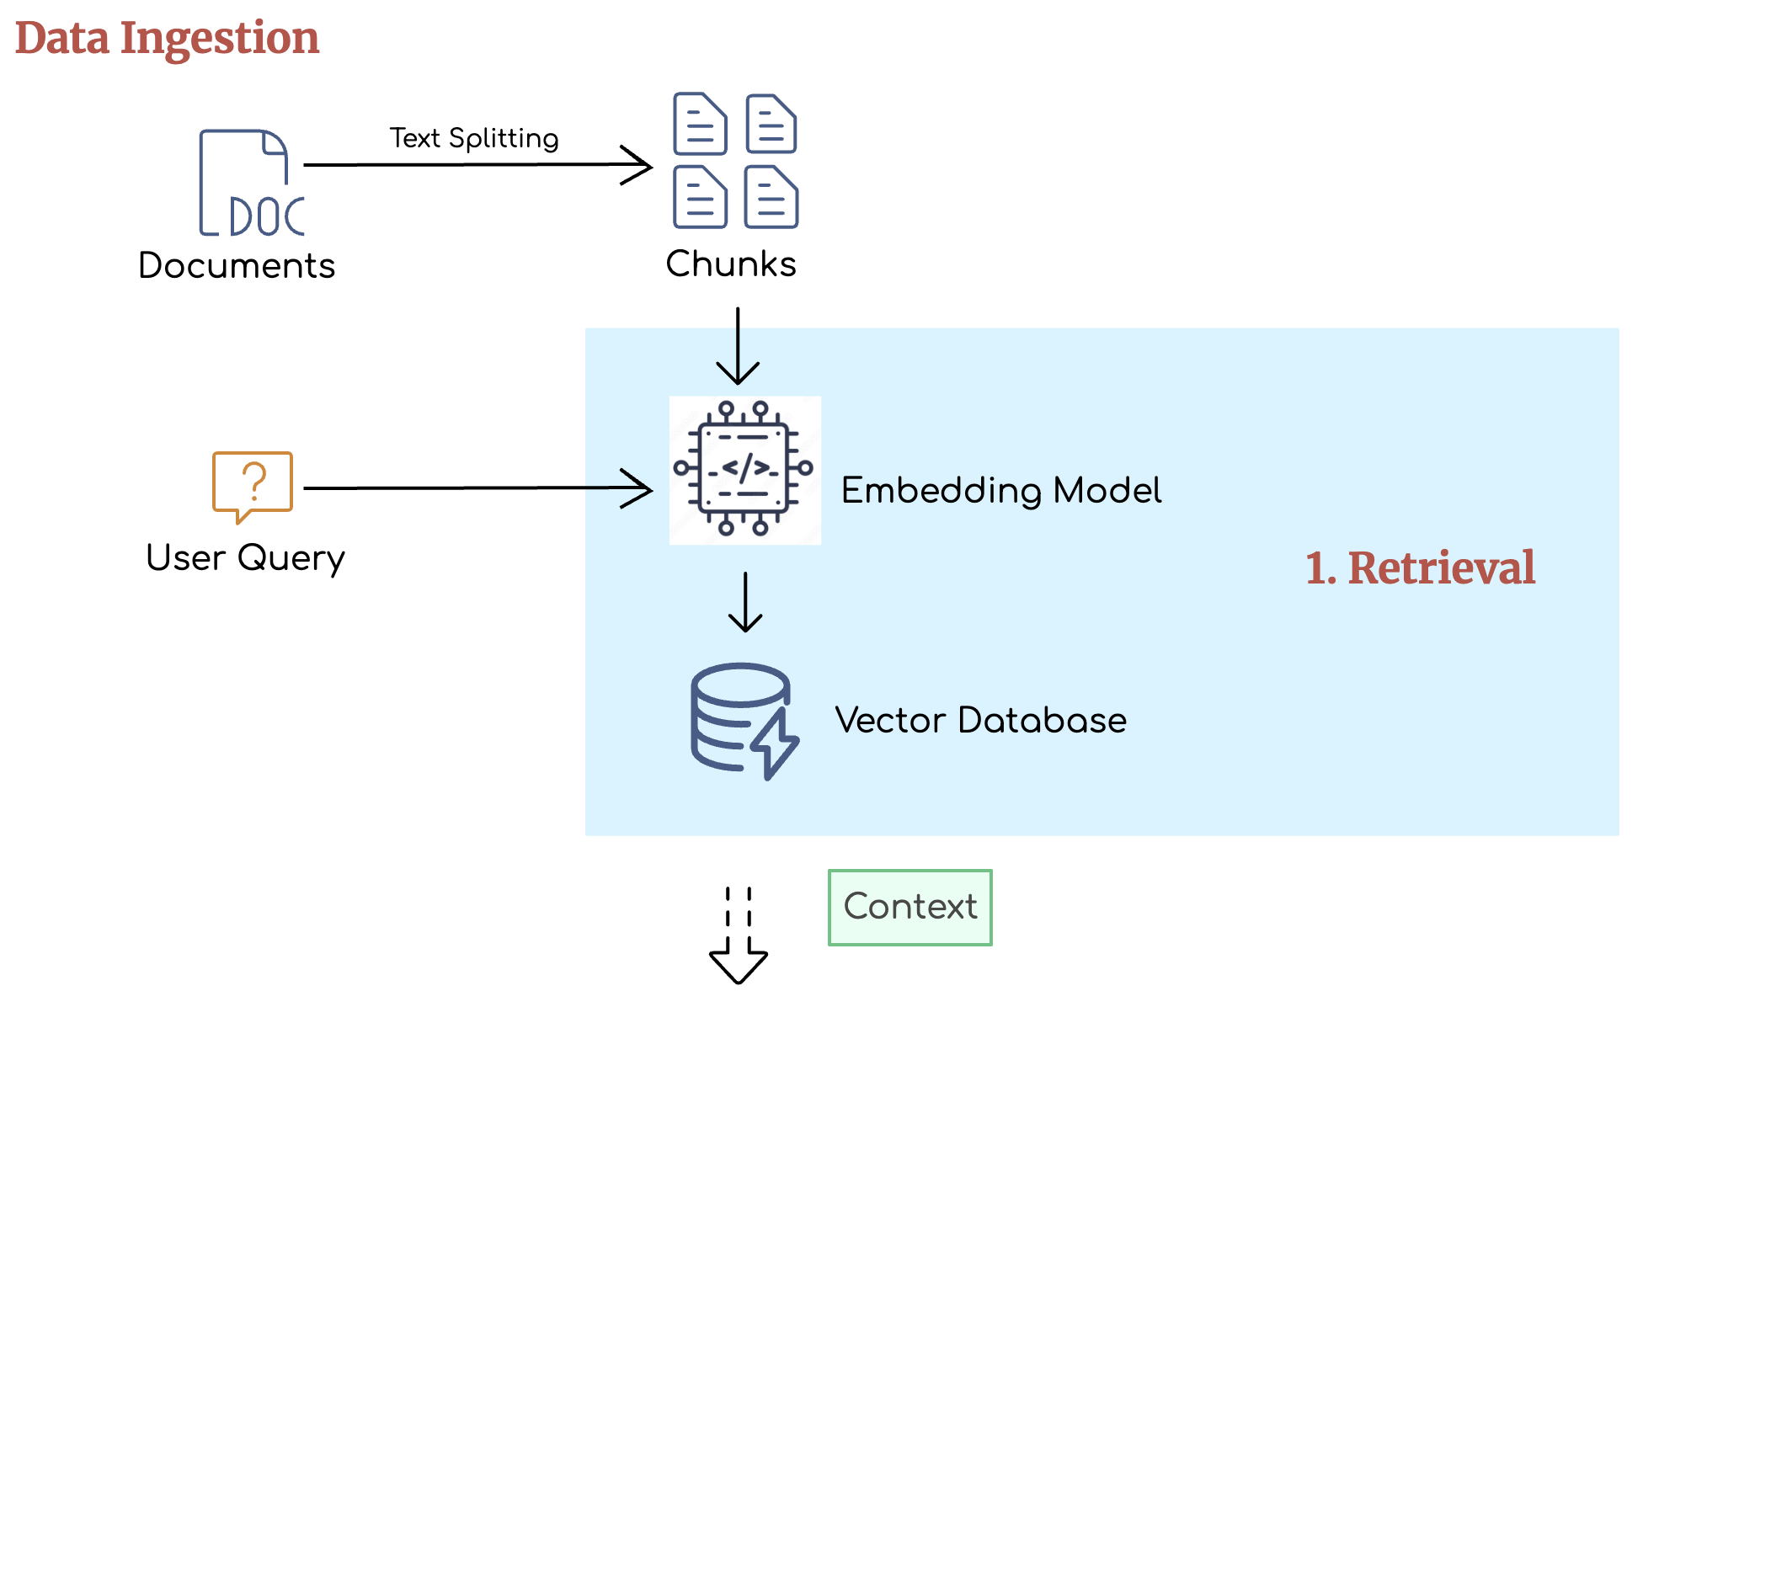
Our current approach: Implementing a retrieval augmented generation (RAG) pipeline

Slide 25
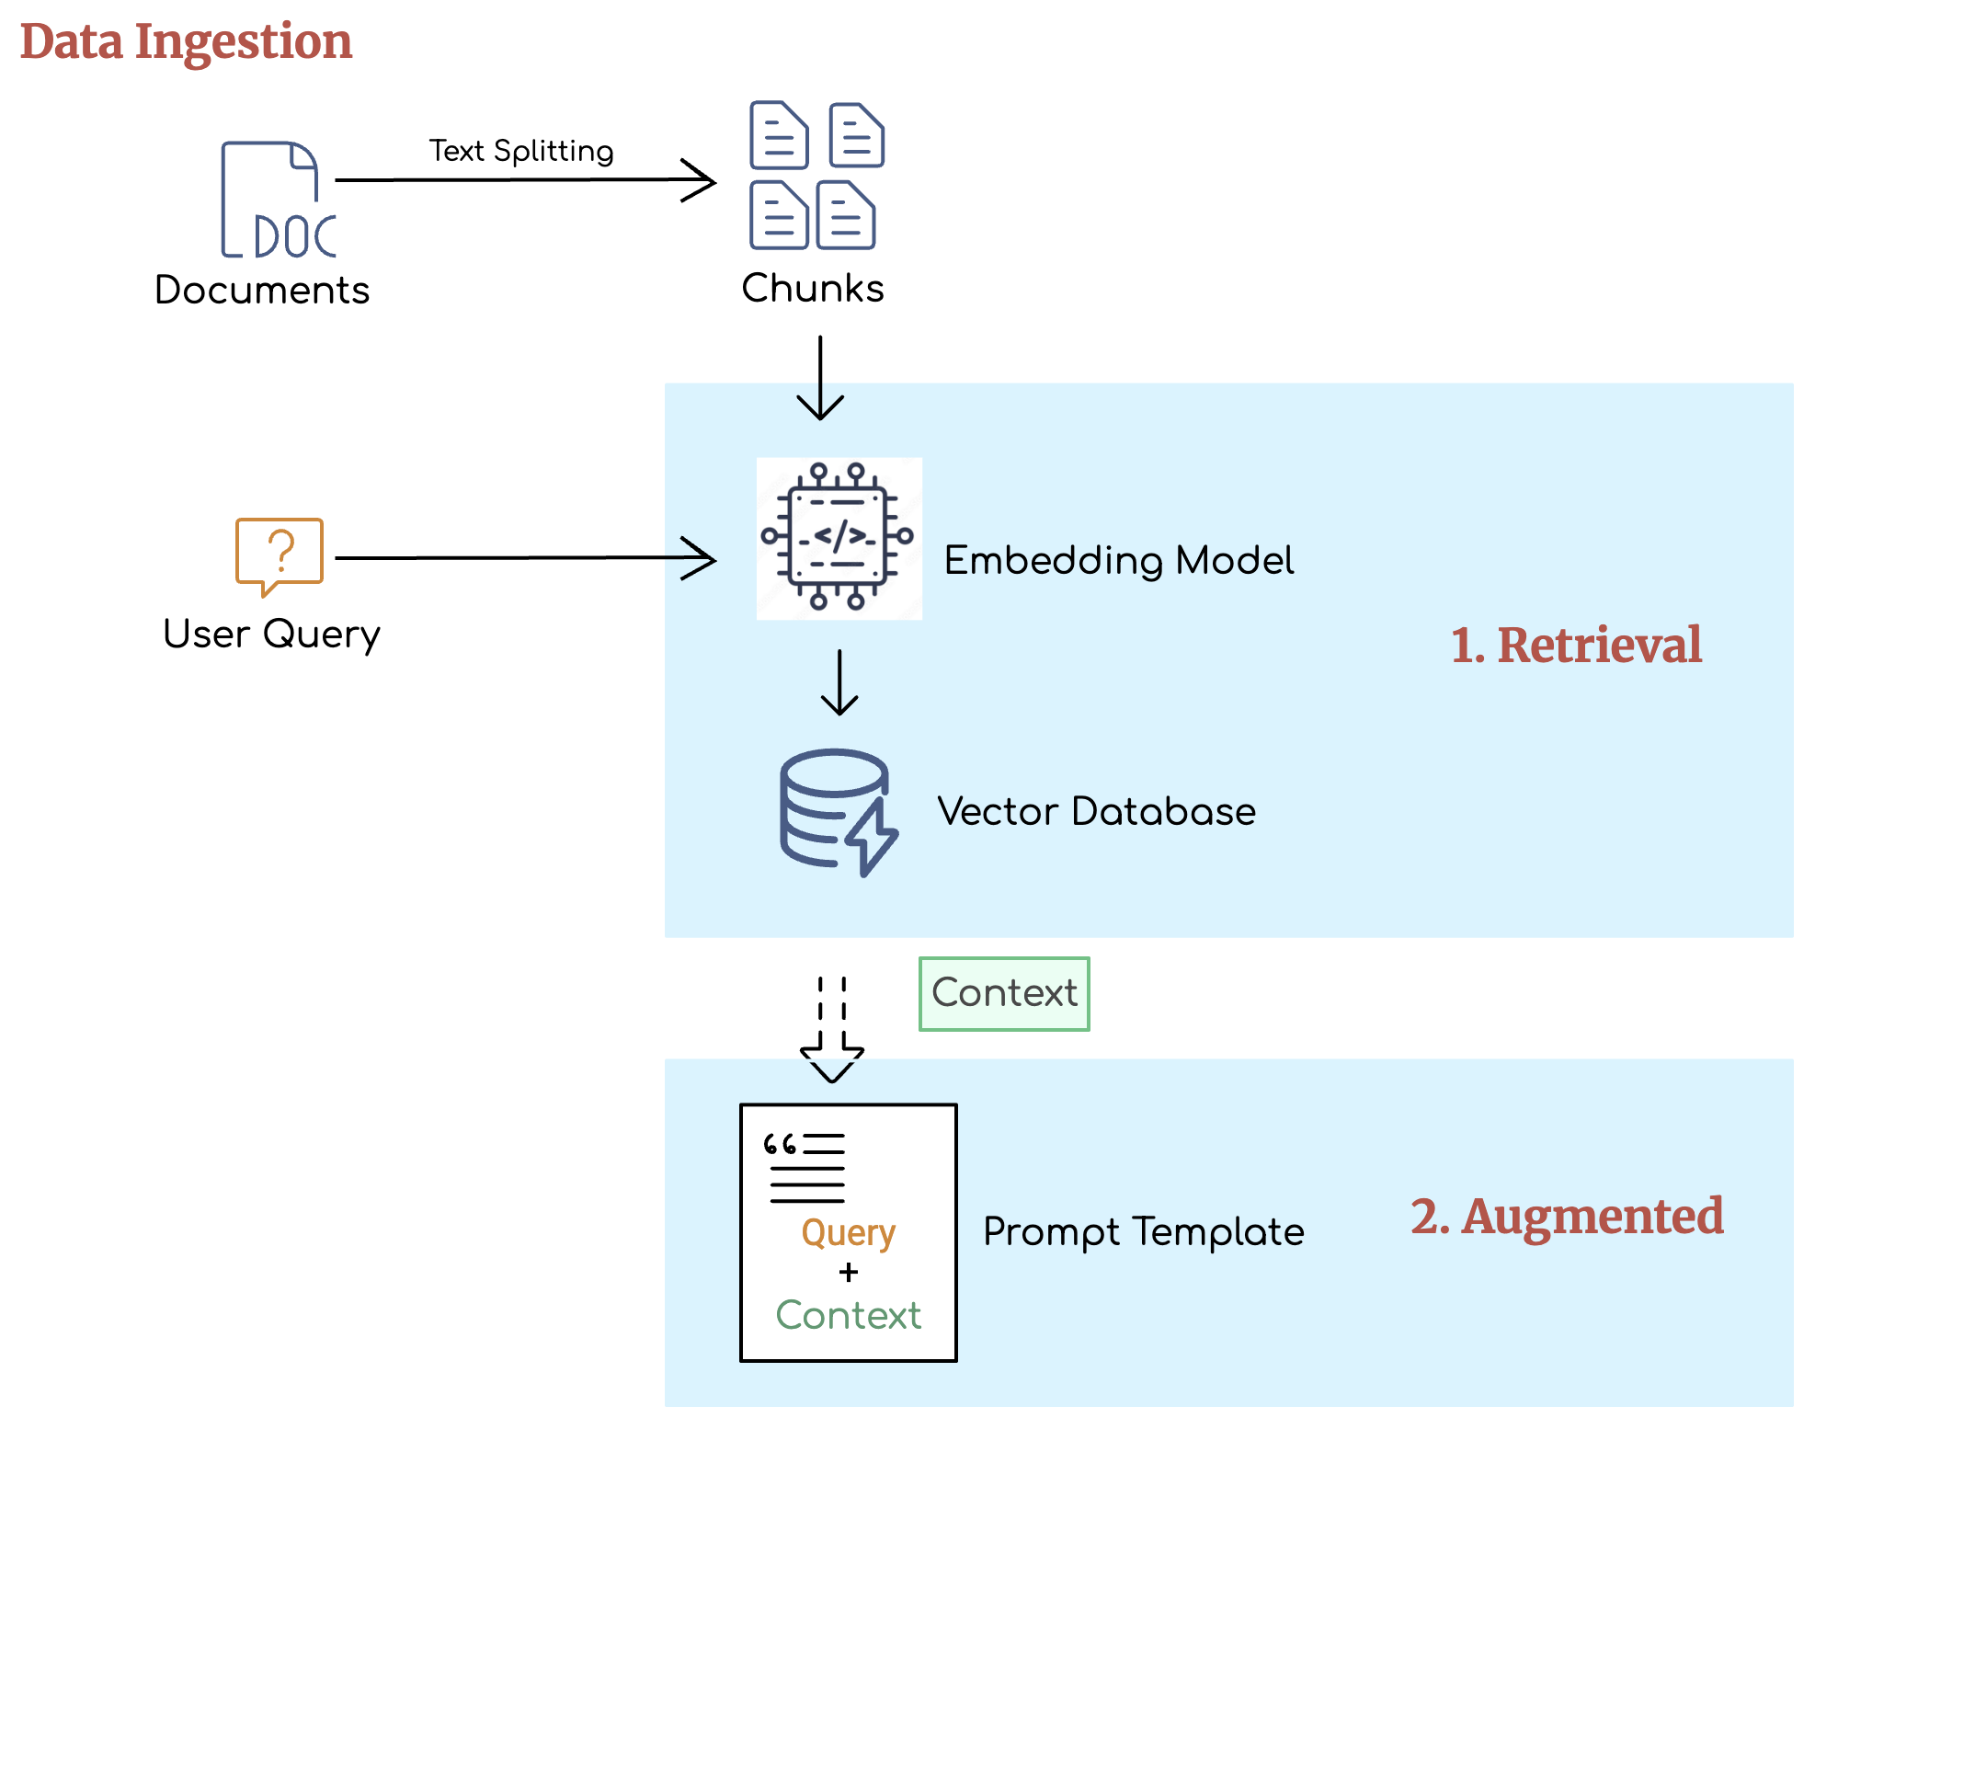
Our current approach: Implementing a retrieval augmented generation (RAG) pipeline

Slide 26
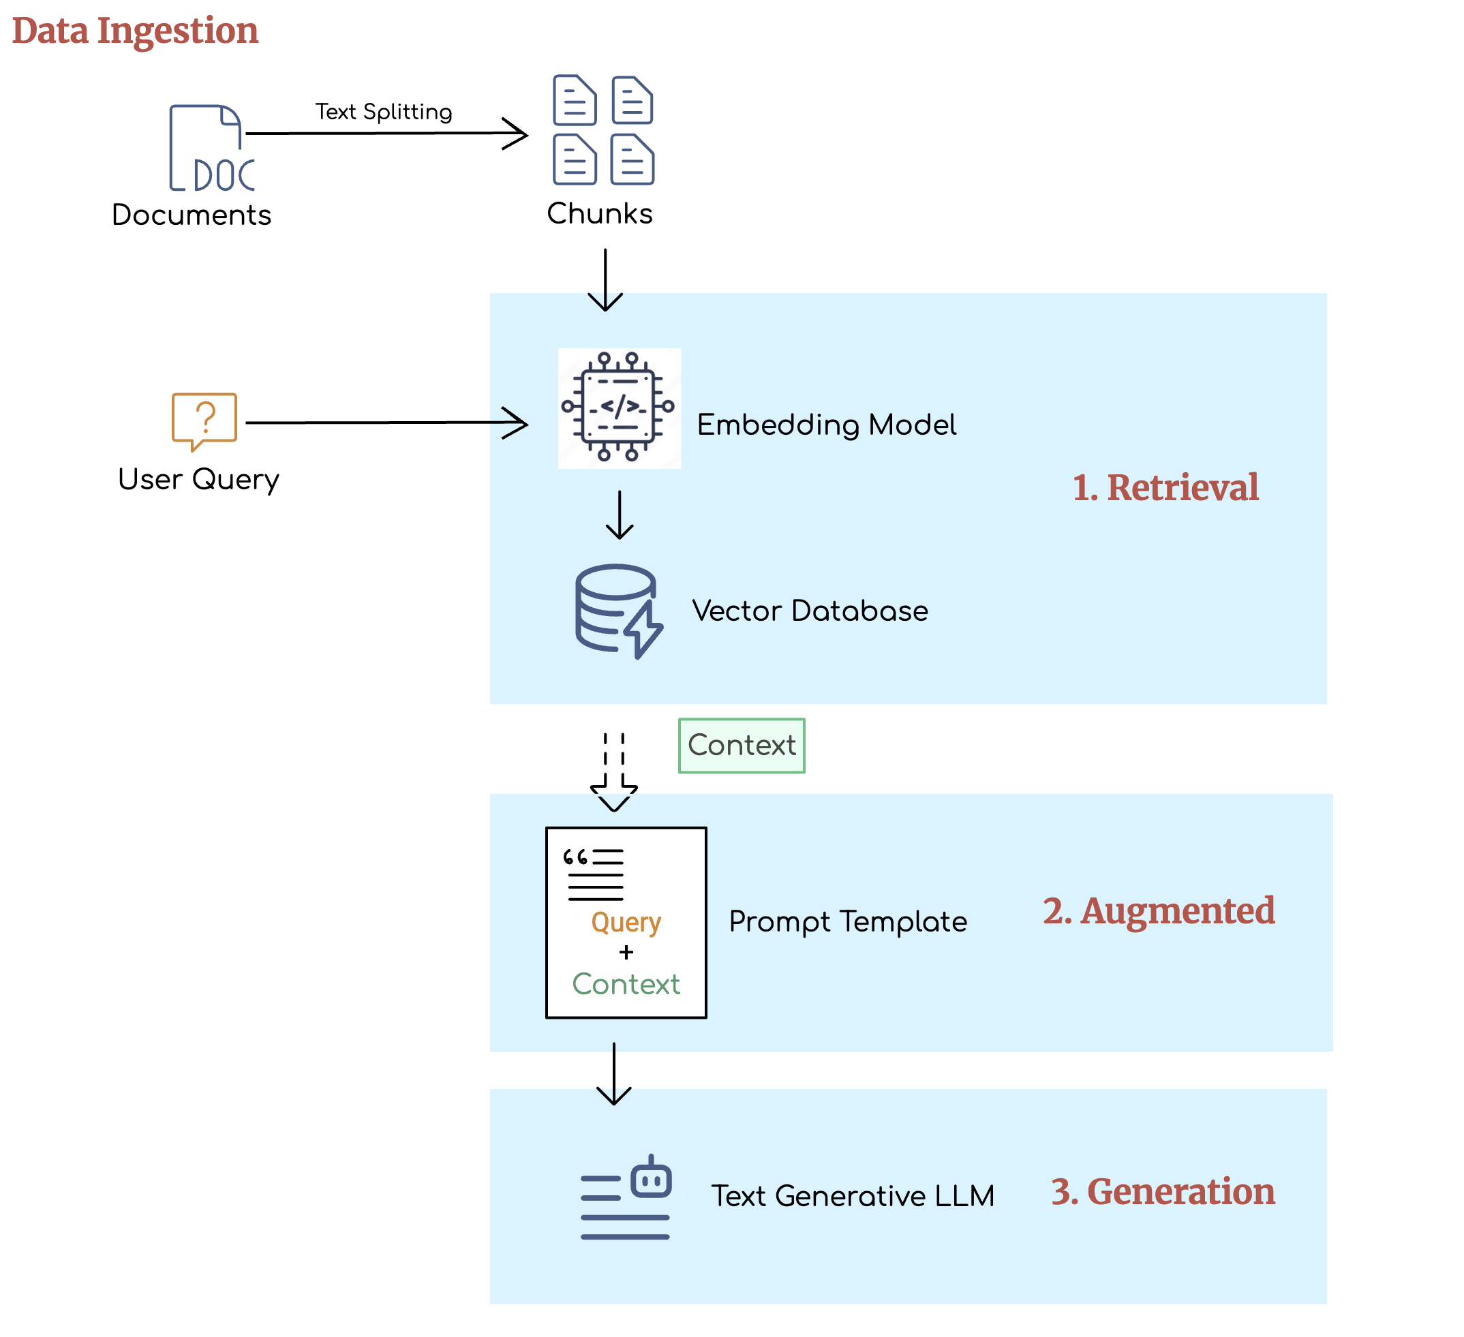
Our current approach: Implementing a retrieval augmented generation (RAG) pipeline

Slide 27
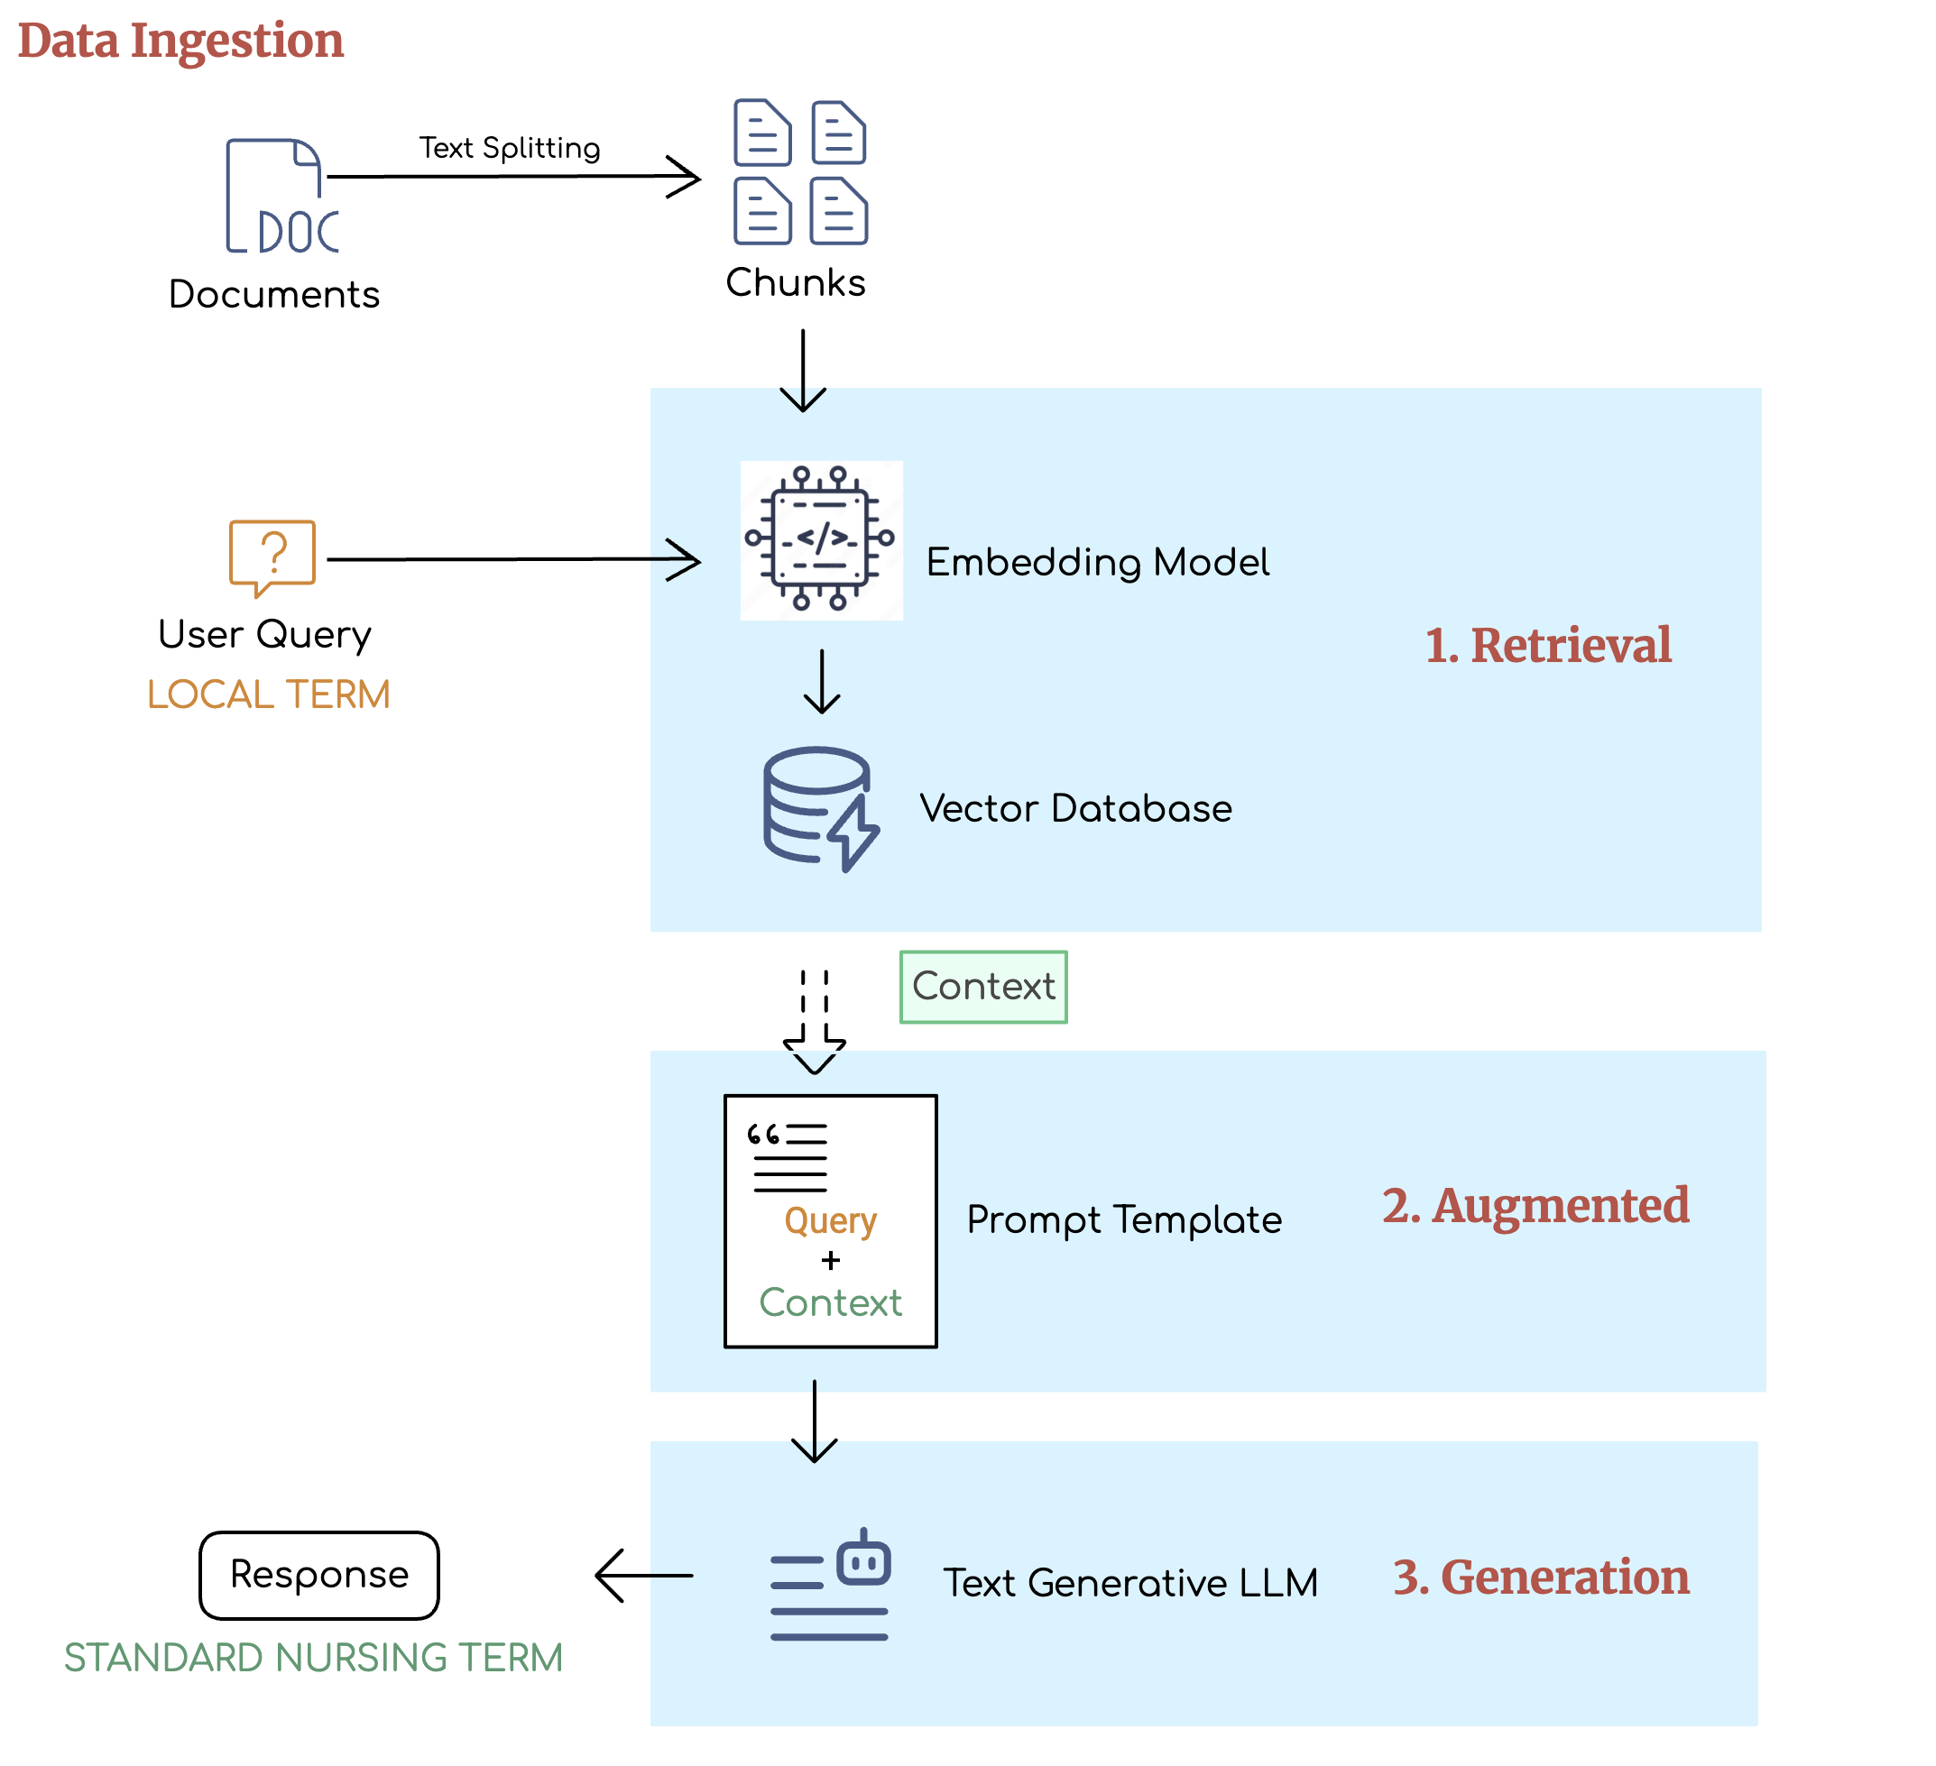
Our current approach: Implementing a retrieval augmented generation (RAG) pipeline

Slide 28
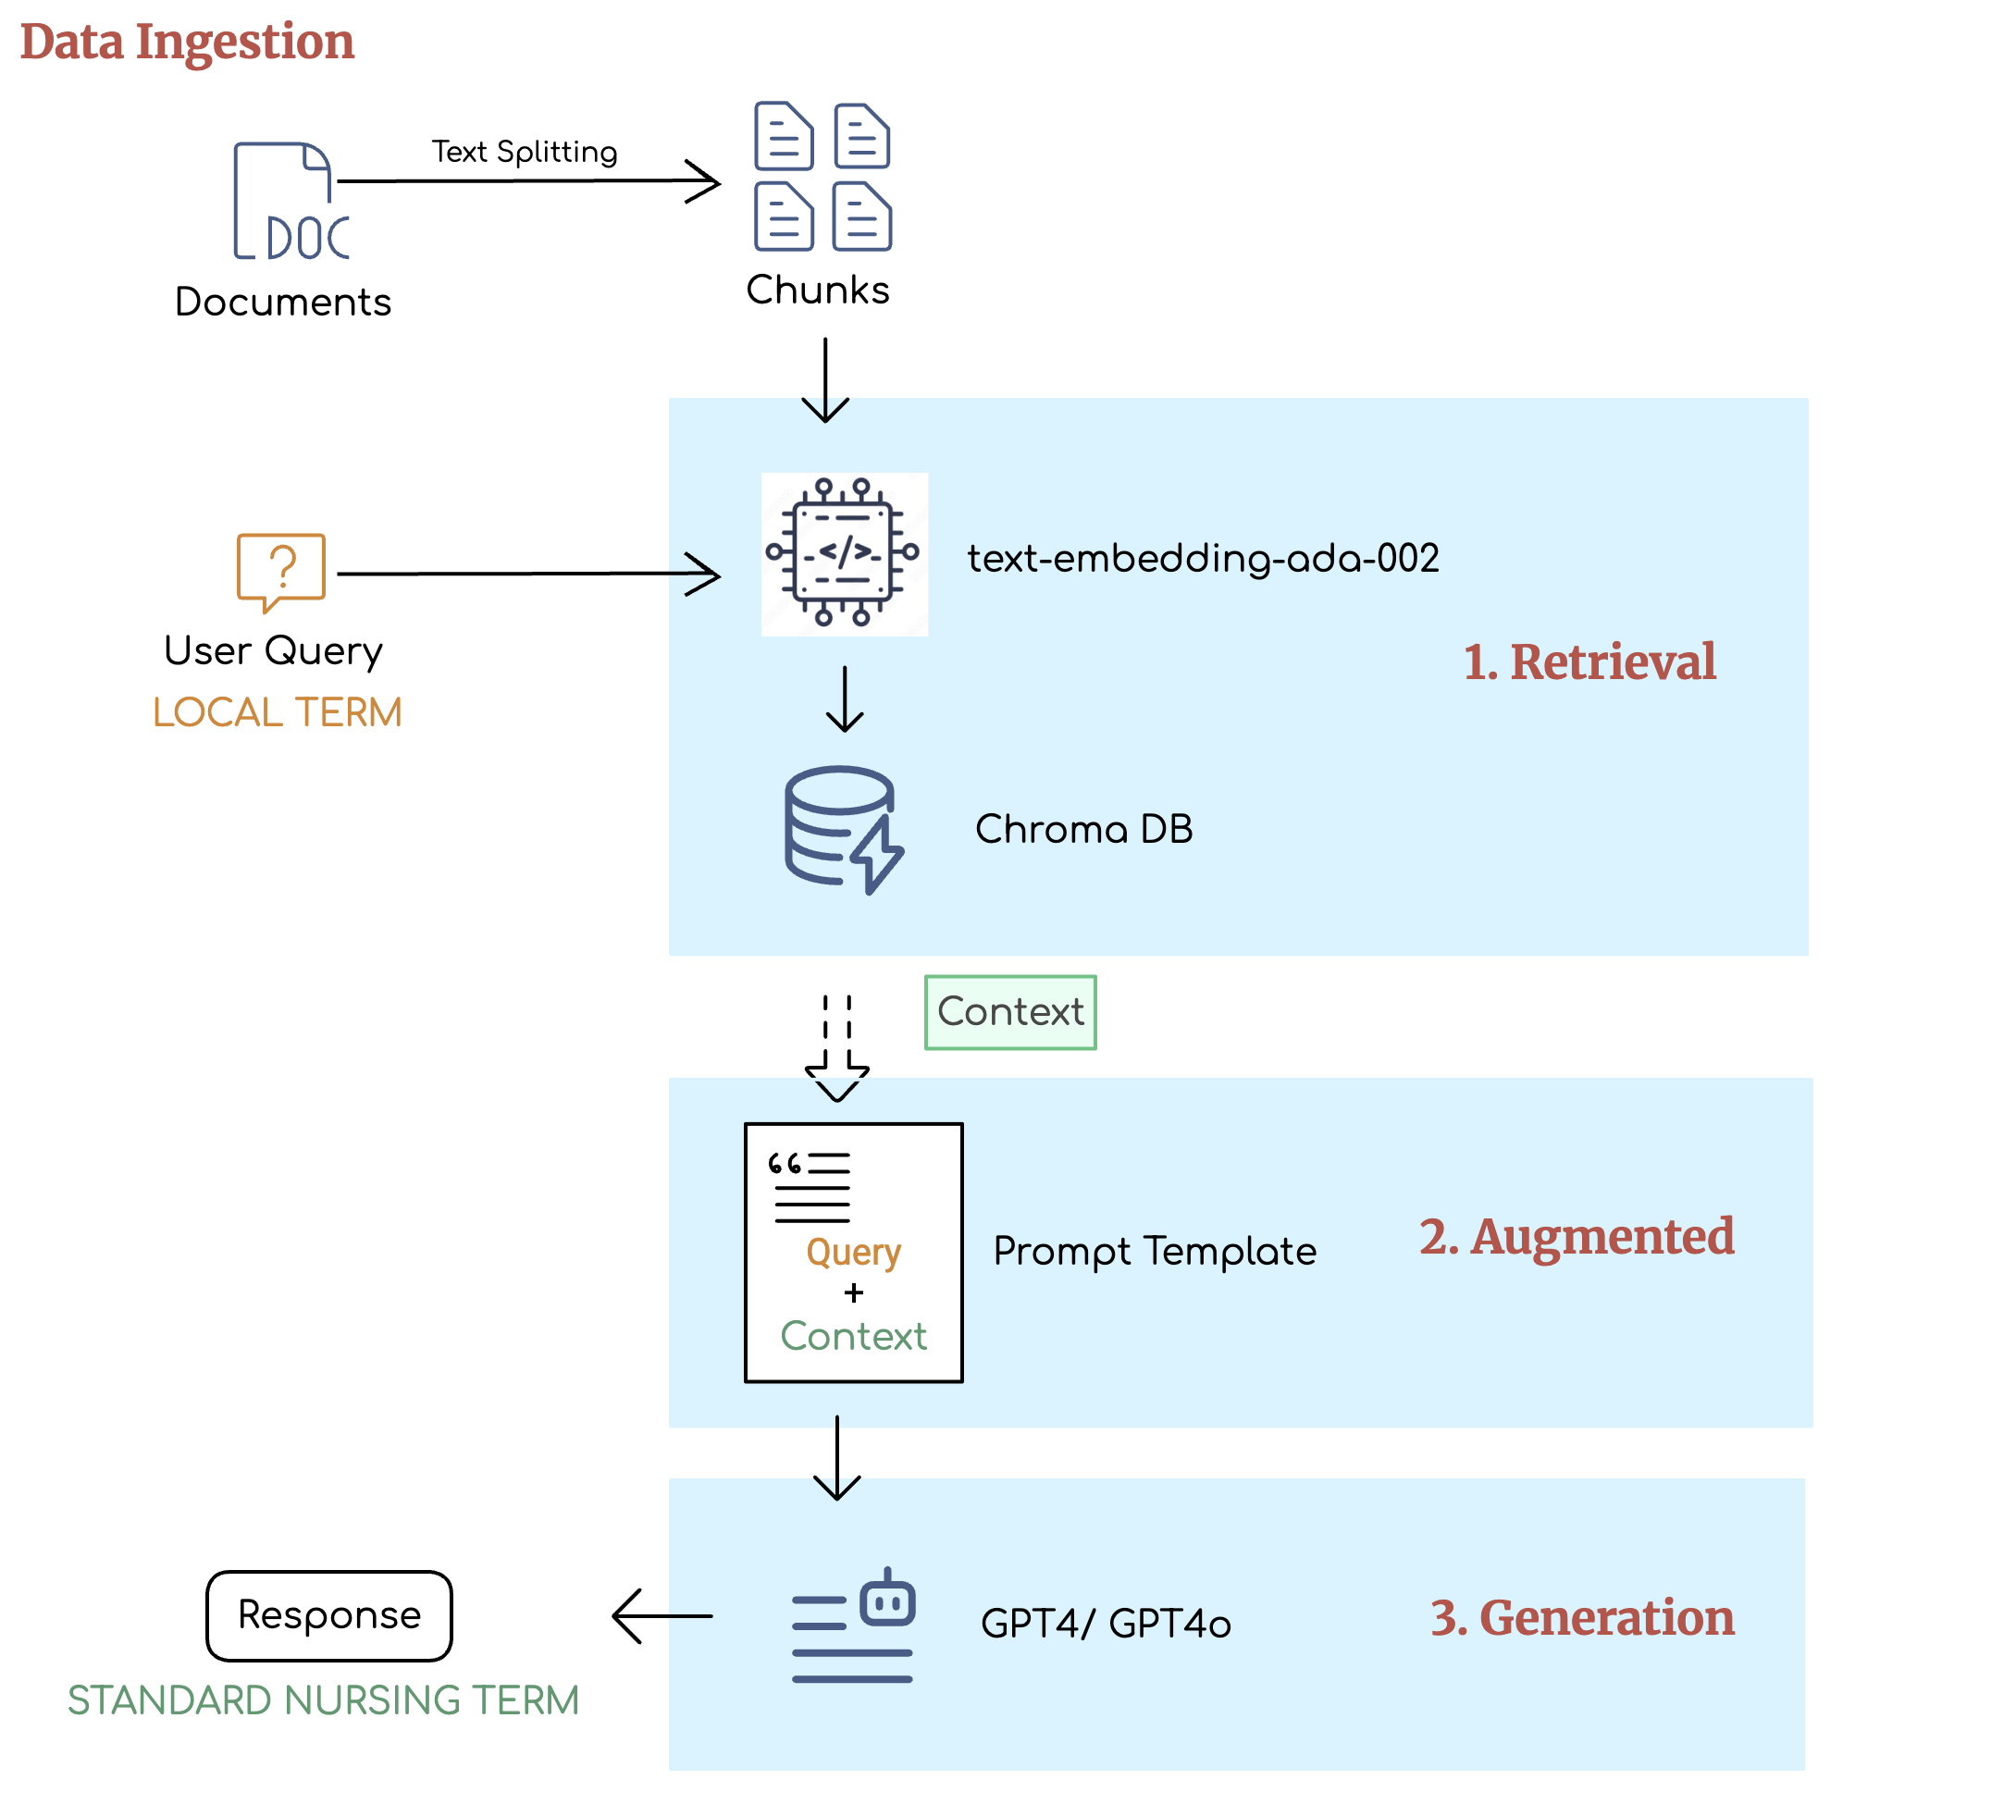
Our current approach: Implementing a retrieval augmented generation (RAG) pipeline
Features of RAG Pipeline
Avails access to precise domain-specific answers from LLMs
Scales to handle diverse clinical queries with reliability
Supports embedding of structured datasets (CSV, TXT, DOCX, etc.)
Leverages LLM intelligence grounded with Deep knowledge of Nursing Terminologies.
Infuses Prompts with real-time knowledge
Improves accuracy and reduces hallucinations

Slide 29
How can we incorporate LLMs into nursing practice?
Notes:
Transition to Moxie

Slide 30
HANDSFreeNurse
handsfreenurse@gmail.com
gkeenan@ufl.edu
Notes:
Hi, we are Moxie, a holistic and innovative solution to help nurses free their hands from computers and enhance their care to patients.

Slide 31
Introducing the “Siri” for nurses
Bypasses outdated technology
Voice-to-text 2-way EHR documentation
Artificial intelligence enabled
Vendor agnostic
Anytime, anywhere, HANDS FREE

Slide 32
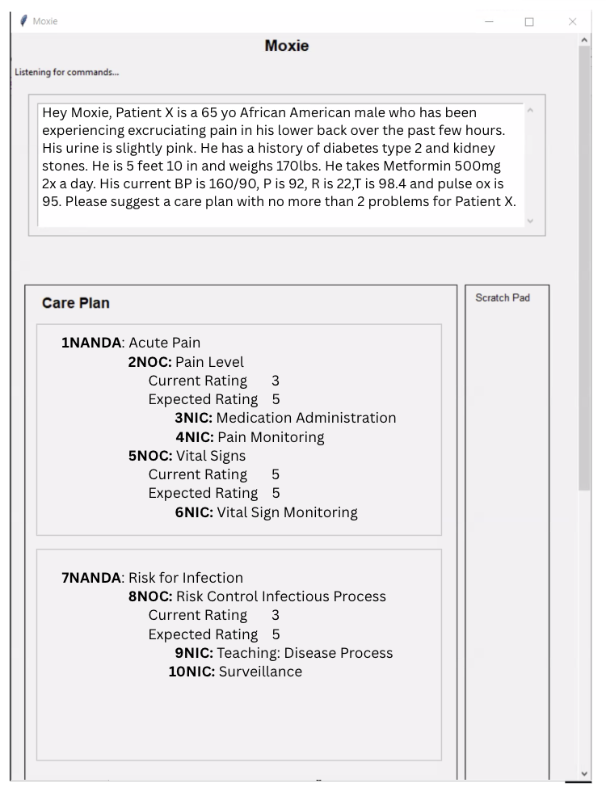
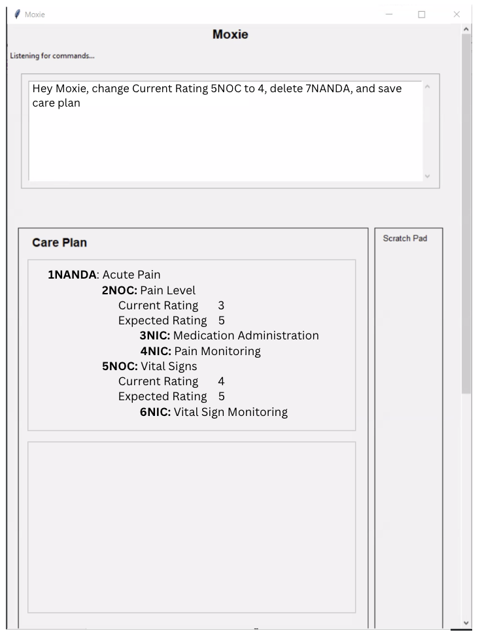
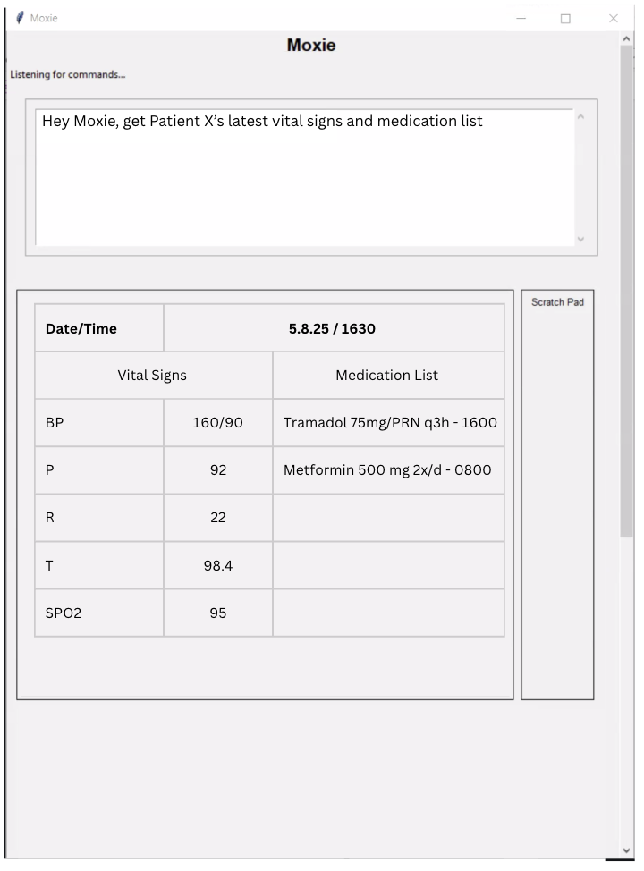
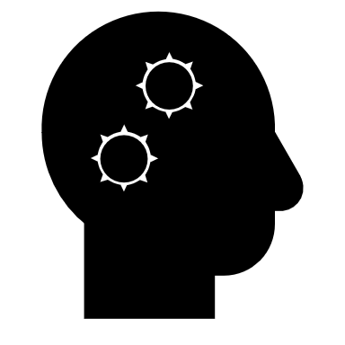
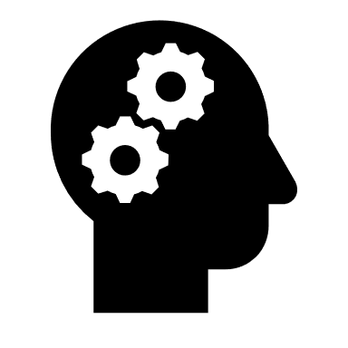
HOW
Works
Notes:
This is an example of how Moxie works showing screens from our MVP
“Assume the nurse is taking care of a patient with kidney stones”
Screen 1 narrative
“The nurse voices information about the patient and asks Moxie for care plan suggestions. Moxie instantly converts the voice to text (shown in top box) and quickly delivers suggestions (shown in the bottom box) for the nurse to review
Screen 2 narrative
“After review the nurse gives another voice command to tweak the care plan and save it to the electronic health record shown in the (top box again)”
“Moxie processes and shows the updated plan in bottom box and saves it to the EHR –(while not shown here the nurse can open scratch pad to see the changes Moxie made)
Screens 3 narrative
The nurse can ask Moxie for many more details related to the patient and here requests the medication list and vital signs. Again the request appears in the top box and Moxie generated the relevant information in the bottom box.
Summary narrative about Moxie,
With Moxie nurses can access and update patient records hands-free and in real-time. This makes their job easier and allows them to focus more on patient care.

Slide 33
Created by nurses for nurses
Gail Keenan, PhD, RN
Founder and CEO
Ashfaq Khokhar, PhD
CTO
Tamara Macieira, PhD, RN
Nursing & IT Manager
Karen Priola, MS-CIS
Operations Manager
Shakira Henderson, PhD, RN, DNP
Board Chair
Nico Torteli, ME
CRO
Notes:
And what makes Moxie so unique? It is created by nurses for nurses
Our team has nursing, technology, engineering, and revenue experts
But to effectively integrate Moxie and other technology in practice, we need to…

Slide 34
1. CREATE SPACE
Notes:
Can be physical space, virtual space, giving “time”, giving “release”
Take away the power big vendors have

Slide 35
2. IDENTIFY CHAMPIONS
Notes:
Who has the energy and bandwidth? Who will be excited? Who will inspire others?

Slide 36
3. IDENTIFY INCENTIVES

Slide 37
4. THINK BIG
Notes:
Whats working, whats not working, what changed

Slide 38
AI CAN TRANSFORM HEALTHCARE,
YOU HOLD THE KEY!

Slide 39
Thank You
YOU should lead the change to enable an AI-driven future for nursing excellence
Email me: tmacie2@ufl.edu

