Slide 1
Nursing, AI, and Clinical Research: 2024 Insights
May 30, 2025

Slide 2
Andrew Phillips PhD, RN, FAMIA

Slide 3
Conflict of Interest
Have no real or apparent conflicts of interest to report.

Slide 4
Learning Objectives
How will AI potentially impact nursing practice

Slide 5
Methods – “Phillips” Study
Step 1 – Identify the Research Question
Step 2 – Search for Relevant Literature
Step 3 – Literature Selection/Review
Sub Step – Take Nap
Sub Step – Caffeine
Step 4 – Summarizing, and reporting the results
Step 5 – Consultation – This is you guys

Slide 6
Step 1: Research Question
What trends and themes emerge from a survey of the published literature in the area of AI in nursing during the past year

Slide 7
Step 2: Identify Relevant Literature
Search Strategy
Databases: PubMed and CINAHL
Search terms
(“artificial intelligence” OR “AI” OR “large language models” OR “machine learning”) AND healthcare AND nurs*
Publication Dates 3/1/2024 – 3/31/2025

Slide 8
Step 3: Study Selection
Inclusion and Exclusion Criteria
Inclusion criteria: healthcare delivery, relevant to nursing, mentions nursing in the abstract
Exclusions: Articles without an AI informatics focus

Slide 9
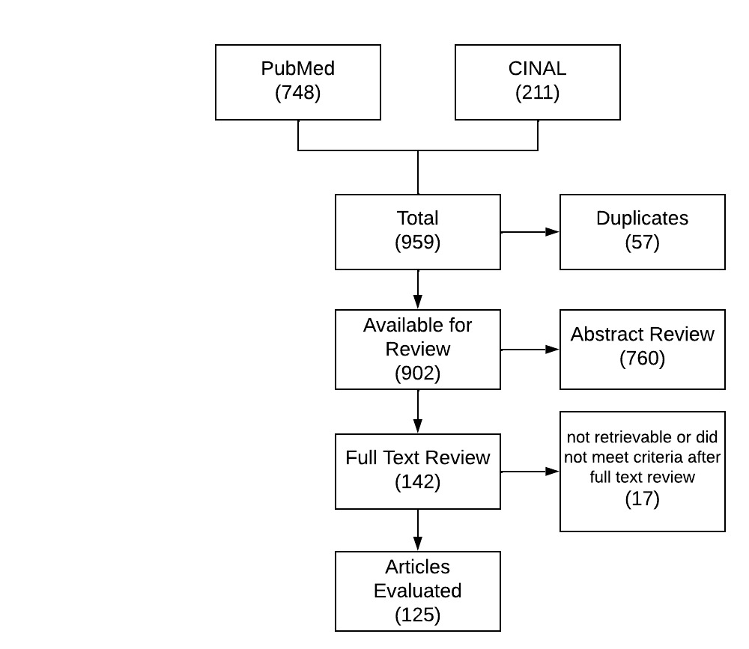
Search Results

Slide 10
Search Results
ChatGPT

Slide 11
Step 4 – Collating, summarizing, and reporting the results

Slide 12
Themes Identified
AI Literacy MUST be a part of Nursing Education
Increasing use of tools
Understanding ethical limitations
AI as Opportunity or Threat
Attitudes towards AI
Readiness
Too much AI – Alert Fatigue
Erode clinical thinking skills/Enhance Clinical Thinking Skills
Ever increasing amounts of data
Patient communications
Patient portals (providers only)
Mental health/support
Robots – mentioned frequently but few studies
Companion
VS monitoring
Medication dispensing
Blood draws
Disinfection and sterilization
Patient transport
Ethics
Security
Privacy
Errors
Generalizability
Over Reliance
Algorithmic Bias
Generalizability
TRUST
What wasn’t emphasized
Greater details on how model was trained
Still, most of the literature was some form of literature review
Social Determinant of Health
Relieving workload
Risk prediction models galore
Much more I did not understand this year

Slide 13
Representative/Interesting Citations
Loughran, E., Kane, M., Wyatt, T. H., Kerley, A., Lowe, S., & Li, X. (2024). Using large language models to address health literacy in mHealth: case report. CIN: Computers, Informatics, Nursing, 10-1097.
Wagner, L., Jourdan, S., Mayer, L., Müller, C., Bernhard, L., Kolb, S., ... & Wilhelm, D. (2024). Robotic scrub nurse to anticipate surgical instruments based on real-time laparoscopic video analysis. Communications Medicine, 4(1), 156.
Wan, P., Huang, Z., Tang, W., Nie, Y., Pei, D., Deng, S., ... & Long, E. (2024). Outpatient reception via collaboration between nurses and a large language model: a randomized controlled trial. Nature Medicine, 30(10), 2878-2885.
Wang, T., Mu, J., Chen, J., & Lin, C. C. (2024). Comparing ChatGPT and clinical nurses’ performances on tracheostomy care: A cross-sectional study. International Journal of Nursing Studies Advances, 6, 100181.
Yakusheva, O., Bouvier, M. J., & Hagopian, C. O. (2025). How Artificial Intelligence is altering the nursing workforce. Nursing Outlook, 73(1), 102300.
Zaboli, A., Brigo, F., Sibilio, S., Mian, M., & Turcato, G. (2024). Human intelligence versus Chat-GPT: who performs better in correctly classifying patients in triage?. The American Journal of Emergency Medicine, 79, 44-47.
Zolnoori, M., Vergez, S., Xu, Z., Esmaeili, E., Zolnour, A., Anne Briggs, K., ... & McDonald, M. V. (2024). Decoding disparities: evaluating automatic speech recognition system performance in transcribing Black and White patient verbal communication with nurses in home healthcare. JAMIA open, 7(4), ooae130.

Slide 14
Yakusheva, O., Bouvier, M. J., & Hagopian, C. O. (2025). How Artificial Intelligence is altering the nursing workforce. Nursing Outlook, 73(1), 102300.
This paper focuses on the implications of Artificial Intelligence (AI) for the nursing workforce, examining both the opportunities presented by AI in relieving nurses of routine tasks and enabling better patient care, and the potential challenges it poses. The discussion highlights the freeing of nurses’ time from administrative duties, allowing for more patient interaction and professional development, while also acknowledging concerns about job displacement. Ethically integrating AI into patient care and the need for nurses’ proactive engagement with AI—including involvement in its development and integration in nursing education—are emphasized. Finally, the paper asserts the necessity for nurses to become active participants in AI’s evolution within health care to ensure the enhancement of patient care and the advancement of nursing roles

Slide 15
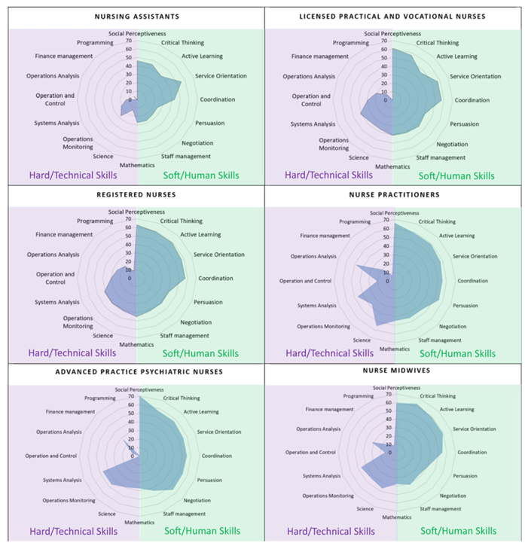

Slide 16
Zaboli, A., Brigo, F., Sibilio, S., Mian, M., & Turcato, G. (2024). Human intelligence versus Chat-GPT: who performs better in correctly classifying patients in triage?. The American Journal of Emergency Medicine, 79, 44-47.
Introduction: Chat-GPT is rapidly emerging as a promising and potentially revolutionary tool in medicine. One of its possible applications is the stratification of patients according to the severity of clinical conditions and prognosis during the triage evaluation in the emergency department (ED).
Methods: Using a randomly selected sample of 30 vignettes recreated from real clinical cases, we compared the concordance in risk stratification of ED patients between healthcare personnel and Chat-GPT. The concordance was assessed with Cohen's kappa, and the performance was evaluated with the area under the receiver operating characteristic curve (AUROC) curves. Among the outcomes, we considered mortality within 72 h, the need for hospitalization, and the presence of a severe or time-dependent condition.
Results: The concordance in triage code assignment between triage nurses and Chat-GPT was 0.278 (unweighted Cohen's kappa; 95% confidence intervals: 0.231–0.388). For all outcomes, the ROC values were higher for the triage nurses. The most relevant difference was found in 72-h mortality, where triage nurses showed an AUROC of 0.910 (0.757–1.000) compared to only 0.669 (0.153–1.000) for Chat-GPT.
Conclusions: The current level of Chat-GPT reliability is insufficient to make it a valid substitute for the expertise of triage nurses in prioritizing ED patients. Further developments are required to enhance the safety and effectiveness of AI for risk stratification of ED patients.

Slide 17
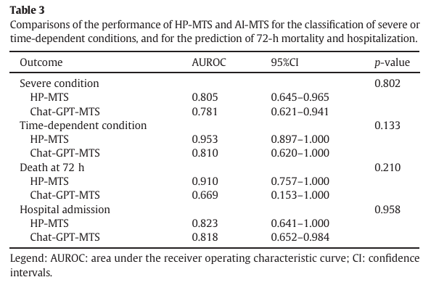

Slide 18
Wang, T., Mu, J., Chen, J., & Lin, C. C. (2024). Comparing ChatGPT and clinical nurses’ performances on tracheostomy care: A cross-sectional study. International Journal of Nursing Studies Advances, 6, 100181.
Background: The release of ChatGPT for general use in 2023 by OpenAI has significantly expanded the possible applications of generative artificial intelligence in the healthcare sector, particularly in terms of information retrieval by patients, medical and nursing students, and healthcare personnel.
Objective: To compare the performance of ChatGPT-3.5 and ChatGPT-4.0 to clinical nurses on answering questions about tracheostomy care, as well as to determine whether using different prompts to pre-define the scope of the ChatGPT affects the accuracy of their responses.
Design: Cross-sectional study.
Setting: The data collected from the ChatGPT was collected using the ChatGPT-3.5 and 4.0 using access provided by the University of Hong Kong. The data from the clinical nurses working in mainland China was collected using the Qualtrics survey program.
Participants: No participants were needed for collecting the ChatGPT responses. A total of 272 clinical nurses, with 98.5 % of them working in tertiary care hospitals in mainland China, were recruited using a snowball sampling approach.
Method: We used 43 tracheostomy care-related questions in a multiple-choice format to evaluate the performance of ChatGPT-3.5, ChatGPT-4.0, and clinical nurses. ChatGPT-3.5 and GPT-4.0 were both queried three times with the same questions by different prompts: no prompt, patient-friendly prompt, and act-as-nurse prompt. All responses were independently graded by two qualified otorhinolaryngology nurses on a 3-point accuracy scale (correct, partially correct, and incorrect). The Chi-squared test and Fisher exact test with post-hoc Bonferroni adjustment were used to assess the differences in performance between the three groups, as well as the differences in accuracy between different prompts.
Results: ChatGPT-4.0 showed significantly higher accuracy, with 64.3 % of responses rated as ‘correct’, compared to 60.5 % in ChatGPT-3.5 and 36.7 % in clinical nurses (X ² = 74.192, p < .001). Except for the ‘care for the tracheostomy stoma and surrounding skin’ domain (X² = 6.227, p = .156), scores from ChatGPT-3.5 and -4.0 were significantly better than nurses’ on domains related to airway humidification, cuff management, tracheostomy tube care, suction techniques, and management of complications. Overall, ChatGPT-4.0 consistently performed well in all domains, achieving over 50 % accuracy in each domain. Alterations to the prompt had no impact on the performance of ChatGPT-3.5 or -4.0.
Conclusion: ChatGPT may serve as a complementary medical information tool for patients and physicians to improve knowledge in tracheostomy care.

Slide 19
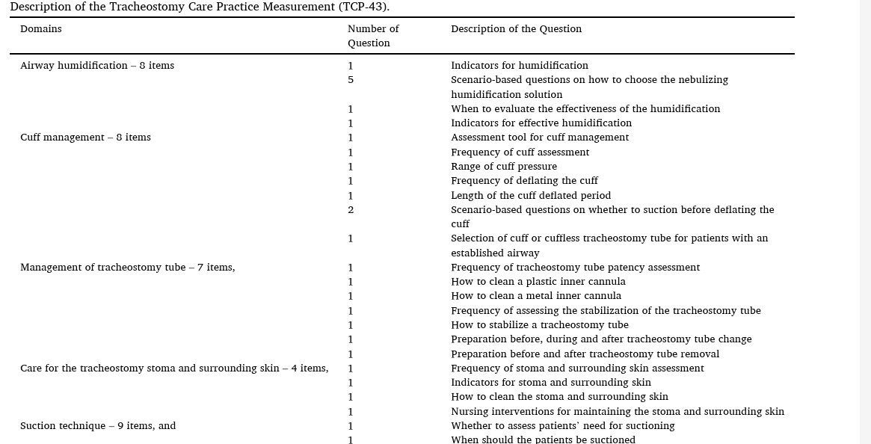

Slide 20
Wan, P., Huang, Z., Tang, W., Nie, Y., Pei, D., Deng, S., ... & Long, E. (2024). Outpatient reception via collaboration between nurses and a large language model: a randomized controlled trial. Nature Medicine, 30(10), 2878-2885.
Reception is an essential process for patients seeking medical care and a critical component influencing the healthcare experience. However, current communication systems rely mainly on human efforts, which are both labor and knowledge intensive. A promising alternative is to leverage the capabilities of large language models (LLMs) to assist the communication in medical center reception sites. Here we curated a unique dataset comprising 35,418 cases of real-world conversation audio corpus between outpatients and receptionist nurses from 10 reception sites across two medical centers, to develop a site-specific prompt engineering chatbot (SSPEC). The SSPEC efficiently resolved patient queries, with a higher proportion of queries addressed in fewer rounds of queries and responses (Q&Rs; 68.0% ≤2 rounds) compared with nurse-led sessions (50.5% ≤2 rounds) (P = 0.009) across administrative, triaging and primary care concerns. We then established a nurse-SSPEC collaboration model, overseeing the uncertainties encountered during the real-world deployment. In a single-center randomized controlled trial involving 2,164 participants, the primary endpoint indicated that the nurse-SSPEC collaboration model received higher satisfaction feedback from patients (3.91 ± 0.90 versus 3.39 ± 1.15 in the nurse group, P < 0.001). Key secondary outcomes indicated reduced rate of repeated Q&R (3.2% versus 14.4% in the nurse group, P < 0.001) and reduced negative emotions during visits (2.4% versus 7.8% in the nurse group, P < 0.001) and enhanced response quality in terms of integrity (4.37 ± 0.95 versus 3.42 ± 1.22 in the nurse group, P < 0.001), empathy (4.14 ± 0.98 versus 3.27 ± 1.22 in the nurse group, P < 0.001) and readability (3.86 ± 0.95 versus 3.71 ± 1.07 in the nurse group, P = 0.006). Overall, our study supports the feasibility of integrating LLMs into the daily hospital workflow and introduces a paradigm for improving communication that benefits both patients and nurses.

Slide 21
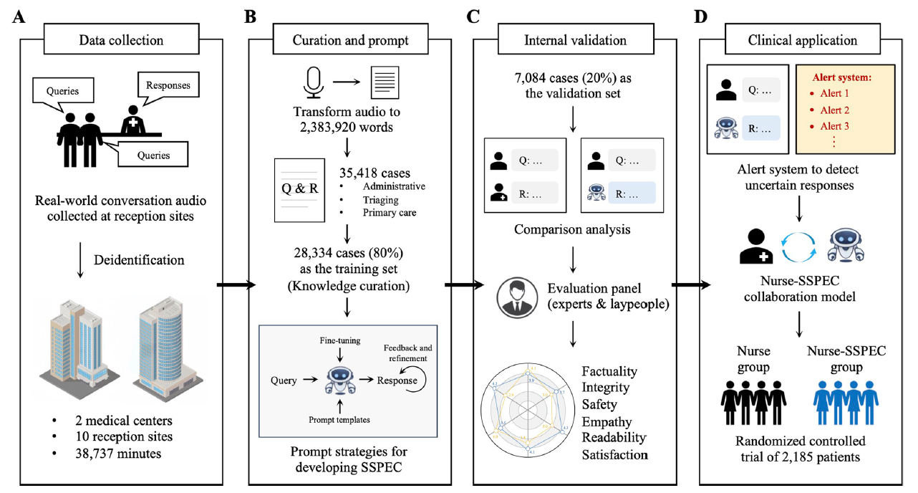

Slide 22
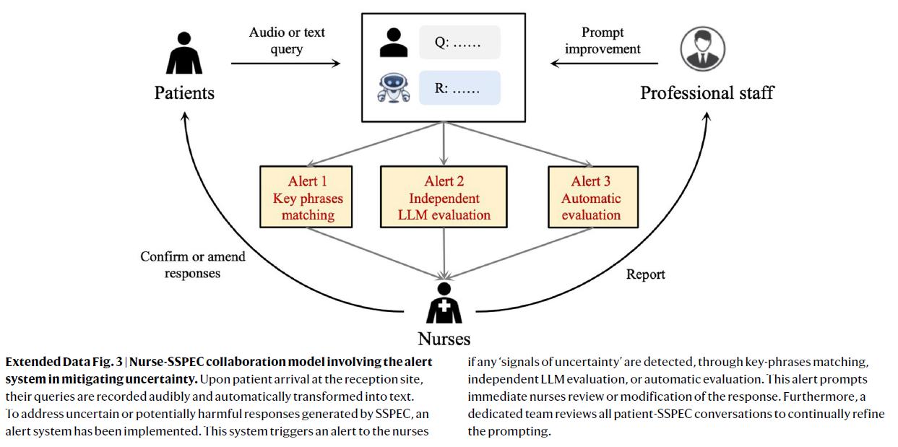

Slide 24
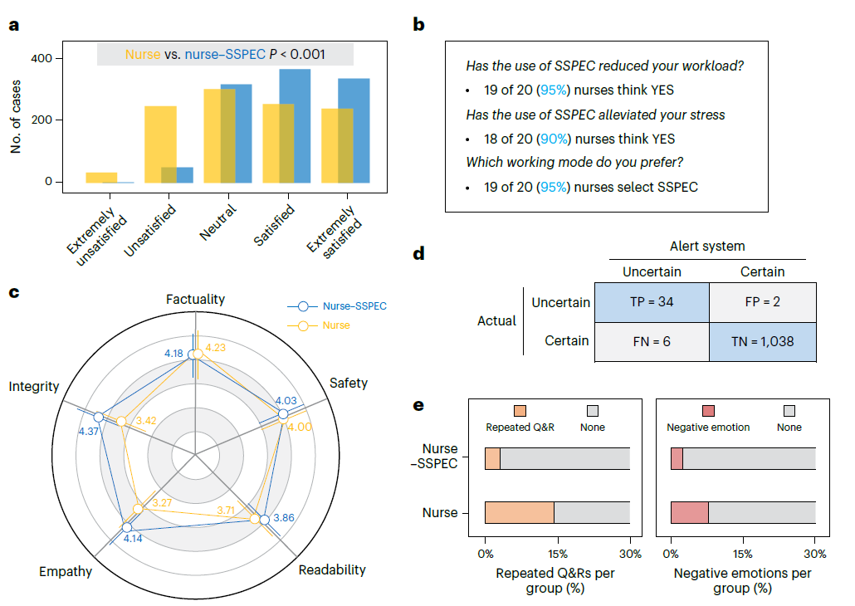

Slide 25
Zolnoori, M., Vergez, S., Xu, Z., Esmaeili, E., Zolnour, A., Anne Briggs, K., ... & McDonald, M. V. (2024). Decoding disparities: evaluating automatic speech recognition system performance in transcribing Black and White patient verbal communication with nurses in home healthcare. JAMIA open, 7(4), ooae130.
Objectives: As artificial intelligence evolves, integrating speech processing into home healthcare (HHC) workflows is increasingly feasible. Audio-recorded communications enhance risk identification models, with automatic speech recognition (ASR) systems as a key component. This study evaluates the transcription accuracy and equity of 4 ASR systems—Amazon Web Services (AWS) General, AWS Medical, Whisper, and Wave2Vec—in transcribing patient-nurse communication in US HHC, focusing on their ability in accurate transcription of speech from Black and White English-speaking patients.
Materials and Methods: We analyzed audio recordings of patient-nurse encounters from 35 patients (16 Black and 19 White) in a New York City-based HHC service. Overall, 860 utterances were available for study, including 475 drawn from Black patients and 385 from White patients. Automatic speech recognition performance was measured using word error rate (WER), benchmarked against a manual gold standard. Disparities were assessed by comparing ASR performance across racial groups using the linguistic inquiry and word count (LIWC) tool, focusing on 10 linguistic dimensions, as well as specific speech elements including repetition, filler words, and proper nouns (medical and nonmedical terms).
Results: The average age of participants was 67.8 years (SD = 14.4). Communication lasted an average of 15 minutes (range: 11-21 minutes) with a median of 1186 words per patient. Of 860 total utterances, 475 were from Black patients and 385 from White patients. Amazon Web Services General had the highest accuracy, with a median WER of 39%. However, all systems showed reduced accuracy for Black patients, with significant discrepancies in LIWC dimensions such as “Affect,” “Social,” and “Drives.” Amazon Web Services Medical performed best for medical terms, though all systems have difficulties with filler words, repetition, and nonmedical terms, with AWS General showing the lowest error rates at 65%, 64%, and 53%, respectively.
Discussion: While AWS systems demonstrated superior accuracy, significant disparities by race highlight the need for more diverse training datasets and improved dialect sensitivity. Addressing these disparities is critical for ensuring equitable ASR performance in HHC settings and enhancing risk prediction models through audio-recorded communication.

Slide 26
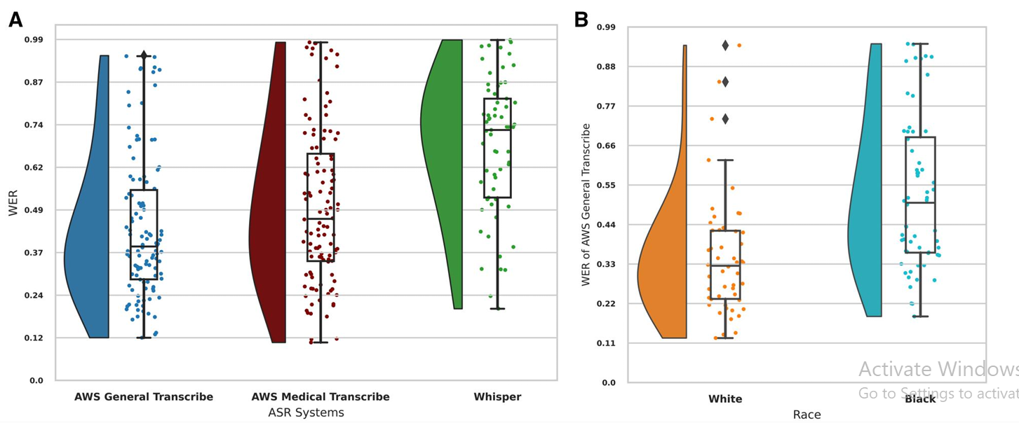

Slide 27
Loughran, E., Kane, M., Wyatt, T. H., Kerley, A., Lowe, S., & Li, X. (2024). Using large language models to address health literacy in mHealth: case report. CIN: Computers, Informatics, Nursing, 10-1097.
Abstract: The innate complexity of medical topics often makes it challenging to produce educational content for the public. Although there are resources available to help authors appraise the complexity of their content, there are woefully few resources available to help authors reduce that complexity after it occurs. In this case study, we evaluate using ChatGPT to reduce the complex language used in health-related educational materials. ChatGPT adapted content from the SmartSHOTS mobile application, which is geared toward caregivers of children aged 0 to 24 months. SmartSHOTS helps reduce barriers and improve adherence to vaccination schedules. ChatGPT reduced complex sentence structure and rewrote content to align with a third-grade reading level. Furthermore, using ChatGPT to edit content already written removes the potential for unnoticed, artificial intelligence–produced inaccuracies. As an editorial tool, ChatGPT was effective, efficient, and free to use. This article discusses the potential of ChatGPT as an effective, time-efficient, and open-source method for editing health-related educational materials to reflect a comprehendible reading level.

Slide 28
ChatGPT Prompt and Response
Prompt
Response
Rewrite this passage—“A vaccine is a substance that is used to stimulate the body's immune system to protect it from disease. It can be given in three methods: by mouth, like the Rotavirus vaccine, through an intramuscular injection, like the flu shot, and intranasally, like the FluMist vaccine that is sprayed into a patient's nose. Vaccines are also called vaccinations, immunizations, or shots”—while including all core information but making it understandable to a 3rd-grade reading level
A vaccine is a special thing that helps our body stay strong and not get sick. There are three ways to get a vaccine: by swallowing it, like the Rotavirus vaccine, by getting a shot in your muscles, like the flu shot, or by having it sprayed into your nose, like the FluMist vaccine. Some people also call vaccines by other names, like vaccinations, immunizations, or shots. So, a vaccine is like a superhero that helps our body fight off sickness!
make it understandable to adults with a 3rd-grade reading ability

Slide 29
Wagner, L., Jourdan, S., Mayer, L., Müller, C., Bernhard, L., Kolb, S., ... & Wilhelm, D. (2024). Robotic scrub nurse to anticipate surgical instruments based on real-time laparoscopic video analysis. Communications Medicine, 4(1), 156.
Background: Machine learning and robotics technologies are increasingly being used in the healthcare domain to improve the quality and efficiency of surgeries and to address challenges such as staff shortages. Robotic scrub nurses in particular offer great potential to address staff shortages by assuming nursing tasks such as the handover of surgical instruments.
Methods: We introduce a robotic scrub nurse system designed to enhance the quality of surgeries and efficiency of surgical workflows by predicting and delivering the required surgical instruments based on real-time laparoscopic video analysis. We propose a three-stage deep learning architecture consisting of a single frame-, temporal multi frame-, and informed model to anticipate surgical instruments. The anticipation model was trained on a total of 62 laparoscopic cholecystectomies.
Results: Here, we show that our prediction system can accurately anticipate 71.54% of the surgical instruments required during laparoscopic cholecystectomies in advance, facilitating a smoother surgical workflow and reducing the need for verbal communication. As the instruments in the left working trocar are changed less frequently and according to a standardized procedure, the prediction system works particularly well for this trocar.
Conclusions: The robotic scrub nurse thus acts as a mind reader and helps to mitigate staff shortages by taking over a great share of the workload during surgeries while additionally enabling an enhanced process standardization.

Slide 30
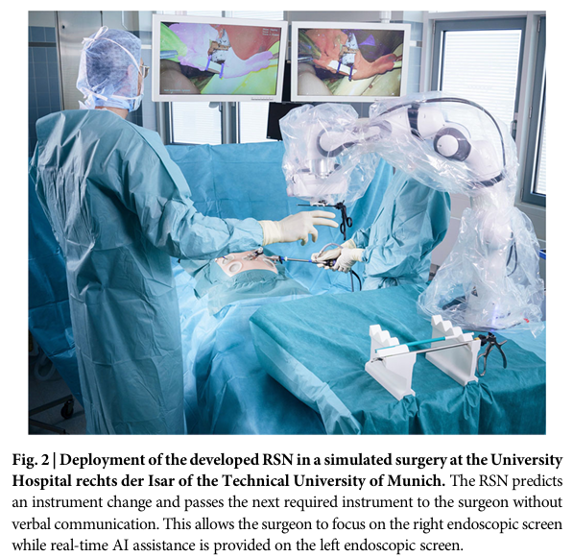
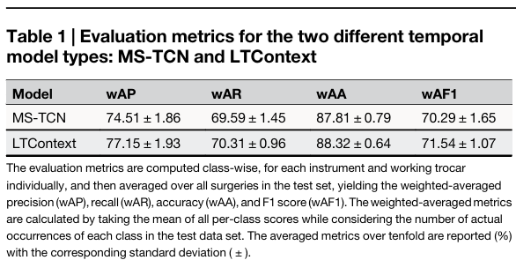

Slide 32
Step 6 – Consultation
Feedback and Professional Input…

